Slide 1
Focusing on health in construction
Liz Bennett BSc PGCE CEng FICE CMIOSH FRSA
Chair of the Design for Health Task Group
Liz@safetyindesign.org.uk

Slide 2
Design for Health Task Group: How we work
Individuals of passion and commitment, not the usual committee regulars
Irregular meetings. London and Edinburgh
“Projects”, currently 8 which may or may not be active at any one time
Each Project has two Project Managers collaborating to deliver
Share developing project content where possible

Slide 3
Project 01: Information for Designers on Health
Initial project leads: Arup and BOHS
Passed to CIRIA after a year
Ceased due to lack of industry will to fund, despite expressed interest
Not considered a problem as clearly not essential output
On ice

Slide 4
Project 02: Client reasonable expectation of designers
Project leads HSE and Mace
Text complete
Staff changes and workload causing challenges
This project is waiting for case studies to illustrate points being made
Draft report is available

Slide 5
Project 03: Skills, Knowledge, Attitude, Training and Experience
Project leads: Atkins and Horizon Nuclear.
Then B&CE Trust funded academic research by Loughborough, UWE, Manchester and East Carolina Universities.
Report complete, awaiting launch by B&CE Trust

Slide 6
Project 03a: Organisational Capability Maturity Index
EPSRC funded post doctoral research to develop web based Tool to measure Capability Maturity Index on scale of 1-5
This is not our project but is very closely linked to SKATE project and led to selection of SKATE Research group
Research complete. Tool live and currently free.
ICE considering managing the scheme.
www.dfosh-cmi.co.uk

Slide 7
Project 04: Top ten think points for designers on health
Project leads: RIBA and ICE
The most contentious project!
RIBA and ICE cannot work together on this and have split into independent groups, neither of which has been able to agree internally an output
Latest version October 2018 from RIBA, ICE no output
New version to be developed for review by HCLG main committee

Slide 8
Project 05: Core learning aims for designers
Project leads: Balfour Beatty, SID and ex SSE Director
Project output changed to various topics: concrete; contaminated land and buildings; human factors; noise; etc
Interest most widely shown when subject was technical eg concrete. THIS IS AN IMPORTANT MESSAGE

Slide 9
Project 05: Core learning aims: Contaminated land and structures
Environmental Hazards Management Association established as a not for profit industry body to work with the whole supply chain
CIRIA is high end professional partner ie will take on the in-depth work in this area
Heathrow keen to develop Client requirements
Research on lower exposure limits current as existing zero tolerances unworkable

Slide 10
Project 05: Noise

Slide 11
www.hearingconservation.org.uk
Contact Clare Forshaw, ex HSE, now Park Health and Director of this new company.

Slide 12
Recent new additions
Project 06: Maintenance. EA and TBA
Project 07: Tracking design decisions: Viewpoint and Landsec
Project 08: Mental wellbeing for professionals: Bechtel and former Crossrail

Slide 13
About HCLG
Our Mission
To unite the construction industry in order to eradicate ill-health and disease caused by exposure to health hazards on building sites.
Our Vision
To make construction the leading industry for occupational ill-health and disease prevention by 2025 – the construction industry initiative.
Our Plan
To achieve a cultural shift within our sector, so that we manage health like safety.

Slide 15
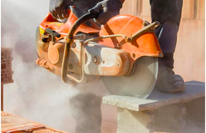
Why the need to focus on health?
80,000 construction workers in GB suffer from an illness caused or made worse by their work:
52,000 are Musculoskeletal
12,000 are stress, depression or anxiety
16,000 skin and respiratory conditions
5,500 new cancer registrations
1.9 million days lost
Cost to society: £0.5bn
*http://www.hse.gov.uk/statistics/industry/construction/construction.pdf

Slide 16
What do we mean by ‘health’ versus ‘Wellbeing’?

Slide 17
What the HCLG is doing
Respiratory Disease
Mental Health
Design for Health
Musculoskeletal Disorders
Health Data

Slide 18
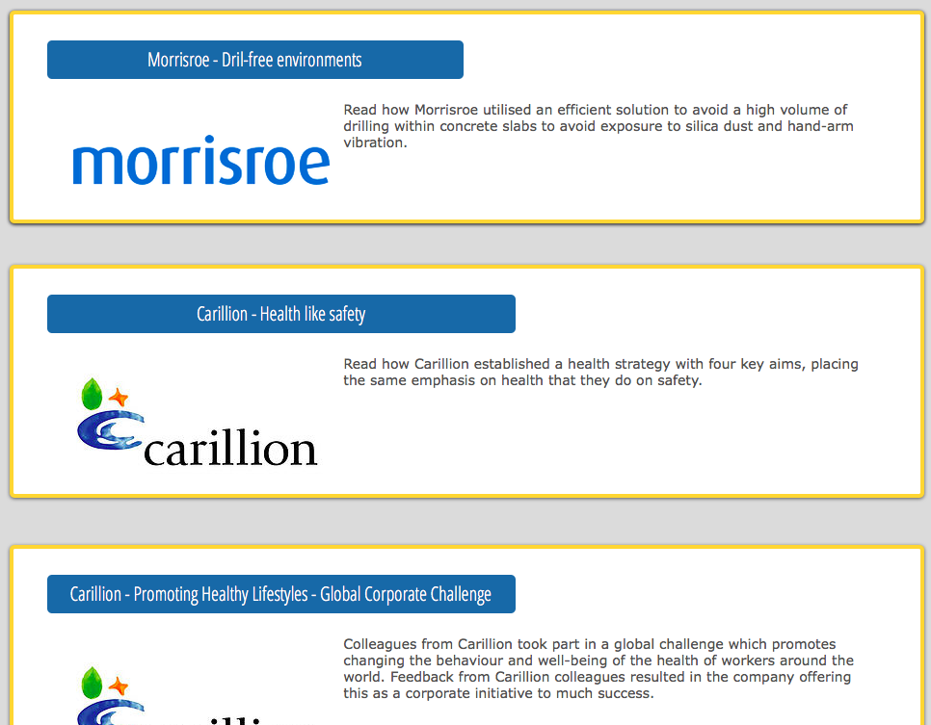
What are our members doing?
For many case study examples of good practice – see www.healthinconstruction.co.uk

Slide 29
Get involved with the HCLG
Become a member – it’s free!
Contribute to a task group
Share your good practice case studies
Join our LinkedIn Group
Follow us on @constructhealth
Visit www.healthinconstruction.co.uk

Slide 30
What can you do?
Engage with content production and sharing
Consider how working with us can enhance you, your organisation and t he wider industry
Be specific about what you will do and when.
Get on and do something.
VIDEO: https://www.youtube.com/watch?v=ioxgTu9KIA0

