Slide 1
Supply Chain Safety Leadership Group
Principal Designers Working Group
April 2020
V1

Slide 2
Background
Vision - to create a clear shift in safety performance to stop lives being lost or permanently damaged.
This group is populated and Chaired by representatives of Highways England’s supply chain, in response to the Home Safe & Well aspiration of raising industry standards and being a learning organisation Strategic Objectives - A number of key measurable actions in Home Safe and Well can be directly influenced by the supply chain. By 2025, we will: - Halve the number of lost-time incidents - Halve service strikes - Halve vehicle incursions into road works - Double our hazard and near miss reporting
HiPo Working Groups- To address the root cause of reoccurring incidents and share best practice consistently across the sector through common intent documents:
Forum Reduction (2019)
Relaunch of HE Safety Hub
Highways England Passport
Service Strike Avoidance Working Group
60mph through roadworks
IPV strikes & TM Incursions Working Group
ü
Accident Investigation Working Group
Mental Health Working Group
People Plant Interface Working Group
Safety by Design
Lost Loads
Supervision
Innovation
ü
ü
ü
ü

Slide 3
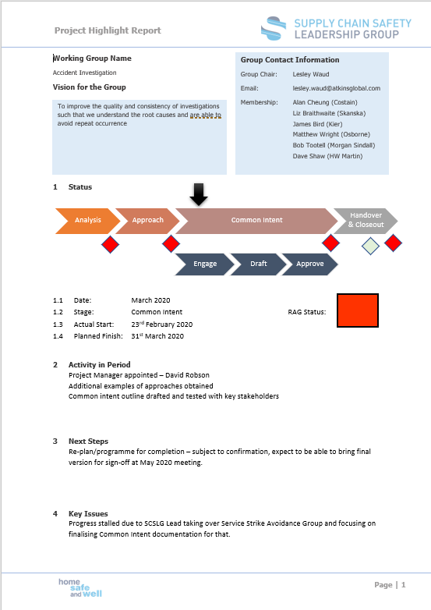
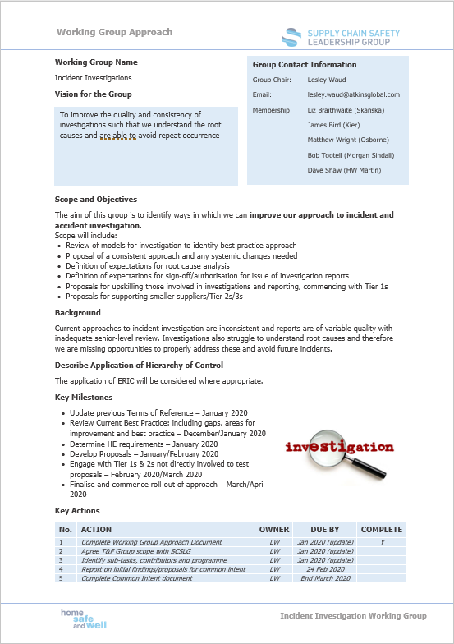
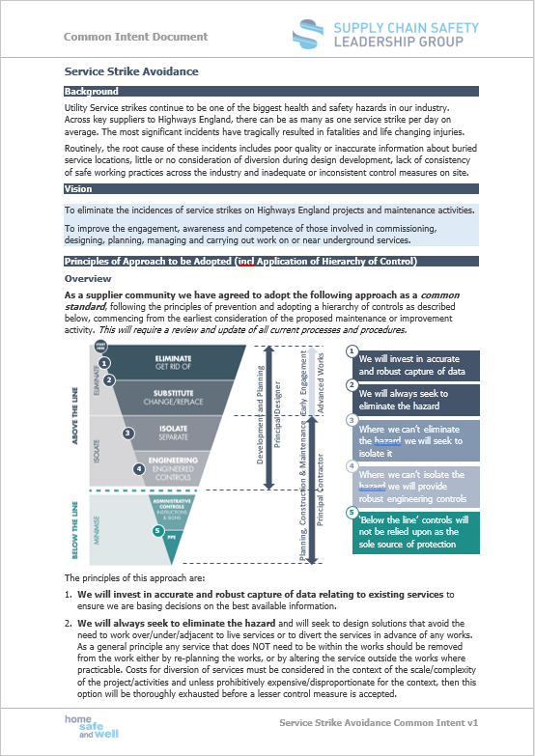
SCSLG General Update
Change in Membership
Chair: Phil Clifton – Balfour Beatty
Member: Dean Sporn – Highways England
Member: Mark Byard – Highways England
Member: Teresa Moss – Highways England
Member: Mark Bridges – Galliford Try (Safety Hub)
Member: James Haluch - Amey
Member: John Dixon – Jacobs
Member: Richard Stuart – Costain
Member: Lesley Waud – Atkins
Member: Nick Holt – WJ Surfacing
Member: Glennan Blackmore - Skanska
Member: TBC – Tier 2

Slide 4
SCSLG General Update
Streamlined Governance
Improved HSE Performance Reporting
Revised ToR with Project Management focus
Created Working Group Guidance
Created Common Intent Guidance
Project status tracker
Agile working using Teams
Relaunching the “Hub” to support SCSLG
Progress:
Analysis – 3No. New Working Groups Identified
Approach – 2No. Working Group Approach Documents in progress.
Common Intent – 5No. Common intent in progress - 3 drafted for approval.
Handover & Close out – 2No. Common Intent approved for roll out.

Slide 5
HiPo Working Groups
Q4 2019
Q1 2020
Q2 2020
Q3 2020
Q4 2020
Q1 2021
Forum Reduction
Relaunch the “Hub”
April 2020
HE Passport
60MPH through roadworks
Service Strike Avoidance
Publish Common Intent
On the “Hub” and shared
through Safer Highways
IPV strikes & TM Incursions
Accident Investigation
Mental Health
People Plant Interface
Safety by Design
Lost Loads
Supervision
Innovation
Analysis
Approach
Common Intent
Handover & Closeout

Slide 6
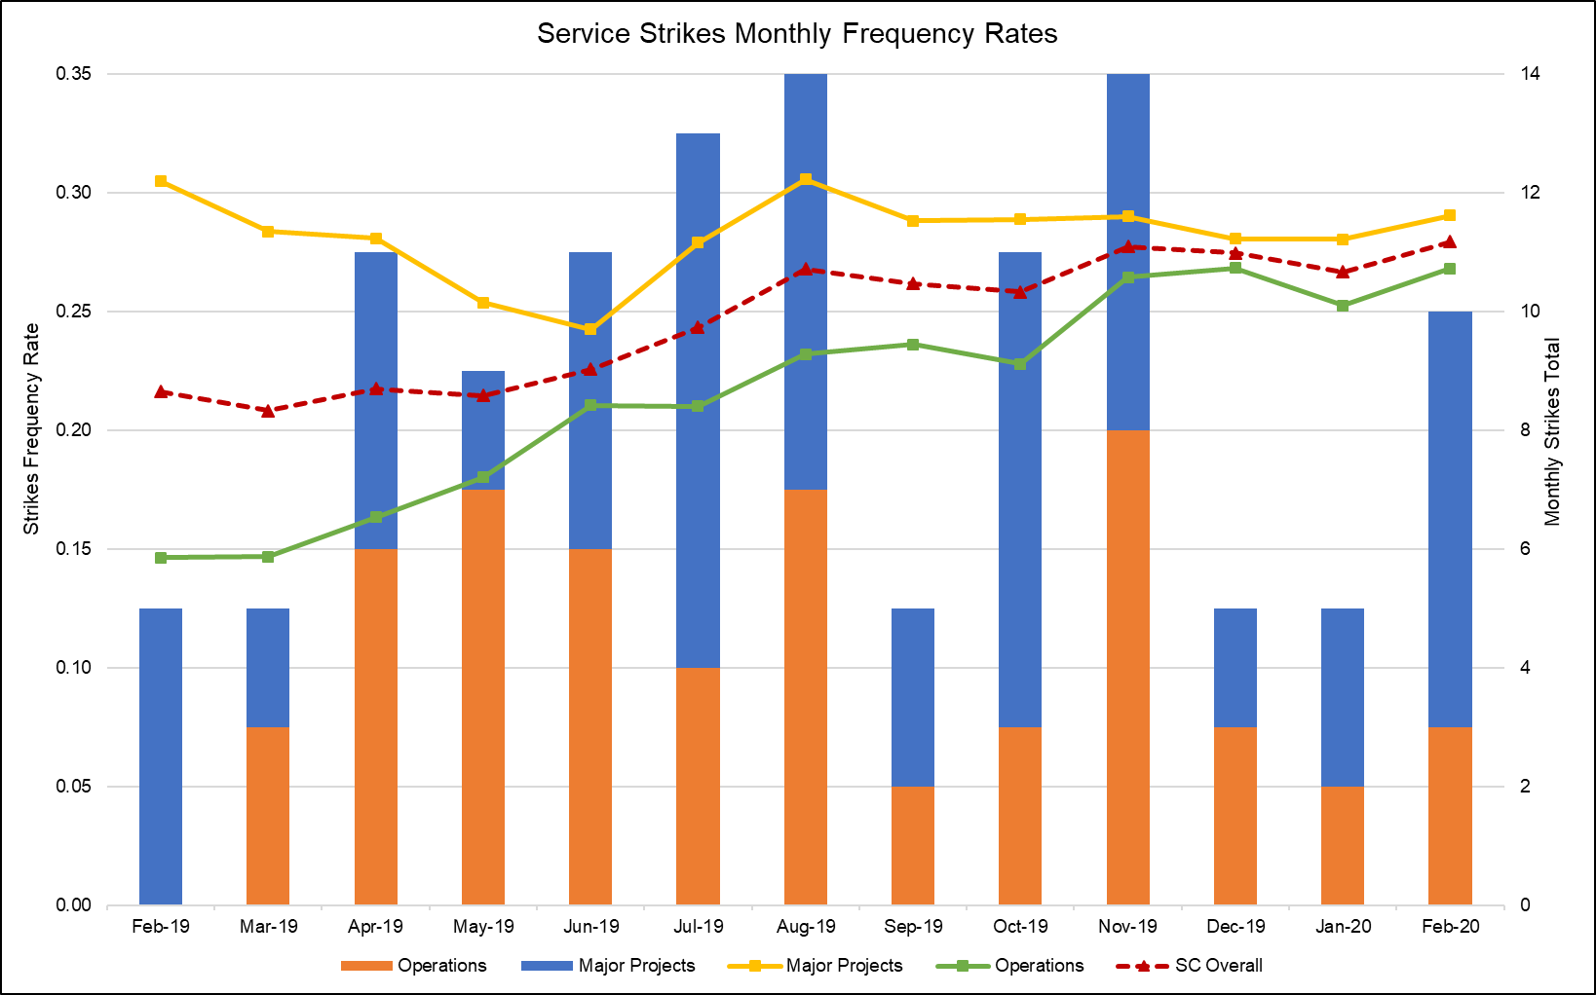
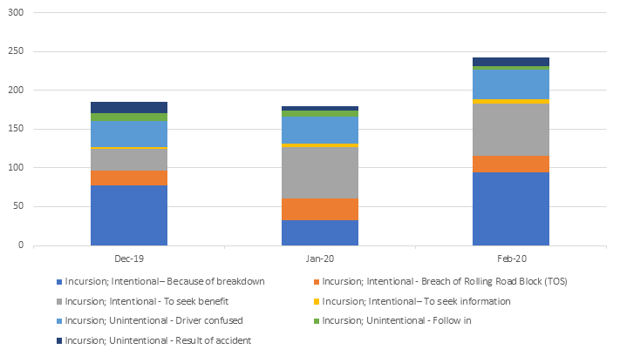
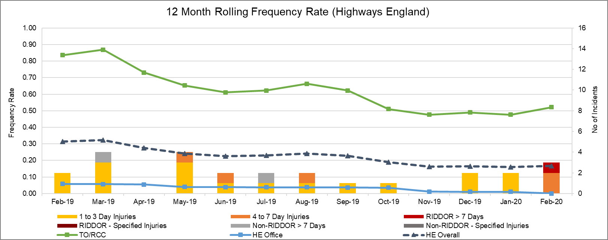
Progress towards Strategic Objectives 2025
Halve the number of lost-time incidents by 2025
Halve service strikes by 2025
Halve vehicle incursions into road works by 2025
Common Intent launching May 2020
Common Intent launching May 2020
Heading in the right direction…

Slide 7
Some Challenges
The goal of creating a set of common intent documents across the supply chain to address high potential and/ or repeated incidents is welcomed and accepted, however the challenges we have faced include:
Holding each other to account There is the promise of undertake tasks but not actually carried out, and we are too polite to challenge.
Pet Projects People have their own agenda to suit their beliefs or individual company objectives and not evidence led
Slow to look outside our industry Degree of complacency or arrogance that own companies approach is best, even when other parts of the same business have better stats for similar activities
Communications with whole community While various communications have taken place the reach of the message, even in Tier 1 Contractors had not landed – whether not heard or deliberately not listening
Providing leadership to our own employees Surprisingly difficult to refocus our own employees to specific task and finish activities and not what they belief should be undertaken. Mixture of cognitive dissonance and power distance. E.g. Hub and Forum reduction

Slide 8
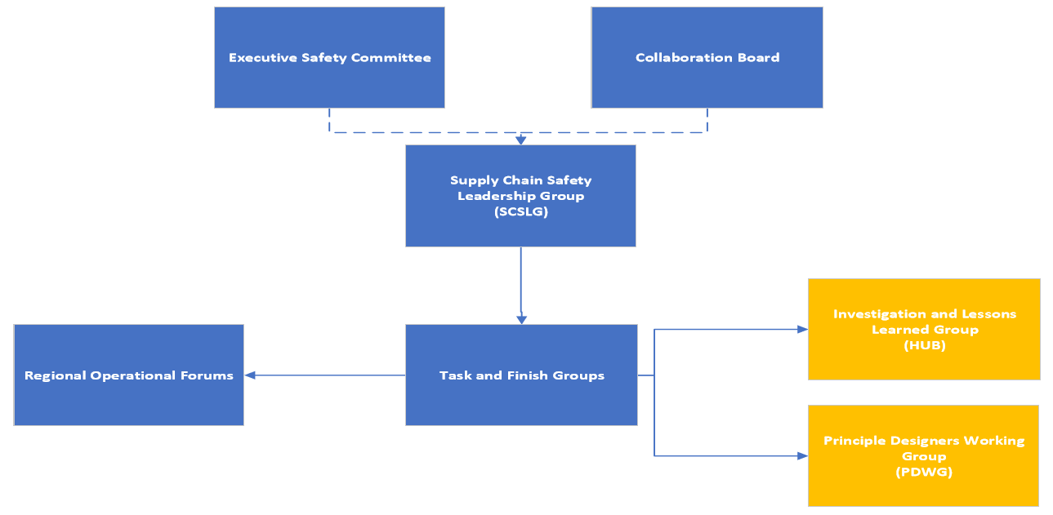
The “Hub” Relaunch in support of SCSLG

Slide 9
Adopting Common Standards
Common Standards - Our approach to defining expectations for methods to be used to improve safety performance across the supply chain includes:
Common Intent - documents that set expectations of what we “must” all do. These provide clear direction and guiding principles in relation to application of the hierarchy of control that we expect to be considered in the processes and procedures followed by every organisation.
Raising the bar – documents that provide “interpretation” on how to implement common intent across the whole asset lifecycle, including design, construction, operations and maintenance.
Common Intent and Raising the Bar Documents can all be found on the Highways Safety Hub.
Actions for Suppliers - We expect all suppliers working on the Highways England network to adopt the principles of the Common Intent documents in their own processes and procedures and to use/contribute to the Guidance contained in the Raising the Bar documents.

Slide 10
Safety Hub & PDWG
Highways Safety Hub includes representatives from across the sector. Previously focused on Major Projects, Hub will continue to operate and will expand its remit to include the whole asset lifecycle, including design/development, construction and operations/ maintenance activities; drawing on support from the Principal Designers’ Working Group and others where appropriate.
Hub will be steered strategically by the Supply Chain Safety Leadership Group (SCSLG) and will be represented on the SCSLG by its Chair, Mark Bridges.
Representatives from the Hub and the wider supplier community will be asked to contribute to the Common Intent documents as these are developed.
Once a Common Intent document is approved and published, the Hub will consider the most appropriate method to supplement the Common Intent with guidance, training and development for the supply chain. Where possible, those who have contributed to the Common Intent will lead on the development of the detailed guidance, to maintain continuity.

Slide 11
Safety Hub & PDWG
The SCSLG Sponsor will ensure appropriate hand over to the Safety Hub and remain available to review any proposals developed by the Hub to ensure the strategic intent is addressed appropriately.
It is anticipated that Detailed Guidance will take the form of updates/refresh of the current suite of Raising the Bar documents to reflect the strategic ‘Common Intent’ and include consideration of the whole asset lifecycle.

Slide 12
Questions?

