Slide 1
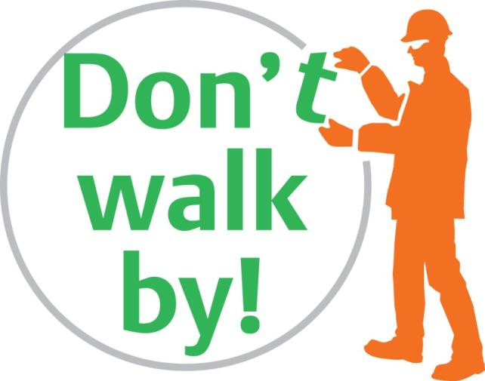
Choose to be safe
‘No one is going to get hurt here’
Notes:
Welcome people to the briefing
At BAM Nuttall we choose to be safe – If we see something unsafe we Don’t walk by! We have to believe that ‘No one is going to get hurt here’ and go about our work with that in mind.
It is our aim to give you a safe working environment so that you go home unhurt at the end of each working day. This will only happen if you also choose to be safe. Please look after your work area and ensure it is a safe place for you and other people. We have an open, honest, culture that allows you to take action if you do find an unsafe situation. We ask that you don’t walk by and make it safe. You should never put yourself or others at risk in doing so. If it’s simple and safe then sort it. If you need assistance – speak to your Supervisor. If you see unsafe behaviour then you are free to challenge the individual involved in a respectful way that shows your concern for the other person. Best of all, set a good example by acting safely yourself and don’t do anything that could put anyone else at risk.
If we Don’t walk by! we will all have a safer and happier workplace where people show a genuine concern for each other. So please choose to be safe and look out for yourself and others. This is surely what we all want and expect. If you have any questions please ask your Supervisor.

Slide 2
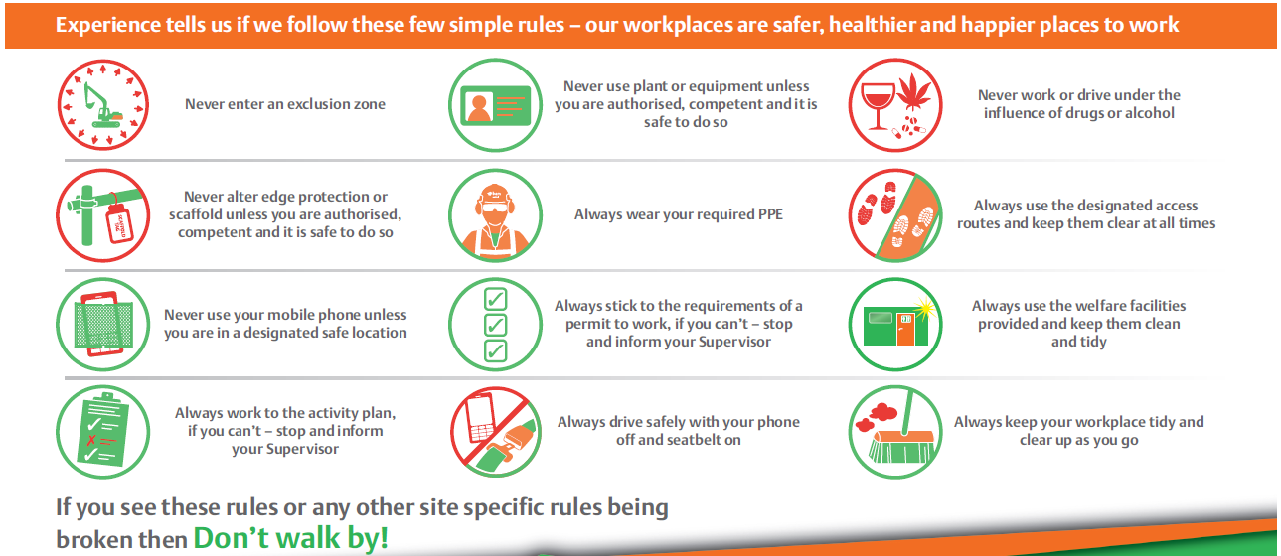
The Rules
Notes:
The Rules
We have the twelve rules of Don’t walk by!
The rules are there to keep us from being hurt. Once we’re hurt we can’t turn back and undo what’s happened. A rule that seemed unnecessary often becomes the opposite when we’re heading towards the local A&E. So let’s make the rules necessary and worth sticking to before we learn the hard way.
There are twelve Rules – these have been created through a review of incidents and observations received in recent years. Some relate to serious hazards encountered on site – others on issues which crop up regularly in observations, inspections and near miss reports. This month we will concentrate on rule number 5 – ‘Never use plant or equipment unless you are authorised to do so’ and give a briefing on it.

Slide 3
5
Rule 5
Never use plant or equipment unless you are authorised, competent and it is safe to do so
Notes:
Rule 5 - Never use plant or equipment unless you are authorised, competent and it is safe to do so
Question: In relation to rule 5 - What does authorised and competent mean in relation to plant and equipment?
See what the delegates responses are and then compare with your own thoughts and the guidance below:
Authorised – The operator has been inducted, had their competence cards checked and verified. The operator is formally briefed for the work activity and is familiar with the plant to be used, prior to being granted permission to use the piece of plant.
Competent – The operators skills, knowledge and experience specific to the plant and work activity to be carried out have been assessed as acceptable for the work to be carried out before the operator is put to work.
Question: Why do you think this is an important rule?
Allow participants to answer the question and top off with your own thoughts based around moral, legal and financial consequences. Not least:
People may get hurt/killed leading to significant lasting effects on wider family and colleagues alike.
Individual and company criminal prosecutions.
Enforcement action on the company and individuals.
Disciplinary action including potential loss of employment.
Loss of production to the work.
Damaged individual and corporate reputations leading to loss of future work for both.
We all have responsibilities as employees and to BAM Nuttall as a whole to not use plant or equipment unless we are authorised and competent.

Slide 4
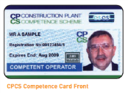
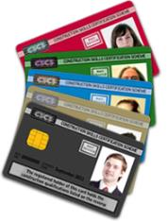
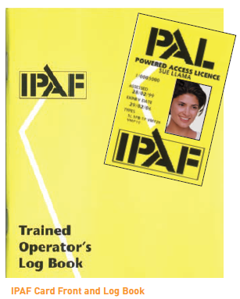
5
Competence starts with a card
Notes:
Competence starts with the card
For most items of operated plant a competence card is the initial baseline in the assessment for competence on site.
Question: How else may the competence for the operator be assessed?
Have an open discussion.
Bring in the following points:
Talking to the operator on the types of plant that have been used, e.g. there may be a need for additional familiarisation training for the specific piece of plant on our site. Whether they have a red or blue CPCS card is a factor for consideration.
As part of the BAM Nuttall system a supervisor or plant coordinator has to watch the plant operator and decide if they are happy with what they see, this is recorded on the company forms. Also, as part of this review, the supervisor for the work observes the skills for the plant operator via ongoing supervision and is recorded as part of the compliance monitoring check for activity plans.
It is important to remember that just having a competence card is not considered to meet the full requirements for skills, knowledge and experience. Also in the mix here is having the right behaviour to operate plant and equipment. E.g. not wearing a seat belt at all times is a breach of training and rules hence casts doubt over the operators competence. This is a similar theory to when someone passes their driving test, it is often considered that someone doesn’t fully learn to drive until after they have passed their test, this is the experience element we need.
As members of the Civil Engineering Contractors Association (CECA), there is a manual of recognised cards which is our staring point for authorising an operator to use a specific piece of plant on our sites. This manual also covers other areas of competence such as scaffolding, demolition, general awareness such as CSCS etc.
Where there is not an industry recognised card such as for an abrasive wheel or other powered equipment, then the competence and in particular the training element to use the equipment is assessed via the Agent in conjunction with the BAM Nuttall training team based at Halesowen.
Note that in relation to an abrasive wheel there is a common misconception that the training is only needed to change the wheel, this use to be the case under previous legislation. However since the introduction of the Provision Use and Work Equipment Regulations 1998, all work equipment requires training to use and training to supervise its use.

Slide 5
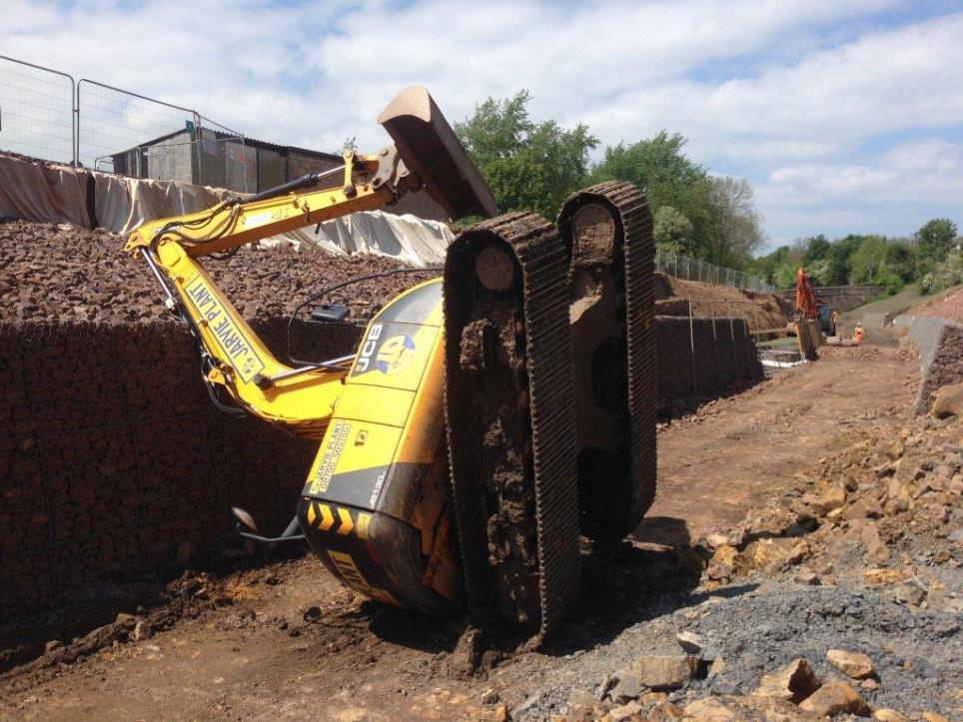
5
Notes:
Incidents
One overturned item of plant on our sites is one too many. Over the years there have been such several incidents, all of which had the potential to cause significant injury to both the operator and anyone in proximity to the plant. Most of these incidents have had some element of operator not carrying out the operation in accordance with their training. This illustrates the importance of respecting exclusion zones around mobile plant. The operator is at least in a cab with their seatbelt on – those within the proximity have no protection whatsoever.
In 2014 a tractor operator was tragically killed on the public highway when the tractor was hit from behind by a road wagon. The investigation found that the operator was not at fault in relation to the collision but had not been wearing his seatbelt. A very sobering thought.
It is also fair to say that some of the incidents have occurred through poor planning and management of an issue or using the wrong piece of plant or equipment for the task.
We have a significant amount of plant and equipment in our sites at any one time and we all need to respect it.
However, we are all in this together and if we see something wrong, we don’t walk by.

Slide 6
5
Defective plant?
Report it
Notes:
Defective plant? Report it
BAM Nuttall has management systems that include planned preventative maintenance, regular visual and recorded inspections and in some cases through examinations.
This is necessary as plant and equipment is expected to operate in all sorts of conditions and environments. This can lead to incidental damage such as scratches and bumps on paintwork up to catastrophic damage such as overturning. Most items of plant are fitted with safety features such as lights, mirrors, sensors, cameras – these must function. Also mechanical damage such as oil leaks and ineffective brakes which can render plant dangerous to operate must be rectified. It is important that we carry out all the required maintenance checks on plant and the required records are kept. We should not abuse or disrespect plant and take ownership of it.
However, additional to that is a responsibility on all of us through Don’t Walk By to report issues that we see. This may include things such as a broken brake light on a 4x4 vehicle, an electric cable with a cut in the outer sheathing, a bald tyre. There are also defects that only the operator will know about such as issues with warning lights, defective brakes, a broken CCTV screen and other safety devices. All of these issues need to be reported, and in some cases is they are deemed a safety critical defect the plant must be stopped from being used pending the issue being fixed.
The preference for all of us is to find defects prior to an incident occurring and having it sorted out. We all know that defects can cause incidents. The subsequent investigation will review the history of defects and whether they have been reported and why they were not fixed. There may well be disciplinary consequences as a result of the findings for the investigation.

Slide 7
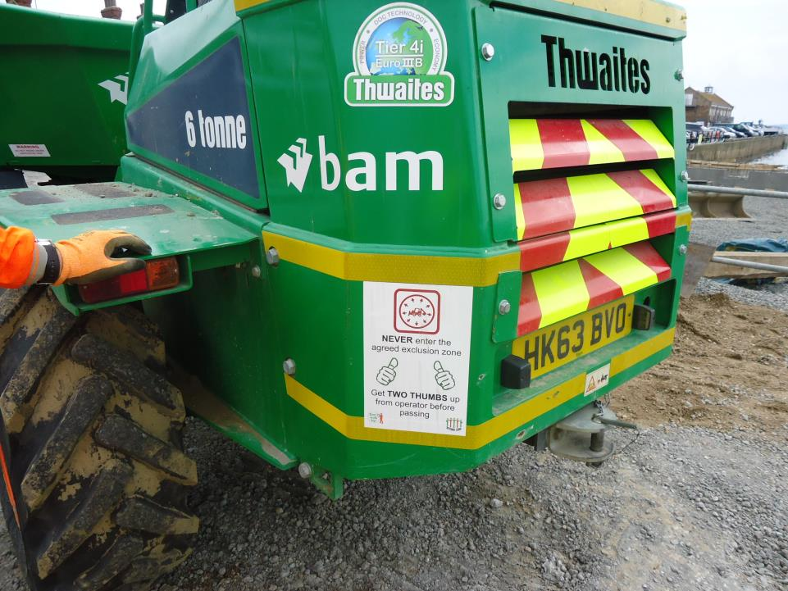
5
Notes:
Incidents
There are thousands of items of plant and equipment on our projects every day. If used properly and maintained they make our lives easier and more productive. We strive to supply good equipment and have invested heavily in our own plant as well as choosing the best plant hire providers in the market.
Despite this - In recent years the use of defective plant has featured in a number of incidents – in some cases leading to serious injuries.
A broken door stay was not reported which contributed to a broken ankle on exiting a piece of plant as the hand hold didn’t work.
A missing bolt in a lifting frame contributed to a load being dropped – seriously injuring the slinger.
A steel walkway was damaged leading to an operative falling into the sea – fortunately uninjured

Slide 8
5
Switch off Secure
Notes:
Switch off secure
It is important to turn off plant when not in use – During breaks in activity and at the end of the shift. It is also important to make it secure. Particularly in areas open to general public.
There have been occasions where keys to plant are lost or unavailable and the it has been started by other means. This is an unacceptable practice. One of main reasons being the item of plant is left running when not in use to save starting again. This practice is rare and must be stopped altogether.
Switch off plant and make it secure is not only relates to operated plant but also equipment such as powered tools. E.g. a drill not being left unattended whilst connected to a power supply preventing the potential for somebody to pick it up and receive an injury through inadvertently switching it on.

Slide 9
The video – Switch off Secure
5
Notes:
Download the video
For this rule, we are going to watch a short video produced under controlled conditions.
Afterwards we will have a discussion on what issues you observed in relation to the plant operator.
After showing the video:
Question: In the first part of the video - What did the operator of the plant do wrong that did or could have lead to an accident?
Allow participants to come up with their thoughts and top with the following:
The key was left in the ignition of the dumper and the dumper was not locked whilst unattended.
He wasn’t wearing a seatbelt on operating the dumper
The wing mirror was cracked, the operator clearly looks at this but cannot be bothered to have it fixed – this is a safety critical defect which means the plant needs to be taken out of service.
The two trespassers were able to gain access to the site and to the unsecured dumper with the key in the ignition. The fact the door to the plant was left open was an invitation to the trespassers to access site to cause mischief.
In the second part of the video – the right way. What did the operator do that was right?
He took the key out of the ignition.
He looks the door, the trespassers still see the dumper but are less inclined to access the site and carry on their way.
He checks his mirror and it is in good condition.
After this section, ask if there any questions.

Slide 10
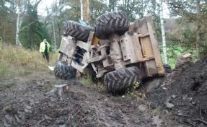
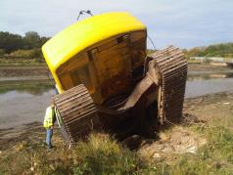
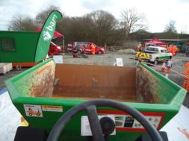
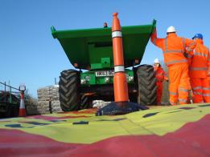
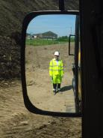
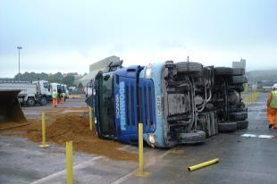
5
Never use plant or equipment unless you are authorised, competent and it is safe to do so
Notes:
Over the last year a number of people have been seriously injured on construction sites when they have been working alongside or operating plant or equipment. The reasons for this are not simple and therefore the solution is not straightforward..
Construction sites place people in situations where they can be vulnerable. We try very hard to avoid this and have invested in technology, training and planning to reduce plant related incidents to a minimum.
You can help us by staying on your guard. Particularly on working with or alongside new or different items of plant or equipment. Only work with plant you are competent to operate. Even when you are doing operating plant or equipment you are used to – occasionally rethink what you are doing. If there is a particular aspect of your work that troubles you and you think should be improved – tell your Supervisor. If plant is damaged – tell your Supervisor.
The victims of an incident aren’t just the injured person. Families have to deal with the aftermath and even people involved in an incident who are not hurt can be left with the mental scars. Never use plant or equipment unless you are authorised, competent and it is safe to do so. If you are Supervisor make sure this rule is not broken when putting people to work.
Thank you.

