Slide 1
PDWG SMP Alliance Handover Improvements
David Owens
Handover Process Lead

Slide 2
Why focus on Handover?
Handover has historically been a pain point for everyone involved
The SMP Alliance now has integrated Delivery Teams enabling us to capitalise on the opportunities for improvement around handover
The negative impact on our outcomes and the reputational damage associated with a poor handover is something the Alliance has to avoid
There is an opportunity to develop an exemplar working relationship with the Operations Directorate

Slide 3
Handover Process/Framework Task
Development the SMP Alliance’s handover process through collaborative workshops and process mapping activity.
Work collaboratively with Alliance Partners and the supplier network to ensure all views and requirements are understood and the process is representative.
Lead engagement with key National Highways stakeholders and interested parties
Collate complex information and present it in a consumable way
Test outputs with users to ensure fitness for purpose

Slide 4
Position the Handover Framework
Production Lifecycle
Handover Framework
Handover Playbook

Slide 5
Our approach to standardisation of Handover
The Alliance’s approach to handover will be standardised and captured within the Handover Framework & Playbook
All content is going through a rigorous Check Review Approve and Verify process including consultation and agreement on content with OD and other key stakeholders prior to release enabling schemes to focus on value add activity.
We aim to capture a national approach to handover of Smart Motorways schemes. Where this isn’t possible we will state where regional variations exist.
The Handover Framework & Playbook will be available to schemes by June 2023.

Slide 6
Handover Framework
A process diagram to guide the project…
DRAFT

Slide 7
What is the Handover Playbook?
Process
Defines the SMP Alliance’s end to end Handover Process and approach; identifying all requirements, stakeholders and key decision points.
Method
Describes how to meet handover requirements through clear definition of roles and responsibilities, deliverable lifecycles and how to guides.
Tools
Support in the production of a successful handover package through provision of annotated best practice examples, detailed guidance on completion of handover deliverables and direction on end of stage handover audits including audit templates.
Notes:
The Handover Playbook shall provide the process, method and the tools across the programme for all SMP Alliance schemes to use when building up a handover and commissioning package. Efficiency savings can be driven across SMP Alliance schemes by minimising duplication of effort in delivery of handover products, standardising the approach to handover, pre engagement with OD through the production of the Handover Playbook and milestones for early OD engagement in Project programmes, providing easy to follow guidance and good practice examples whilst leaving open opportunities for future innovation and updates.

Slide 8
Handover Playbook Structure and Content
The Handover Playbook consists of 12 chapters:
Introduction and Scope
Construction (Design and Management) Regulations 2015
End to End Handover Process
Roles and Responsibilities
Handover Requirements
Information Management Systems and Requirements
Management of the Digital Asset
Acceptance of the Asset from OD (before SMP Alliance starts work)
Handover Deliverables
Risks and Opportunities
Efficiency and Benefits
Conclusion and Close Out
Notes:
1, Introduction and scope, including intended users
2, CDM Regulations, Handover requirements and responsibilities under CDM and where these are covered within the Handover Playbook
3, End to End process, covering the defined end to end process owned by the SMP alliance handover lead and work being completed currently on the Commissioning and handover Sequence by Andy Kings central alliance planning team
4, Roles and Responsibilities, Aligned to the ADER - key internal roles and responsibilities in the handover process including Handover Lead (central alliance), Handover Manager (project), (planning lead, construction lead, Head of Early stages lead, risk lead, Project information manager, Head of production, Design Lead, Interface manager). This section will include Supply Chain Partners and key external stakeholders.
5, Handover Requirements, Contractual requirements SMP alliance with NH, Supply partner framework and individual contracts. OD, Legacy team handover requirements based on guidance documents and review of content by OD and Legacy team
6, Information Management Systems and Requirements, BC and AIMS, PW, BIF and IDP tool, NH reporting Systems, Operational Technology Specifications Library
7, Management of the Digital Asset, Management of BIM and the Digital LOIN
8, Acceptance of the Asset from OD (before SMP Alliance starts work) To cover link to Survey Playbook, Joint Dilapidation / pre condition Survey with OD, Asset Renewals Matrix Agreement (ARMA) Memorandum of Understanding, data and format of data required from OD on existing assets at Initiate design phase.
9, Handover Deliverables, aligning to stage gate lifecycle, stage A to F of GG182 and the ADER
10, Risk and Opportunities, Example content for project risk and opportunity registers based on previous SM projects and consultation with SME’s
11, Efficiency and Benefits, Description of Handover efficiencies gain by using the Handover playbook on a project, Standard content for project efficiency and benefits registers based on previous SM projects and consultation with SME’s
12, Conclusion and Close Out

Slide 9
Example Content

Slide 10
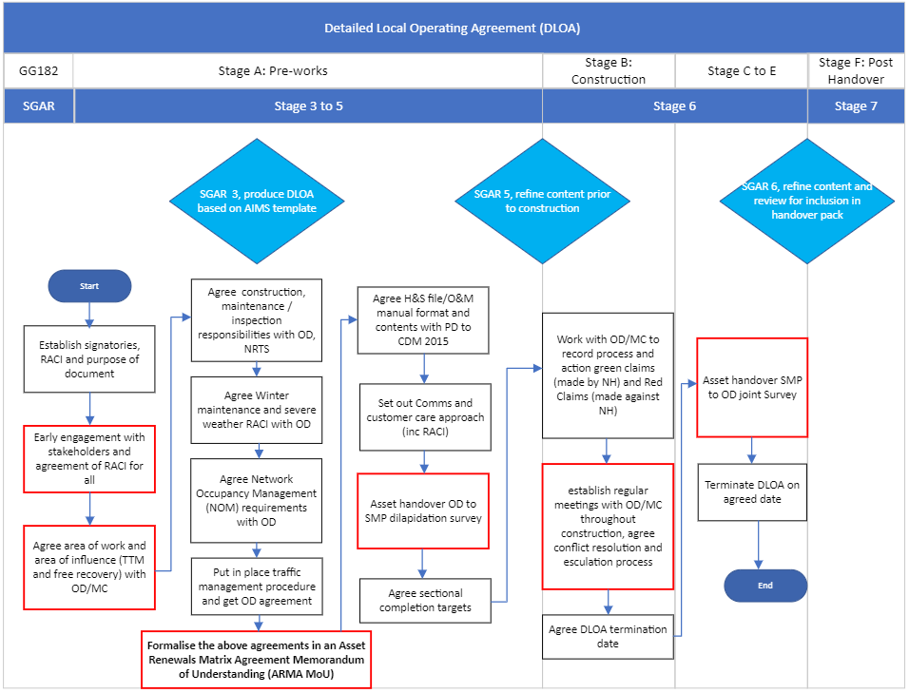
Deliverable Lifecycles
A Deliverable Lifecycle will be available for key handover deliverables, which will chart the key process steps in production of that deliverable.
Where a deliverable is a PCF deliverable, this information will supplement, but not replace, any content already available on the PCF Supply Chain Portal.
This tool enables individuals to understand the full journey of a deliverable and its key interfaces with other processes and procedures.
The adjacent example is for the Detailed Local Operating Agreement (DLOA).
Red box items are priority steps in the production of a scheme DLOA and project lifecycle.

Slide 11
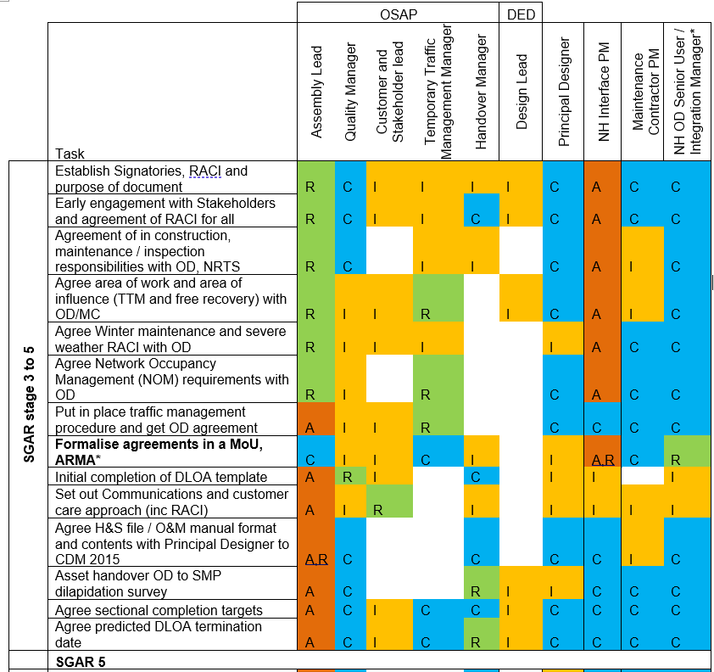
RACI Matrices
A RACI Matrix will be available for key Handover deliverables. These are based on the AIMS template to set out the responsibilities through the lifecycle of an individual deliverable.
This tool enables individuals to see ‘at a glance’ their involvement in that deliverable.
The adjacent example is an extract from a Stage 3 to 5 DLOA.
Responsible
Assigned to complete the task or deliverable
Has final decision making authority and accountability for completion - one per task
An adviser, stakeholder, or subject matter expert who is consulted before a decision or action
Must be informed after a decision or action
*Regional variation on OD owner / approach
Accountable
Consulted
Informed

Slide 12
Terminology Support
The Playbook will support individuals to navigate the language used to describe stages of a project’s delivery as this can become confusing. The example below shows comparative terminology for an ALR scheme’s lifecycle, the SGAR stage, onsite, GG182/ MCH1349 and the Alliance Delivery Execution Requirements (ADER).

Slide 13
Health & Safety File
Structure
19.1 - Volume 1 – Introduction and Index
19.2 - Volume 2 – Roadworks
19.3 - Volume 3 – Structures
19.4 - Volume 4 – Lighting
19.5 - Volume 5 – Motorway Communications MCH1349
19.6 - Volume 6 – Geotechnical
19.7 - Volume 7 – Environmental
19.8 - Volume 8 – As-Builts
19.9 - Volume 9 – Material Approvals, Testing & Commissioning, Works Packages
19.11 - Volume 11 – Other Information/Documents
19.12 - Volume 12 – HE Databases

Slide 14
Questions?

