Slide 1
PRINCIPAL DESIGNER WORKING GROUP
Safe by Design – Review of Safety Alerts, Near Misses and Lessons Learnt
16th May 2019

Slide 2
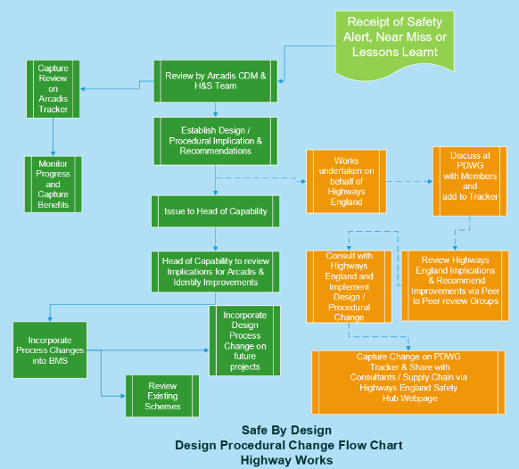

Slide 3
Feedback
Within the period since our last PDWG meeting on 24th January 2019 we have received and reviewed 28 safety alerts within our safety team (Principal Designers / H & S Practitioners) at monthly Safety, Design and Designers meetings.
HEi063 CCTV Cable Strike M6_
HEi064 CCTV Mast Failure
HEi066 -Broken Gantry Hatch – Area 9 ASC
HEi067 MEWP Boom Failure
Hei068 11kv Overhead Cable Strike – 21.01.2019
Kier Highways SHE Crawler Crane Incident M23 Southbound
HEi069 Jerol Lighting Column Sheath Fault
HEi070 Change in HSE Enforcement Expectations for Mild Steel Welding Fume
HEi071 M1 J39-42 Smart Motorway: Pile Connection Defect
HEi072 Conquip Boat Skip (CA122-03000) Recall
HEi073 Operative injured on Safety Fence
HEi074 Missing Inspection Chamber Cover
HEi075 - UK Protect – Explosives in post
HEi076 - Road Bridge Crane Strike
HEi078 - Overturned Rider on Roller
HEi079 - Trailer Rolling off Low-loader
HEi080 Slip, Trip or Fall event
HEi081 M27 Concrete pumping incident adjacent to live carriagewayHEi082 Lifting Chains Failure
Balfour Beatty: BBV-HS-TEM-N001-000 021 -RIDDOR Specified Injury – Fracture to foot
Kier: SHEA/A/2019/04 Drying Room Fire
HEi083 Reinforced Concrete Wall Quality Alert
HEi084 A1 Varioguard Foot Injury
HEi085 Lighting Column Falling from Lorry Loader
HEi086 Updates to incident Reporting System – AIRSweb
Network Rail Safety Alert - Syringes and Drug Paraphernalia
Network Rail Safety Alert - Needle Stick Injury

Slide 4
Feedback
Of which 23 were notified through Highways England, 2 from Kier, 1 from Balfour Beatty and 2 from Network Rail.
We segregated these into the following categories:
Asset failure – 5
Lifting – 2
STATS (OH / UG) – 4
Occupational Health – 1
Plant – 6
VRS – 1
Slips, Trips, Falls – 1
Other 8 (Inc. Postal Exp, Drugs paraphernalia, AIRSweb, Drying room fire, Vandalism, etc)
Of these, 50% (14) were assessed as having relevance to/ implications for Designers, while a similar number (not necessarily the same ones!) had implications for Principal Designers.
The list and main points to note for (i) Designers and (ii) Principal Designers are listed below:

Slide 5
Possible Designer Mitigation items (including TW designers)
HEi067 MEWP Boom Failure - Effective temporary works management
HEi068 11kv Overhead Cable Strike –This was a major incident where the boom of a lorry loader came in to contact with an 11KV overhead power line. Effective hazard signage on drawings is required, temporary works management.
HEi069 Jerol Lighting Column Sheath Fault - Ensure designer-specified street furniture is fit for purpose over the anticipated product lifetime.
HEi070 Change in HSE Enforcement Expectations for Mild Steel Welding Fume - Designers, including TW designers, to be aware of HSE’s expectations in relation to welding fumes and take this into account when designing steel items including connections, joints etc.
HEi071 M1 J39-42 Smart Motorway - Pile Connection Defect: Designers not to assume a design detail can be upscaled to a larger item without increasing member sizes, numbers, torques etc. Where there is a design change - need to check suitability
HEi072 Conquip Boat Skip (CA122-03000) Recall - Awareness of how a design detail can be misapplied, particularly in the case of items subject to movement or dynamic loading (as in this case, a weld extending to prevent movement of a pivot pin).
HEi076 - Road Bridge Crane Strike - Look to minimise use for craneage as part of the design process
HEi077 - Suspected Vandalism - Risk to designers during site surveys/ inspection - to be aware.
HEi080 Slip, Trip or Fall event - Note for designer's site visits. Telescopic ladders are preferable, but have an issue with trapping fingers if not correctly instructed in their use
HEi082 Lifting Chains Failure - Have lift chains been inspected as required under LOLER. LOLER requires lift equipment to be regularly inspected by a competent person.
Balfour Beatty: BBV-HS-TEM-N001-000 021 -RIDDOR Specified Injury – Fracture to foot - Personal safety when supervising GI - be aware and keep a safe distance from drilling operations
HEi083 Reinforced Concrete Wall Quality Alert - TW designers at manufacturing facilities to be aware and ensure sufficient factors of safety/ QC checks are performed on prefabricated items. This will become more important if modular design becomes more widespread.
Network Rail Safety Alert - Syringes and Drug Paraphernalia: To be aware for personal safety on site visits
Network Rail Safety Alert - Needle Stick Injury: as above, being mindful that hazards from third parties can be deliberate/malicious

Slide 6
Possible Principal Designer Mitigation items
HEi063 CCTV Cable Strike M6 - PD needs to ensure this hazard is picked up in the Hazard Elimination Schedule and effectively communicated to site
HEi068 11kv Overhead Cable Strike - This was major incident where the boom of a lorry loader came in to contact with an 11KV overhead power line. PD needs to ensure this is picked up in the Hazard Elimination Schedule and effectively communicated to site, e.g. through effective hazard signage on drawings.
HEi070 Change in HSE Enforcement Expectations for Mild Steel Welding Fume - PD to be aware of HSE’s expectations in relation to welding fumes
HEi071 M1 J39-42 Smart Motorway: Pile Connection Defect - PD to be monitoring design change process and ensure it is picking up relevant issues
HEi073 Operative injured on Safety Fence - Check RAMS and ensure changed scope is addressed and controls noted in PCI/ documentation. Make clear in hazard identification that this is a tensioned barrier and appropriate controls need to be in place.
HEi076 Road Bridge Crane Strike - Ensure Principal Contractor has captured requirements for lifting plans etc within the CPP
HEi078 Overturned Rider on Roller - When reviewing the SSoW/ CPP for temporary works, ensure that this mitigates the key hazards associated with it.
HEi079 Trailer Rolling off Low-loader - Responsibility to ensure the site setup is satisfactory, inter alia allowing adequate manoeuvring/ loading space for plant. Was there a suitable method statement in place?
HEi082 Lifting Chains Failure - Check that Construction Phase Plan contains lifting plans, in accordance with LOLER.
HEi083 Reinforced Concrete Wall Quality Alert - Lifting arrangement needs to be fit for purpose. Possible coordination of multiple designers.
HEi084 A1 Varioguard Foot Injury - Was there a lift plan? Apparent lack of coordination between activities.
HEi085 Lighting Column Falling from Lorry Loader - Was lift plan adhered to? Contractor management issue.
HEi086 Updates to incident Reporting System – AIRSweb - Potential for improved feedback from Highways England to support PDs reporting back AIRSweb data to contractors/ enabling continuous improvement?
Network Rail Safety Alert - Syringes and Drug Paraphernalia - did PPE specified for site include appropriate gloves to counter this hazard?

Slide 7
Way Forward
Please share your company Safety Alerts, Near Misses and Lessons Learned with the Whole Life Design Group
We are pushing for better route cause analysis – particularly where this impacts design
Highways England Agree this needs to be improved across the sector
Follow up investigation conclusions will be generated for HE in the future
We want to make a real difference to the way the supply chain deals with safety data
Our aspiration is to deliver a step change in the delivery of whole life design for health, safety and welfare.
Please share your safety alert data!

