Slide 1
PRINCIPAL DESIGNER WORKING GROUP
How is Site Feedback Influencing Design?
Proposed new Design Change Procedure
18th May 2018

Slide 2
How is Site Feedback Influencing Design
PDWG have previously raised concerns over the interaction between site and the design office – and the capture and improvement of unsafe design
This has been mirrored at a recent Highways England CDF Lot 1 meeting
“How site feedback was influencing design and to assess whether this was effective”
Attendees felt there was a lack of evidence that issues raised by sites were leading to hazard warnings on other projects and a lack of evidence to demonstrate the next project was safer as a result of lesson learnt.

Slide 3
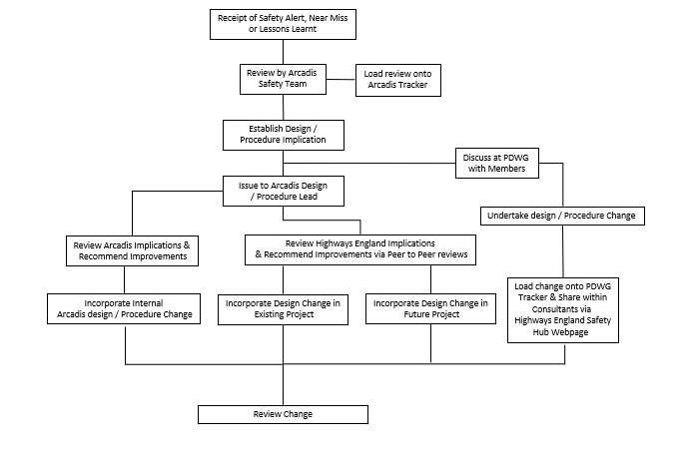
How is Site Feedback Influencing Design
Arcadis have been developing a Design Change Procedure – The proposals are as follows:
Upon receipt of a Safety Alert, Near Miss or Lessons Learnt information this will be reviewed by the Arcadis Safety Team (Principal Designers / H & S Practitioners) who meet monthly at the Safety, Design and Designers meeting.
As part of this the team will assess the subject and findings, initially to establish any design / procedural implication. As part of the review the Safety Team will update the monthly Arcadis Safety Alert / Near Miss Tracker Should our team highlight a potential design-based issue they will, via the meeting chair, establish contact with the specific design discipline lead within Arcadis and forward the communication on for action.

Slide 4
How is Site Feedback Influencing Design
Our design discipline lead will, dependant on source / information type, undertake one or all the following:
Discuss the source findings with a member of the Safety team (Principal Designer / H & S Practitioner) to consider the initial findings, and seek advice where required, prior to undertake an internal review and developing a process design change.
Consider if the matter requires modification of the internal design processes or should be delivered through the Highways England Supply Chain through the PDWG.
If the matter is considered to impact internal processes only, establish the correct design update or procedural change. Then ensure that lessons have been learnt and adopted within Arcadis’s future practices, across all delivery streams (SMP, RIP, CIP, NIP, etc);
As Design lead representative for Arcadis, the resource will ensure the source findings are, where relevant, brought to the attention of the Highways England Peer to Peer community (if one exists) to share the understanding of the design / procedural changes required; or
Work through the PDWG and Highways England Communities of Practice to deliver design change across the programme.

Slide 5
How is Site Feedback Influencing Design
Where applicable, details of the potential design change will be shared with the scheme Arcadis Project Managers, who will raise a project Change Control form to inform the Highways England Client of the issue and seek authority to adopt the design change.
As above should the design discipline (and/or Safety Team, where required) decide a change in design or procedure is required. The discipline lead will complete the design / process change form. Following the review, the discipline lead will forward the completed change form to the Safety Team chair, to store and attach a link within the Arcadis Safety Alert / Near Miss Summary Tracker to inform Arcadis staff of the design changes. Adoption of the design changes will be monitored and the benefits captured by the Safety Team over the next 12 months.

Slide 6
How is Site Feedback Influencing Design
To aid this process the PDWG have access to Highways England Highways Safety Hub webpage (http://www.highwayssafetyhub.com/alerts.html) where a Highways England PDWG tracker will be located. The Arcadis Safety Team will, at their monthly meetings, review the contents of this tracker to establish the current PDWG discussions / findings to gain information necessary to undertake a lesson learnt review internally. The Safety Team will also update the PDWG tracker where required and share accordingly across the community.
The tracker will also be part of the agenda items at the quarterly PDWG meetings and will feed back into the Whole Life Design Sub group.

