Slide 1
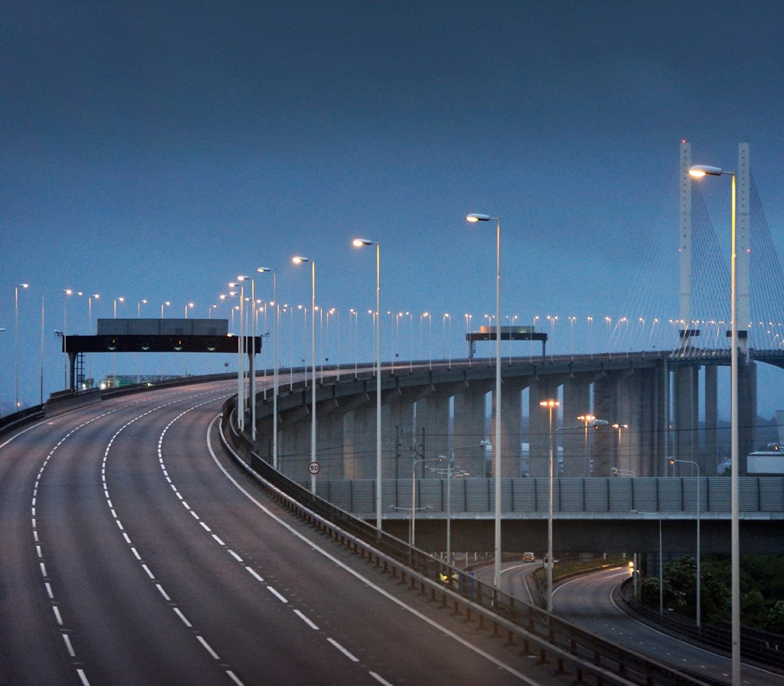
Incursions
October 2023

Slide 2
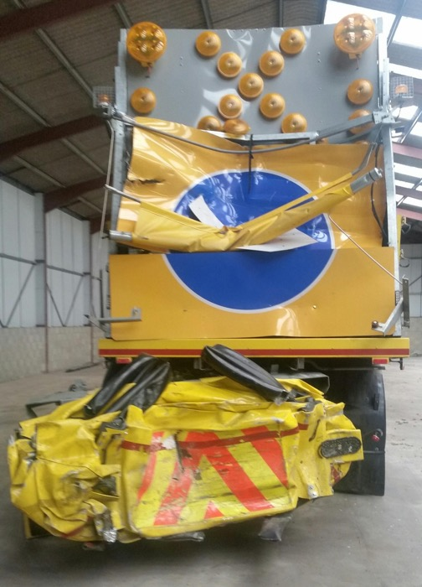
Agenda
  What is an incursion & an IPV strike?
  Examples
  Headline Statistics
  Improving the working environment by bringing these figures down
  Our ask of you

Slide 3
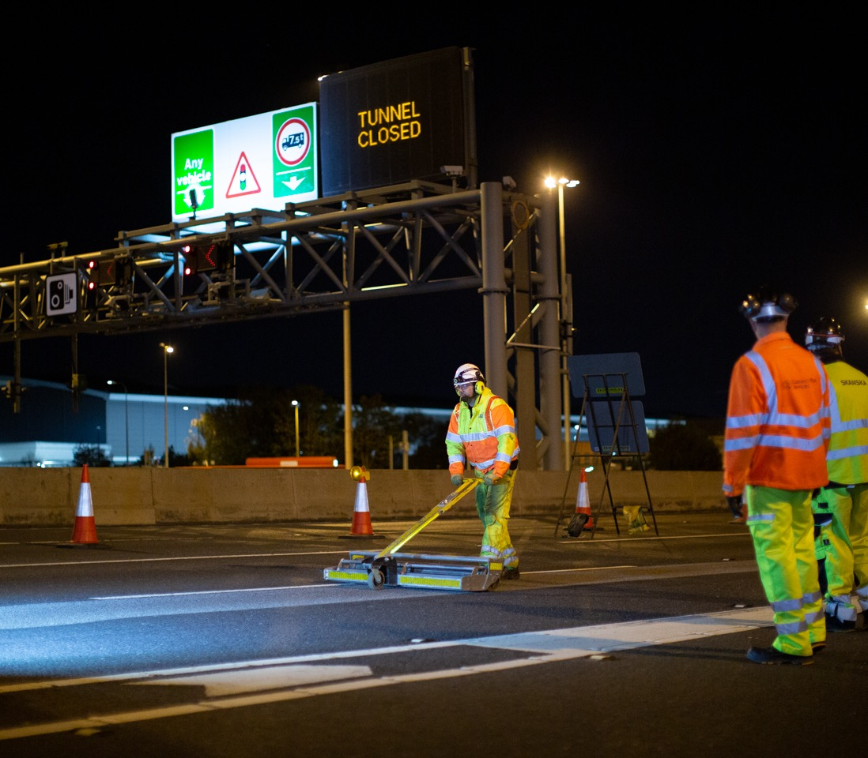
What is a Traffic Management Incursion & an IPV strike?

Slide 4
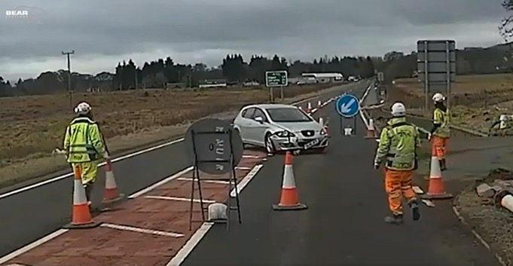
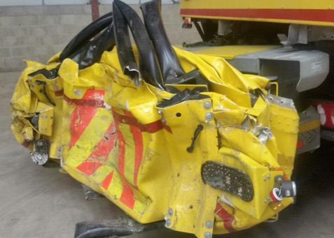
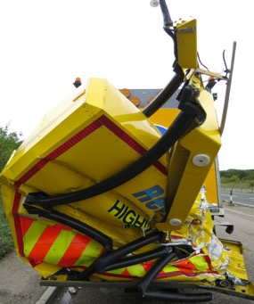
Traffic Management Incursion
Impact Protection Vehicle (IPV) Strike
An intentional or unintentional, unauthorised entry into temporary traffic management, by a vehicle being driven by a member of the public or emergency services.
  When an IPV, which is in the deployed position, is struck by a third party (errant) vehicle.
Both incursions and IPV strikes are recorded in the National Highways (HART) system
Notes:
Incursions are not always caused through neglect of the roaduser; they can be both intentional and unintentional
Intentional Incursions can be separated into three groups:
Intentional Incursion where the road user seeks to gain a benefit.
Intentional Incursion where the road user is seeking information.
Intentional Incursion where the road user is seeking refuge.
Unintentional Incursions can be separated into three groups:
Unintentional incursion where a road user follows a works vehicle into the works in error, also known as a follow in.
Unintentional incursion where a road user enters the works area as a result of confusion.
Unintentional Incursion where a road user enters the works area or traffic management as a result of a collision or to avoid a collision.

Slide 5
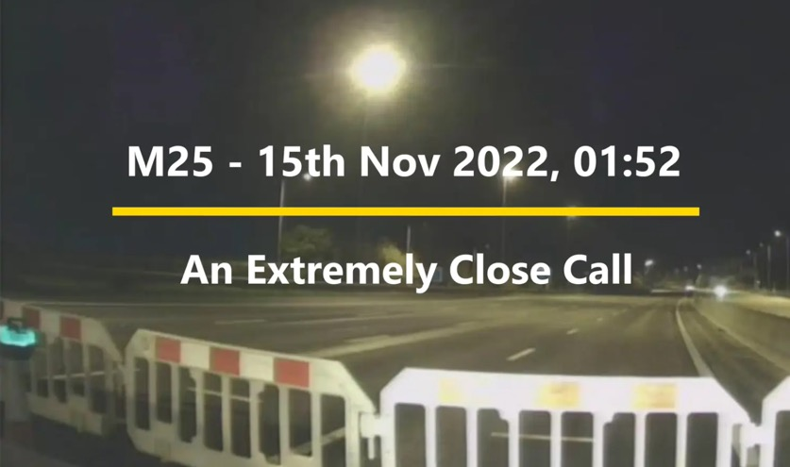
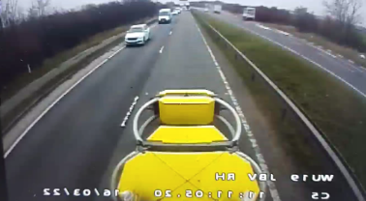
Video Examples
TM Incursion – Milestone
IPV Strike
Notes:
More videos available at the bottom of this safety hub page: https://www.highwayssafetyhub.com/roadworks-vehicle-incursions-2018.html

Slide 6
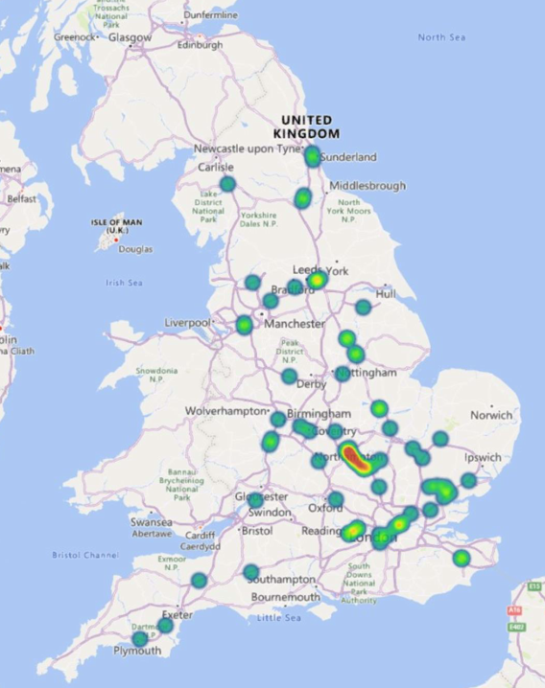
Heatmap of all IPV strikes
IPV Strikes
82 IPV strikes since October 2017
Clusters of IPV strikes and incursions can relate to:
    frequency of works taking place in a specific location
    geometry of the location (e.g. complex slip roads)
Notes:
One of the ways to mitigate the risk of IPV strikes is to change the start location and design of TM deployment.

Slide 7
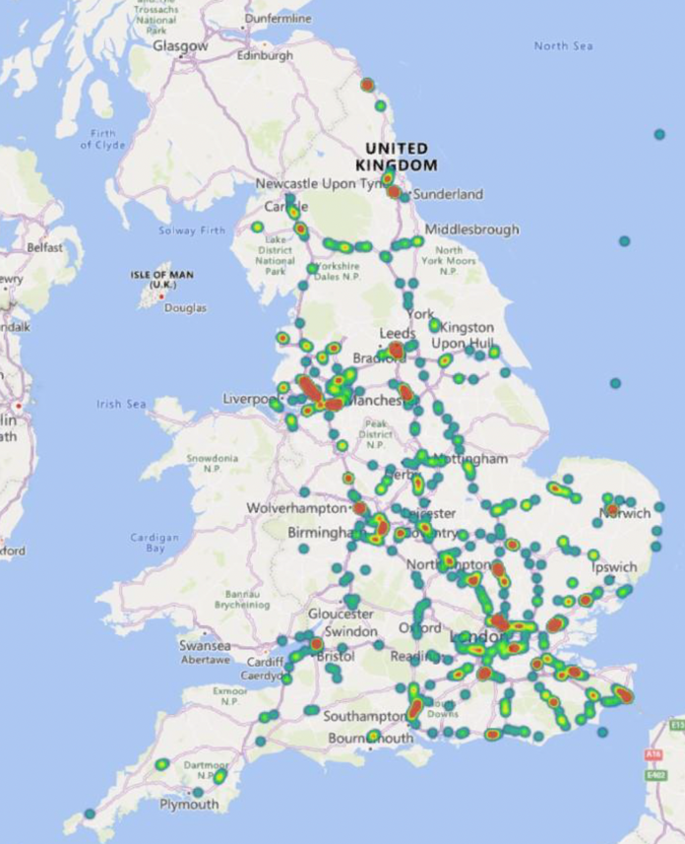
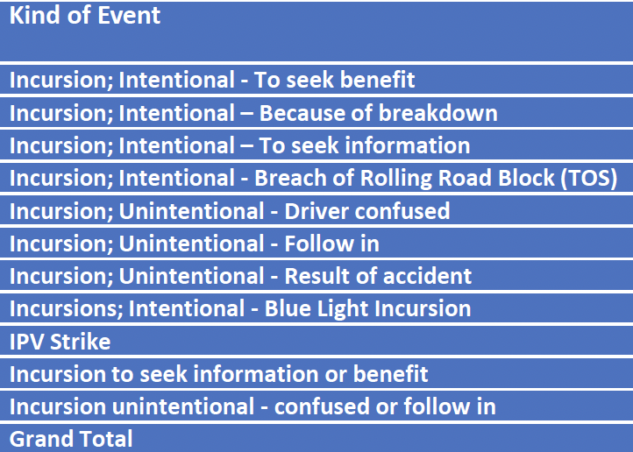
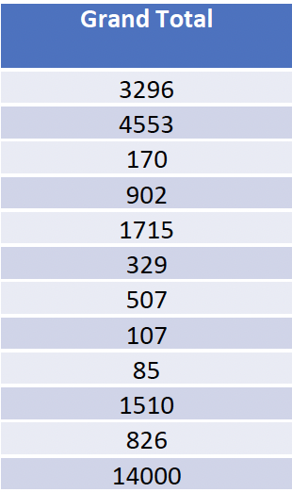
Heatmap of all IPV Incursions
Incursions last 12 months
Notes:
NOTE: the data is from October 2017, whereas the map only relates to last 12 months – as there’re so many…

Slide 8
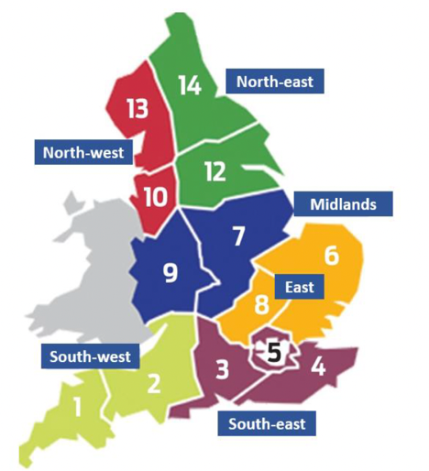
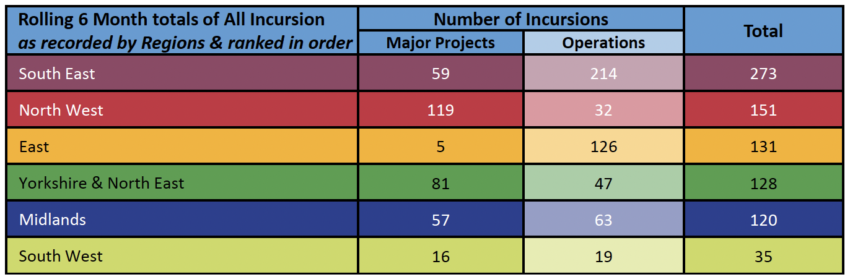
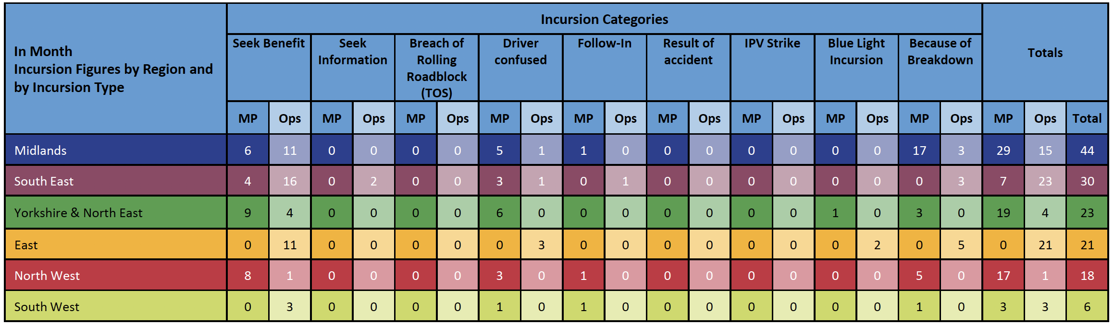
Incursions report by region and category
Notes:
More granularity in respect to NH OD. This is a typical extract from the monthly report which is generated from HART – this is what forms the basis of discussions and improvements so if things aren’t reported, we don’t have a clear picture of the scale of these types of incidents, and it therefore prevents us from making changes to improve things.

Slide 9
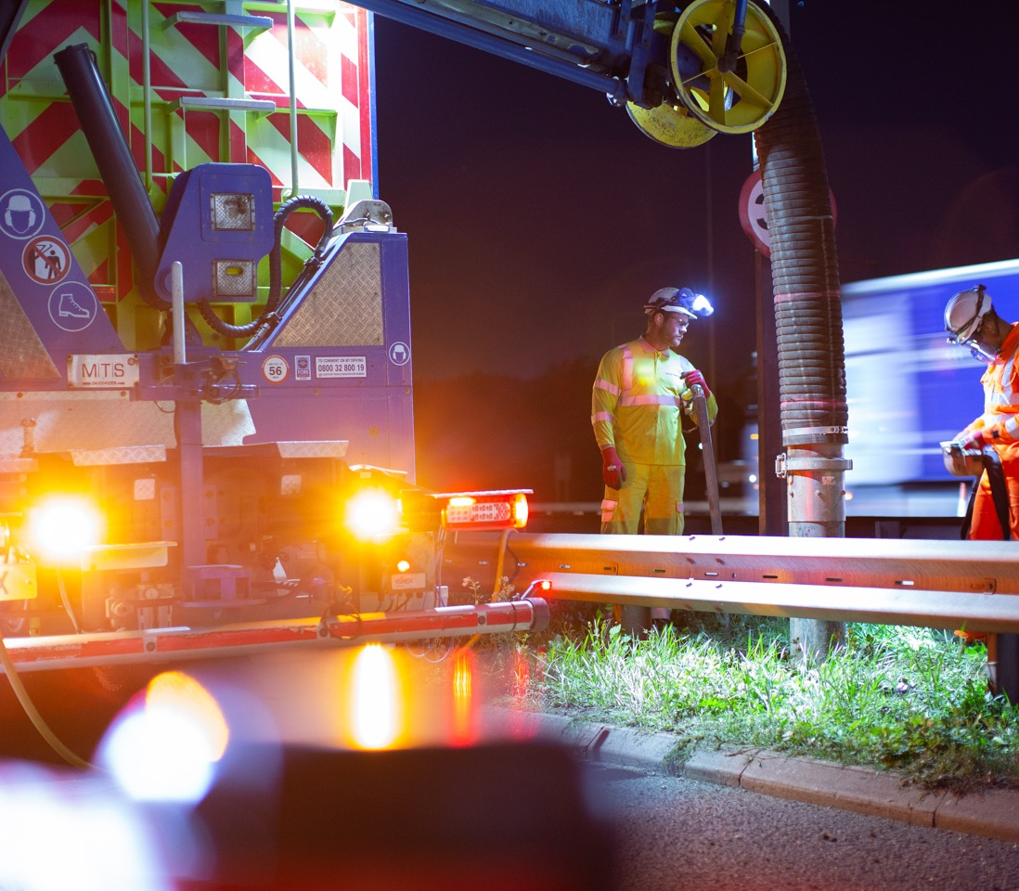
Improving the working environment

Slide 10

Across the industry – improvements (strikes and incursions)
  National Highways Incursions and IPV Group
  Group comprises a wide membership from industry T1, TMCA members and National Highways.
  Role is to analyse data and with consistency try to identify and target ways to reduce IPV strikes and Incursions
  Looking to identify ways to reduce total number of traffic management installations to reduce the risk
  It considers and supports the development of ‘Raising the Bar’ documents designed to reduce Incursions and strikes.
Mitigating incursions
  In some instances, the travelling public become confused with works access sites; work has been done to optimise where work access should be within the TM design, along with optimisation of signing.
  Collaborative working with police authorities to issue ‘incursion warning letters’
Example of an airlock
Eliminating incursions
  Exploring more efficient ways of working and incorporating more works in the same closure
  Less closures = less risk
Reducing Incursions
  Use of airlocks has been widely promoted as best practice and since introduction the number of incursions appears to be reducing
  Focus on the quality and consistency of airlocks
  Modify behaviour of road users – engaging with specialist media companies to work with influencers
  Stamp it out
IPV Strike
Notes:
Here’s what we’re doing
We have the data and a consistent way of reporting so we can make improvements
NH and suppliers recognised that this was a growing problem so led to National Highways Incursions and IPV Group
National Highways Incursions and IPV Group
Role is to analyse data and with consistency try to reduce IPV strikes and incursions
Looking to reduce number of traffic management installations to reduce the risk
‘Raising the Bar’ in inspection (IPV strikes) and testing of IPV crash cushions
Developed several raising the bar documents relating to hard shoulder closures
By tracking the data and bringing together industry TM leads – we’ve found that the installation of airlocks makes a big difference to incursions numbers. The number of incursions look to be starting to decrease and the view from TM specialists is that this is believed to be due to the way air locks are being increasingly used
Eliminating incursions
Exploring more efficient ways of working and incorporating more works in the same closure – this leads to fewer closures and eliminates some exposure risk
Number of closures are going up – we are seeing year-on-year increases. 2019 saw a reduction due to COVID – over the last 5 years, the number of TM systems going out on network is going up between 5 and 15% year on year (across whole SRN)
Mitigating incursions
In some instances, the travelling public become confused with works access sites. Work is therefore being done to optimise where work access should be within the TM design, along with optimised signage for them
Reducing Incursions
Increased use of airlocks – industry has signed up to this!
Since the introduction of airlocks, number of incursions is reducing
Quality of airlocks is next step – to get consistency up and standard higher to build on this success
Modify behaviour of road users – engaging with specialist media companies to work with influencers to have a national impact. Use social media as a positive to try and deter – counter reckless social media behaviour/ trends
Stamp it out – roadworker abuse – correlation between abuse and TM incursions – individuals will drive into site and then give abuse to roadworkers

Slide 11
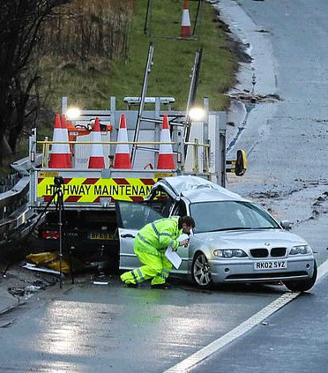
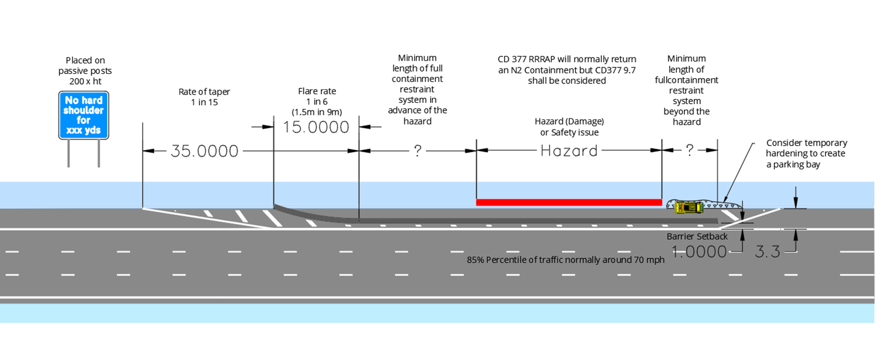
Incursions - Raising the Bar Documents
Highways Safety Hub : https://www.highwayssafetyhub.com/raising-the-bar-guidance.html
RtB 27 - Preventing and Managing Incursions
Promote a uniform approach to TTM design
Ensure robust measures were implemented to deter incursions
Ensure that supporting technologies are correctly applied
Guide organisations how to reduce conflict and harm to our front line
Promote communications with customers
RtB 39 – Traffic Safety and Control at Roadworks
  New revision in Oct 23
  Roles and Responsibilities of the TM Designer, TM Manager and the Traffic Safety Supervisors (replacing TSCO)
  Addresses the skills, knowledge, attitude, training and experience necessary to complete these safety critical roles.
RtB 42 – Working on Hardshoulders and Verges
  New Raising the Bar to be issued in Q4 2023
  Strives to eliminate :
    Poor industry practices
    Incorrect interpretation of technical standards
    Provides greater explanation to support correct assessment of risk

Slide 12

Our ask of you
Please keep reporting!
  We can only make changes if we have the data
  Without your reports, it will appear that incursions are coming down, giving the impression that life is getting better.
  Accurate reporting data (via HART) leads to more targeted focus to improve roadworker safety.

Slide 13
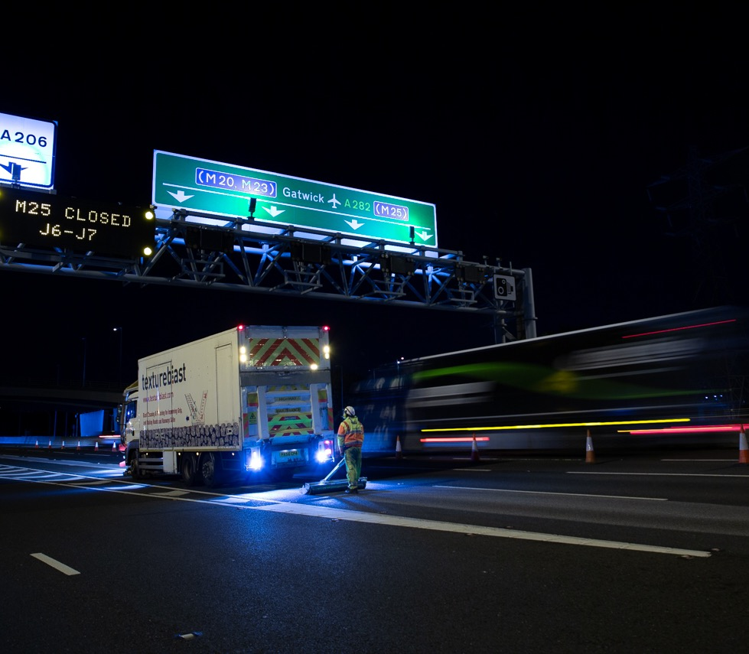
Any Questions?

