Slide 1
Wellbeing
October 2023

Slide 2
Introduction Video
Mel Clarke
Health Safety and Wellbeing Director, National Highways

Slide 3
Introduction
Mental and emotional health, physical health and a healthy lifestyle all contribute to an individual's health and wellbeing.
'Wellbeing' is a broad concept and can relate to the following areas in particular:
personal dignity (including treatment of the individual with respect)
physical health
mental health
emotional wellbeing
protection from abuse and neglect.
Notes:
**Read once all points have appeared on screen*
Mental health is a global issue and 1 in 4 people experience poor mental health each year. Over the past couple of years organisations have become more aware of the impact poor mental health can have on their workforce
A fitter, healthier, happier workforce can impact positively on productivity and prosperity. Society also benefits from a workforce concentrating on better health for themselves. In difficult economic times, safeguarding the health of the working age population becomes even more critical.
Construction work characterised by limited-term contracts, long hours, long commutes, time away from family and the pressure to complete on time and within budget negatively impacts an employee’s mental health. The ‘macho’ culture that’s embedded in many organisations can be a blocker to workers speaking out and seeking help, meaning many will suffer in silence, causing a deterioration of their physical and mental health.
Sadly, the industry has some of the worst rates of suicide in the UK, with male construction workers being 2.7 times more likely to commit suicide than the average person. Not only does poor mental health impact an employee but it affects their colleagues, friends, family and the business.
This session will look to provide information on support available, provide some insight into how to recognise colleagues that might be struggling and share tips on looking after your own wellbeing, so we can contribute to being a happier, healthier workforce.

Slide 4
Putting the Well in Wellbeing
Taking care of yourself

Slide 5
Individual Wellbeing
Wellbeing can mean many different things.
Both Physical and Mental wellbeing are as important as the other, if you are struggling with either, reach out and ask for help, it’s one of the bravest words to say.
There will always be more people willing to help you than ignore you.
Notes:
1. It is difficult for humankind to constantly be on top of each domain of their own wellbeing.
Most of us will, at one time or another, struggle or neglect part of this pyramid of wellbeing.
Wellbeing can be different for everyone, we all have different wants and needs, this provides us all with differing opportunities to maintain our wellbeing.
Maintenance of your wellbeing is important, do what is right for you and your loved ones, make the little moments count so they can be base when the big moments come along.
2. Holistic health is an approach to wellness that simultaneously addresses the physical, mental, emotional, social, and spiritual components of health.
A holistic approach reminds you that the whole is made up of many interdependent parts. In the case of the individual, when one part is out of balance or neglected, it affects the other parts. Be aware that you are providing yourself with the right balance for your wellbeing to thrive.
3. Above all else, strive for Happiness.
Smile and the world smiles with you.
Happiness is the best form of health.
Try to be a rainbow in someone else’s cloud.
Happiness comes in waves, it’ll always come back.
No rain, no flowers.
We grow through what we go through.
Smile, it makes people wonder what you’re up to!

Slide 6
Employee Assistance Programmes
Employee Assistance Programmes are 24/7 confidential support services which employers sign up to. Check to see if your employer provides one. If support is not available through your employer, https://www.citizensadvice.org.uk/ assist with advice on things life can throw at you.
Home, family and work issues as well as financial matters including debt, buying a house and consumer rights.
Medical concerns
Challenging situations
Notes:
Employee Assistance Programmes are 24/7 confidential support services which employers sign up to. Check to see if your employer provides one. If support is not available through your employer, https://www.citizensadvice.org.uk/ assist with advice on things life can throw at you.
As well as being able to offer help on everyday matters, they are there too for more serious problems such as medical or personal issues. They offer a free, confidential and impartial service.
They can provide guidance on common aspects of life which include;
Home, family and work issues as well as financial matters including debt, buying a house and consumer rights.
Medical concerns
Challenging situations

Slide 7
Body Weight Exercises
Exercise can be daunting, but can bring joy and a feel good factor with it. You don’t have to run 10 miles or lift countless heavy weights for it to impact your life. Check out free online resources for body weight exercises.
You can do them anywhere in your home.
No need for expensive gym memberships or equipment.
Anyone can join in, kids, partners, parents even Grandparents will be able to keep up.
Check out websites such as www.livestrong.com or find a video on YouTube
Video - What happens inside your body when you exercise? British Heart Foundation
Notes:
Exercise can be daunting, but can bring joy and a feel good factor with it. You don’t have to run 10 miles or lift countless heavy weights for it to impact your life. Check out free online resources for body weight exercises.
You can do them anywhere in your home.
No need for expensive gym memberships or equipment.
Anyone can join in, kids, partners, parents even Grandparents will be able to keep up.
Check out websites such as www.livestrong.com or find a video on YouTube
Play video

Slide 8
Health
Your Health is one of the most important things you own. Most health implications can be managed providing they are identified early enough.
Speak to your GP or call NHS 111 for advice on any concerns you have.
There is lots of information online, if you need help using the internet ask a friend or colleague for help.
There may be support avenues available through your employer.
Video - NHS Better Health
Notes:
Information on slide

Slide 9
Health
Eating Well
Resources
NHS Eat Well can provide advice on food types, food labels, balanced diets and digestive health. For more information go to www. Eat well - NHS (www.nhs.uk).org/employee.
Food Standards Agency provides an Eat Well guide and other resources to help maintain a balanced diet. For information go to The Eatwell Guide and Resources | Food Standards Agency.
Video - A healthy diet, a healthier world
Notes:
“What we eat has a big impact on how we feel, mentally as well as physically. Your brain needs nutrients to stay healthy, certain types of food contain essential components for good mental health. Remember what is good for you physically is good for you mentally”

Slide 10
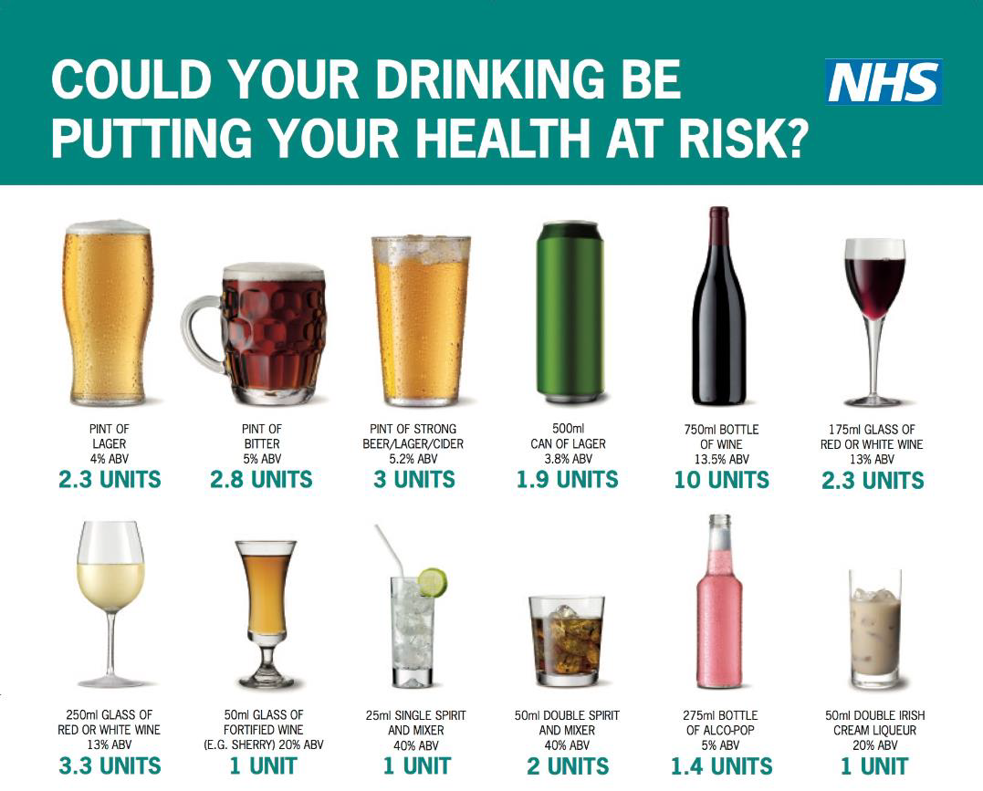
Health
Stay Hydrated, but try and drink less alcohol
About 3.5 litres a day for men and 2.5 litres for women.
https://www.nhs.uk/live-well/alcohol-advice/the-risks-of-drinking-too-much/
Notes:
“Drinking too much and too often can contribute to a low mood. Take on more water and drink less to help maintain a positive mindset”
Regularly drinking more than 14 units of alcohol a week risks damaging your health.
To keep health risks from alcohol to a low level if you drink most weeks:
men and women are advised not to drink more than 14 units a week on a regular basis
spread your drinking over 3 or more days if you regularly drink as much as 14 units a week
if you want to cut down, try to have several drink-free days each week
If you're pregnant or think you could become pregnant, the safest approach is not to drink alcohol at all to keep risks to your baby to a minimum.

Slide 11
Health
Fit for Work can provide support if you are in work and or if you are off sick from work. If you have been (or are likely to be) off work for four weeks or more, you can be referred to an occupational health professional. For more information go to www.fitforwork.org/employee
NHS has a website that provides information and practical advice for anyone on many health aspects. For more information go to https://www.nhs.uk/live-well/
Easyhealth.org.uk is a website that provides information and further links. For more information go to https://www.easyhealth.org.uk/
Video - Let’s be active for health for all
Notes:
These organisations can provide information that can help you maintain or improve your health.

Slide 12
Mental Health
Extracts from the Midlands Collaborative Community Resource Pack

Slide 13
Mental Health
Talk about your feelings
Have you spotted the signs?
Notes:
Telling somebody that you are sad can take some of the sadness away and sharing joy will add more joy. We often crave closeness to other people and sharing feelings helps
There are many reasons why mental health has become such a huge issue in the workplace today, but one factor is that many cases go unrecognised.
The following slide identifies some of the common signs that someone with mental health may experience.

Slide 14
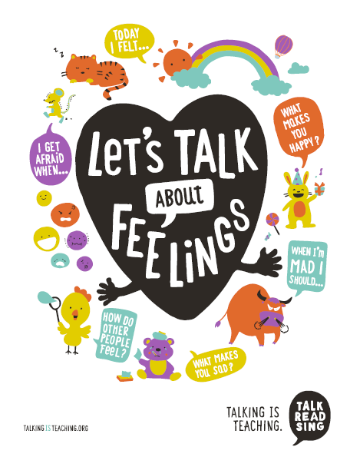
Mental Health
Emotional
Thinking or Decision Making
Behavioural
Physical
Work
Video - 5 Steps to Wellbeing Animation
Notes:
Emotional – They may appear to be irritable, sensitive to criticism, demonstrate an uncharacteristic loss of confidence or seem to lose their sense of humour.
Thinking or Decision Making – They can make more mistakes than usual, have problems making decisions, or are not be able to concentrate or their performance may suddenly drop.
Behavioural – This can include issues such as arriving late for work, not taking lunch breaks, taking unofficial time off, not joining in banter at work or generally acting out of character.
Physical – People who are stressed sometimes exhibit physical symptoms such as having a constant cold, feeling tired at work, looking as though they have not made an effort with their appearance or they can experience rapid weight loss or gain.
Work – People with mental health issues may have increased absences from work, may work longer hours or experience a general drop in motivation or productivity.
5 Steps to wellbeing video

Slide 15
Mental Health
Stigma
We are conscious that mental health issues attract a lot of stigma and bad press; and we are committed to:
Breaking down these barriers and raising the profile of mental health within the company.
Positively influencing mental health issues within industry.
Remember - You are not alone!
Video - Tyson Fury And The Invisible Opponent | CALM A Movement Against Suicide
Notes:
If you spot a colleague or a member of your family with one or more of the symptoms mentioned it does not necessarily mean that they have an underlying mental health issue, but it does mean that they possibly need further guidance and advice; especially if they are going through a difficult time inside or outside work.
We are conscious that mental health issues attract a lot of stigma and bad press; and we are committed to:
Breaking down these barriers and raising the profile of mental health within the company.
Positively influencing mental health issues within industry.
Remember - You are not alone!
Invisible opponent video

Slide 16
Mental Health – Resources and support
Resources
NHS Choices has a website that provides information and practical advice for anyone experiencing mental health issues. For more information go to www.nhs.uk/livewell/mentalhealth
Remploy provide a free and confidential Workplace Mental Health Support Service if you are absent from work or finding work difficult because of a mental health condition. It aims to help people remain in (or return to) their role. For more information, go to www.remploy.co.uk or call 0300 456 8114.
Rethink Mental Illness is the largest national voluntary sector provider of mental health services, offering support groups, advice and information on mental health issues. For more information, go to www.rethink.org or call 0300 5000 927.
Samaritans provide confidential help and support 24 hours a day. For more information, go to www.samaritans.org or jo@samaritans.org or call 08457 90 90 90.
The Mental Health Foundation provide guidance and advice in relation to managing mental health issues. For more information go to www.mentalhealth.org.uk
Highways Safety Hub provides further information including Common Intent and raising the bar documents Mental Health (highwayssafetyhub.com)

Slide 17
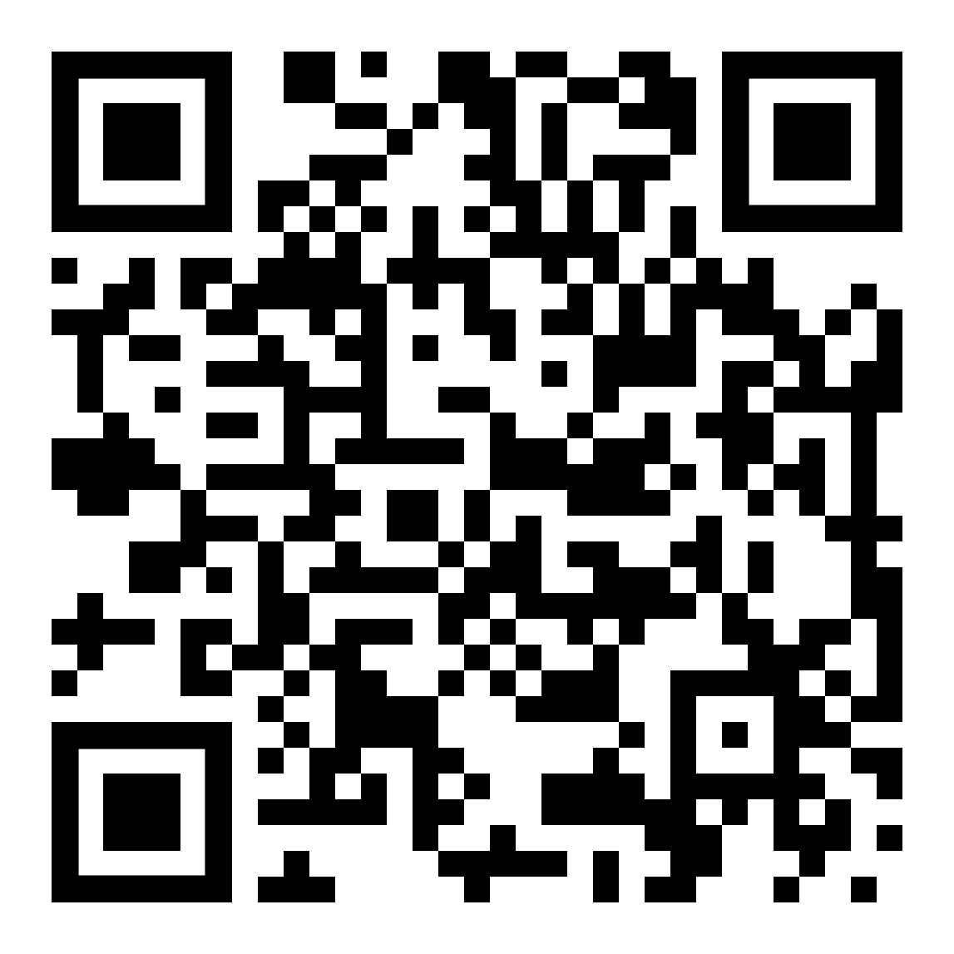
Mental Health – Resources and support
Lighthouse Club – Construction Industry Helpline.
Lighthouse Club - The Construction Industry Charity or call 0345 605 1956
There are videos on YouTube to help raise awareness of the Lighthouse Club. One of these can be viewed following the link below or by typing the address into the address bar of your search engine or scanning the QR code.
https://www.youtube.com/watch?v=eK5I9sw-t1Q&t=50s
You can also download the construction industry helpline App on either the App store for Apple devices or Google Play store for Android devices.
Notes:
The Lighthouse Construction Industry Charity is the only charity that provides mental, physical and financial wellbeing support to the construction community and their families. They also provide e-learning on a number of topics as part of their wellbeing academy.
They offer phone, text and app support services. Links to their website and youtube video are on the screen.

Slide 18
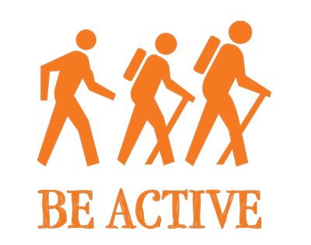
Mental Health
Self-acceptance
Be proud of who you are
Notes:
“For many people self-acceptance is hard to come by on a good day, but when you have had a bad day your self-acceptance is in shreds. Its normal to feel like this. Learn to accept that you’re unique, work on your strengths and be kind to yourself. Feeling good about yourself will boost your confidence. Be proud of who you are”.

Slide 19
Mental Health - Helplines
CALM (Campaign Against Living Miserably) – Phone: 0800 585 858 7 Days a week 17:00 - Midnight (Men only)
PAPYRUS (Prevention of Young Suicide) HOPELineUK – Phone: 0800 068 41 41 Monday to Friday 10:00 – 22:00, Weekends 14:00 to 22:00 and Bank Holidays 14:00 to 17:00.
The Samaritans - Phone: 116 123 (24/7/365) https://www.samaritans.org/ jo@samaritans.org
I Am Alive - www.iamalive.org
PAPYRUS (Prevention of Young Suicide) HOPELineUK - https://www.papyrus-uk.org/ pat@papyrus-uk.org
Videos
We are Mates in Mind.
Lighthouse Construction Industry Helpline UK (2022)
Notes:
If you find talking too difficult, there is also online support to help people that is just a click away!
Videos to play

Slide 20
Wellbeing at Work
The importance of wellbeing for the workplace – source Public Health England

Slide 21
Why Wellbeing matters to Employers
Notes:
The cost of ill health
From an employer perspective, the benefits of a healthy workforce are clear. Healthy staff are more productive, take less time off sick and do not necessarily need to retire early.
Looking at the wider economy, combined costs from worklessness and sickness absence amount to approximately £100 billion annually, so there’s a strong economic case for action. The costs of ill health to the UK government is estimated to be around £50 billion a year, as a result of benefit payments, additional health costs, taxes and national Insurance.
An unhealthy workforce negatively impacts our economy and society due to:
lost productivity
a reduction in income tax receipts
increases in long-term sickness
increased informal caregiving
increased healthcare costs

Slide 22
Why Employment matters to Health
Notes:
As adults in employment spend a large proportion of their time in work, our jobs and our workplaces can have a big impact on our health and wellbeing. In fact, employment can impact both directly and indirectly on the individual, their families and communities.
There is clear evidence that good work improves health and wellbeing across people’s lives, not only from an economic standpoint but also in terms of quality of life. ‘Good work’ means having not only a work environment that is safe, but also having a sense of security, autonomy, good line management and communication within an organisation.
There is also evidence that shows that good quality work protects against social exclusion through the provision of:
Income
social interaction
a core role
identity and purpose

Slide 23
Creating Healthy Workplaces
Diversity, equality, and inclusion are three closely linked values held by many organizations.
They are also an important factor in creating healthy workplaces.
Notes:
Creating healthy workplaces entails supporting disabled people and people with long-term health conditions. It is also important to ensure the health and wellbeing of healthy employees who do not have existing health conditions is maintained, as work and the workplace also play a pivotal role in this.
Jobs need to be sustainable and offer a minimum level of quality, which should include:
a decent living wage
opportunities for in-work development
flexibility to enable people to balance work and family life
protection from adverse working conditions that can damage health
Mental health and musculoskeletal (MSK) conditions remain 2 of the leading causes of sickness absence. The following sections outline the burden these conditions place on individuals of working age and their employers.

Slide 24
MSK and work
The pain and disability of poor MSK health limits independence and the ability to participate in family, social and working life.
Notes:
The pain and disability of poor MSK health limits independence and the ability to participate in family, social and working life. It is estimated that 17.8 million people live with an MSK condition in the UK, and according to Arthritis Research UK, only 59.4% of people of working age with an MSK condition are in work. Furthermore, around 1 in 5 people with arthritis have depression.
In 2017, MSK problems were the second most common cause of sickness absence, accounting for 28.2 million days lost in work (17.7% of total sickness absences). The most common cause of sickness absence was acute illnesses such as cough and colds, which accounted for 34.3 million days lost. adults in employment spend a large proportion of their time in work, our jobs and our workplaces can have a big impact on our health and wellbeing. In fact, employment can impact both directly and indirectly on the individual, their families and communities.

Slide 25
Mental Health in the workplace
Notes:
The prevalence of mental ill health at work
According to Mental Health First Aid England
1. At any one time, one in six people of the working age population of Britain experience symptoms associated with mental ill health.
2. 50% of employees have experienced at least one characteristic of burn out due to greater job demands and expectations, lack of social interaction and lack of boundaries between work and home life.
3. Almost half of workers (46%) say they’ve worked in recent months despite not feeling physically or mentally well enough to perform their duties.

