Slide 1
Highways Health & Safety Hub
Occupational Health Campaign: Noise
IDENTIFYING THE RISKS
V2
Notes:
NW

Slide 2
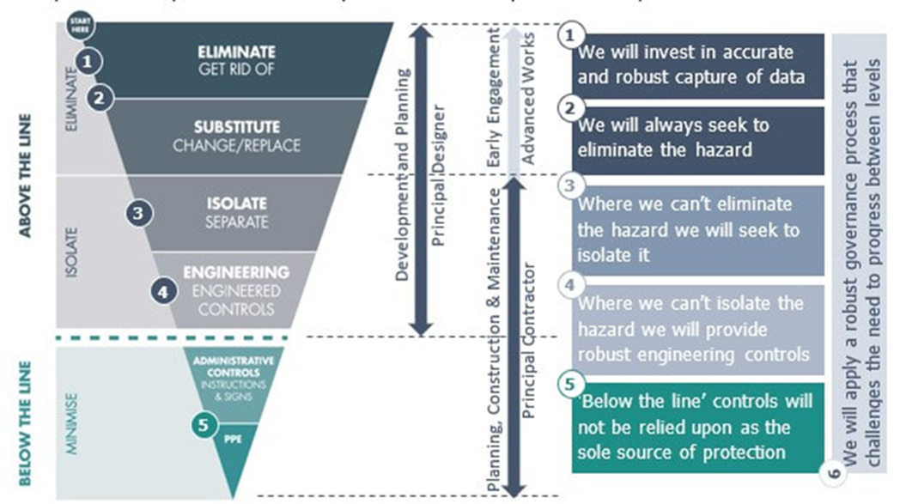
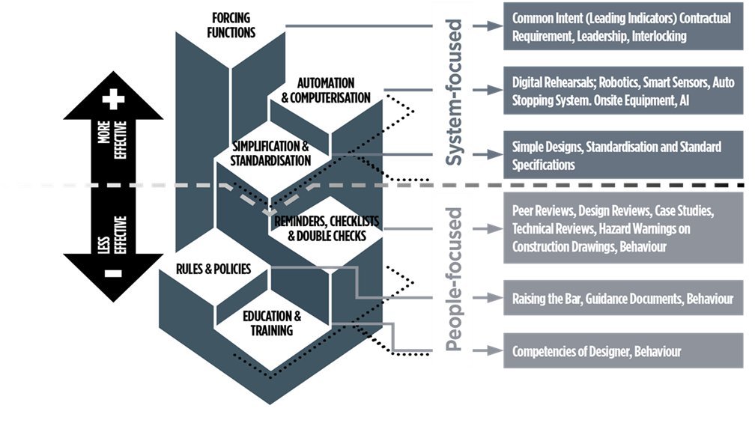
Highways Health and safety Hub
NOISE
The latest Hub health and wellbeing campaign is aligned too the strategic direction of the Supply-Chain Safety Leadership Group (SCSLG) ‘Health and safety by design’ common intent document and significant risk thinking focusing on ‘Above the line’ controls and the ‘Hierarchy of intervention effectiveness’.

Slide 3
Highways health and safety hub
NOISE
WHAT IS NOISE?
When workers are exposed to high noise levels in the workplace, they can suffer from various adverse health effects. These can be caused by a single exposure to a very loud noise or by exposures to raised levels.
The effects of noise on hearing depend on:
noise intensity or sound pressure (dB)
frequency or pitch of sound (Hz)
exposure time
distance from source
individual susceptibility (age, disease, genetics etc)
nature of the sound (reverberation, impact noise etc)
other factors (lifestyle, hobbies).
The most well-known effect of occupational noise is loss of hearing. However, it can also aggravate other health conditions. Some individuals are more sensitive to the effects of noise than others and will suffer harm more readily through noise exposure.
What is harmful noise?

Slide 4
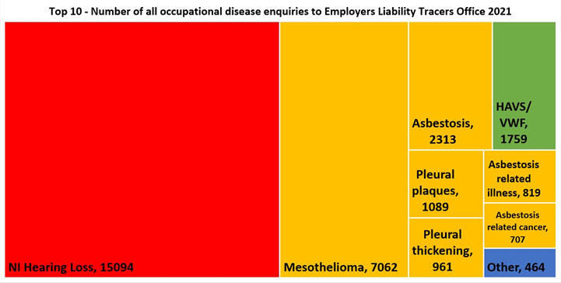
Highways health and safety hub
NOISE
The main issue
17,000 people in the UK suffer deafness, ringing in the ears or other ear conditions directly caused by excessive noise at work
Typical hearing damage claim settlements are around £5k-8k.
HSE estimates that the true cost for each claim is often an additional £7k-29k.

Slide 5
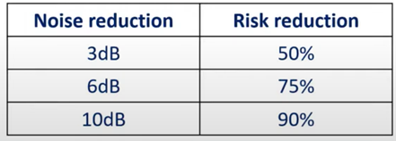
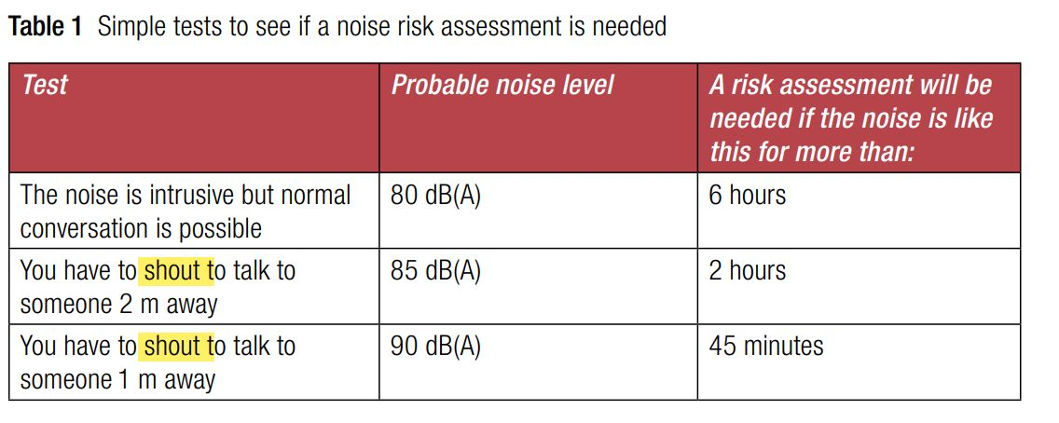
Highways health and safety hub
NOISE FACTS
Hearing damage risk is proportional to noise dose
Double the dose, double the risk
Every 3 dB increase in noise level doubles the risk
95 dB(A) – very difficult to guarantee sufficient protection from PPE
100 dB(A) – very stringent measures must be used to ensure adequate protection
If you need to “SHOUT” noise is an issue

Slide 6
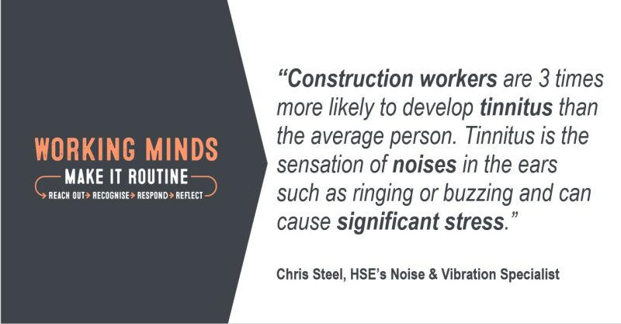
Highways health and safety hub
NOISE
Personal consequences of an untreated disabling hearing loss
Negative impact on:
Physical and mental health
Social life and relationships
Work life and income
Quality of life

Slide 7
Highways health and safety hub
NOISE
Requirement for Health Surveillance
Health surveillance (hearing checks) must be provided for all employees who are likely to be regularly exposed above the upper exposure action values, or are at risk for any reason, e.g. they already suffer from hearing loss or are particularly sensitive to damage.
The purpose of health surveillance is to:
Warn when employees might be suffering from early signs of hearing damage;
Give an opportunity to do something to prevent the damage getting worse;
Check that control measures are working. Allowing for consultation with trade union safety representative, or employee representative and the employees concerned before introducing health surveillance. It is important that employees understand that the aim of health surveillance is to protect their hearing.

Slide 8
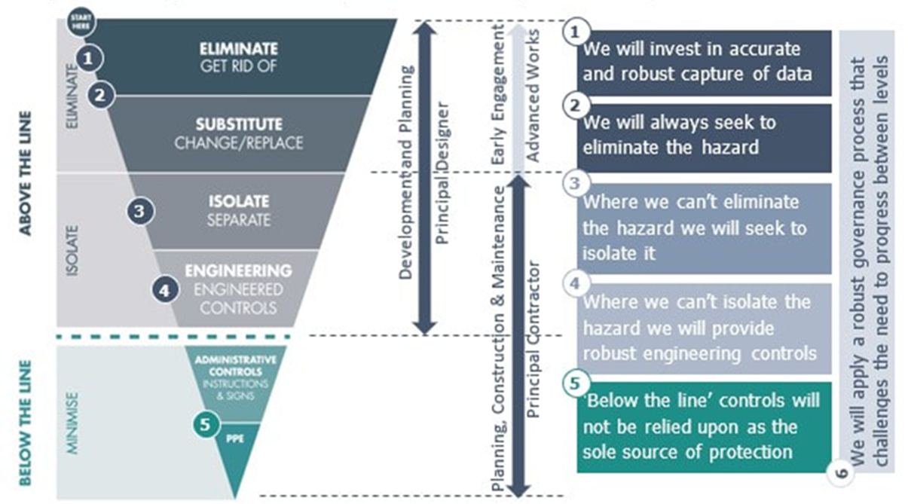
Highways Health and Safety HUB
NOISE
Below are some examples of above the line thinking during design regarding noise
Design
Eliminate – Design-out noisy activities (e.g. cutting or fabricating off-site, no noise alternative processes)
Substitute – Design-in quieter process (e.g. bore piles rather than impact piling, or use of a rubber hammer rather than a metal)
Isolate –separating the noisy area from other workspaces i.e. using barriers or screens to block the direct path of sound; locating noise sources further away from workers
Engineering Controls – Changing processes i.e. use of diamond tip cutting systems that are quieter than other alternatives such as tungsten.
Admin Controls – PC to identify additional control methods to reduce noise through the way work is organised.

Slide 9
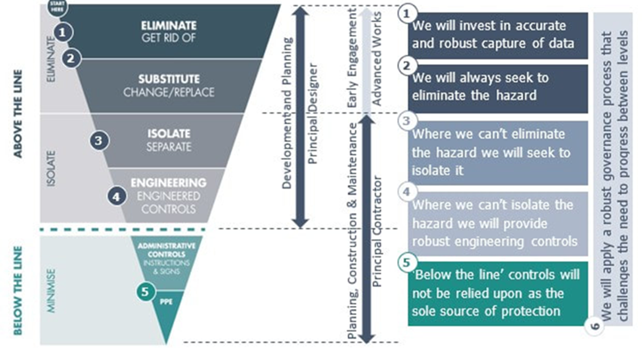
Highways Health and Safety HUB
NOISE
Below are some examples of above the line thinking during Construction and Maintenance regarding Noise
Construction and Maintenance
Eliminate – Know the ‘noisy’ tasks/processes/machinery and understand if the activity or source is necessary.
Substitute – Buy Quiet - use manufacturers data to help determine quieter plant, equipment and tools. Switch things off when not in use
Isolate – Use barriers, screens or enclosures around noisy area; Use noise absorption materials; Keep on top of maintenance and repair; Using electrically powered tools and equipment
Engineering Controls – Use low-noise machinery; use enclosures around noisy processes maintain and lubricate plant and equipment
Admin Controls- Segregate noisy work areas and remove those in the vicinity, where possible; Plan and organise work areas to reduce sound by implementing time restrictions; Signage and warning around site and on equipment/plant powered tools and equipment
PPE – Adequate and suitable against the risk, for the person and environment; Provides good fit for wearer with protection of correct type; Training and supervision

Slide 10
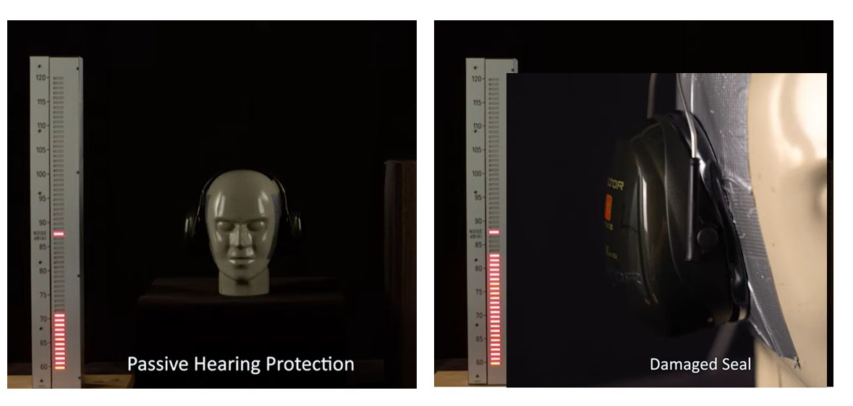
Highways health and safety hub
NOISE
The HSE Solutions videos:
Hearing loss – what is it like? https://youtu.be/4861LaNvxDo?si=MVOwFculatbxMc_f
video to help explain how damage and incorrect use of hearing protection will change how well they work HSE Hearing Protection demonstration - YouTube

Slide 11
Highways health and safety hub
NOISE
Use Hearing Protection Correctly
40% of PPE users got no protection whatsoever
60% was inadequate
14% of personnel did not wear them
90% of NIHL is preventable with correct wear of hearing protection
There is evidence that damage can begin to occur at 75dB(A)
In a sample of 19 organisations the range of compliance with the Noise at Work Regulations ranged from 50% to 100%.
Common shortcomings included:
noise surveys that did not allow individual exposures to be estimated
insufficient training
HSE research paper RR720 (2009)

Slide 12
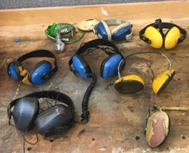
Highways health and safety hub
NOISE
HEARING PROTECTION – IS IT ‘CUFF’:
Good Condition of hearing protection,
Use hearing production 100% of time in noise,
Fits the ear – avoid sound leaks,
Fit for purpose – provides the right level of production

Slide 13
Highways health and safety hub
NOISE
Shaping Health in Construction Seminar
When: 4th October 2023
Where: 3M Centre in Bracknell
Focus Topics: Dust, Noise & Hand Arm Vibration (HAVS).
Target Audience: The event is aimed at those with health and safety responsibilities at all levels within the construction sector as well as procurement and construction designers/engineers.
Bring a Subby: We would encourage Tier A’s and large infrastructure projects to bring your key supply chain to this event. The agenda will demonstrate aspects of the hierarchy of controls with a particular focus on innovative engineering control solutions which can be taken away and put into practice in real life. There will be case studies of best practice & guest speakers including Mr. Chris Steel | HM Principal Inspector of Health & Safety (Noise & Vibration Specialist) from the HSE.

Slide 14
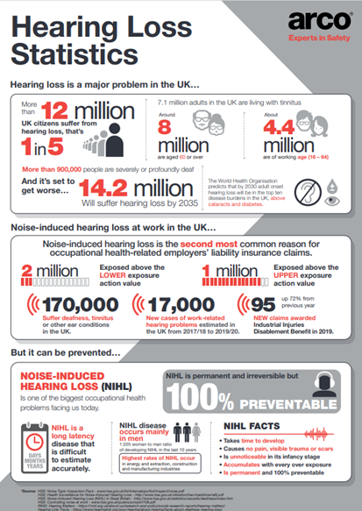
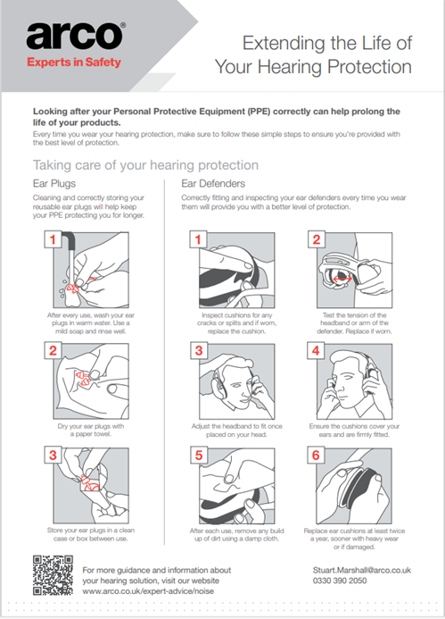
Highways health and safety hub
NOISE
POSTERS

Slide 15
Highways health and safety hub
NOISE
RESOURCES
HSE Noise exposure calculator
HSE Hearing protection calculator
HSE Removal of hearing protectors severely reduces protection – online tool
HSE daily and weekly noise exposure ready-reckoner
HSE INDG363 Noise: Don’t lose your hearing!
Hearing Conservation Association
3M “Hearing for Life” Toolkit
UKHCA Hearing Protection Fit Testing
https://tinnitus.org.uk/
UKHCA FAQs for Construction Noise & Hearing Conservation

Slide 16
Thank You

