Slide 1
V8 Working at height and the prevention of falls from vehicles
Notes:
Introduce yourself and the toolbox talk
Explain how long the talk will take and cover what will be discussed
You will need to know what your company’s policy is on working at height and the prevention of falls from vehicles and incorporate any materials used.
Before you start
Make sure you have a copy of:
The FORS standard
Ensure you have the accompanying notes of the presentation
Ensure you have slide packs to hand to drivers at the end of the talk

Slide 2
Fleet Operator Recognition Scheme (FORS)
FORS is important to our company because it helps us:
Demonstrate the quality of our operation
Improve our road safety record
To win / maintain work
Remain legally compliant
Become more efficient
Reduce our environmental impacts
Requirement:
Fleet operators shall risk-assess the potential for persons to fall off vehicles and for unauthorised access to vehicles and where appropriate take mitigating action.
Notes:
- Explain what FORS is: ‘FORS aims to raise the level of quality within fleet operations, and demonstrate which operators are achieving the standard’
Explain the importance of FORS to the company and to the drivers
Not all the images or examples used in the talk may be relevant to how you work. Where this is the case, use examples from your own workforce.

Slide 3
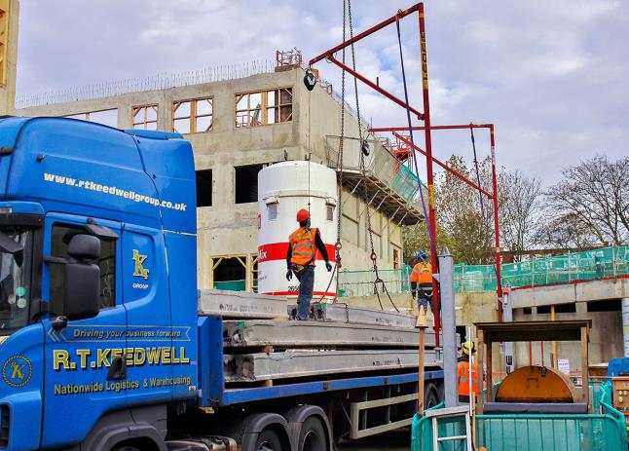
Aim of toolbox talk
The aim of this toolbox talk is to ensure the safety of persons around vehicles, which can often involve working at height.
This specifically includes drivers and those who assist them in loading activities, and passengers in passenger carrying vehicles
Notes:
This slide introduces the tool box talk and what we aim to achieve by presenting this talk.
The aim of this toolbox talk is to communicate this company’s policy to all driver’s (including sub-contracted and agency drivers) on working at height and the prevention of falls from vehicles.
This policy specifically includes drivers and those who assist them in loading activities, and passengers in passenger carrying vehicles. As a driver you must make sure that all work carried out at height is properly planned, supervised and carried out by people who are competent to do the job.
Please note: Not all the images or examples used in the talk may be relevant to how you work. Where this is the case, use examples from your own workforce.
Additionally this talk may not include so risks that apply to your workplace therefore, before you use this toolbox talk:
Check its contents against your own risk assessment and make sure it is relevant to your workforce.
If necessary you can add additional information which may also be relevant for drivers to know.

Slide 4
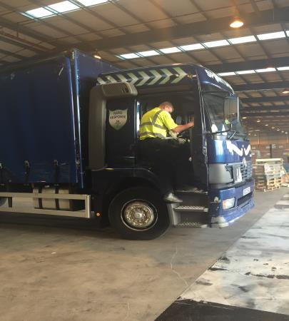
How this toolbox talk will help you
This toolbox talk covers:
Getting on and off the vehicle safely
Keeping your vehicle safe
How you can work safely
What you should consider with regards to the risk assessment
Notes:
This toolbox talk covers:
Getting on and off the vehicle safely
Keeping your vehicle safe
How you can work safely
What you should consider with regards to the risk assessment
The talk will end with some confirmatory questions, so listen up!

Slide 5
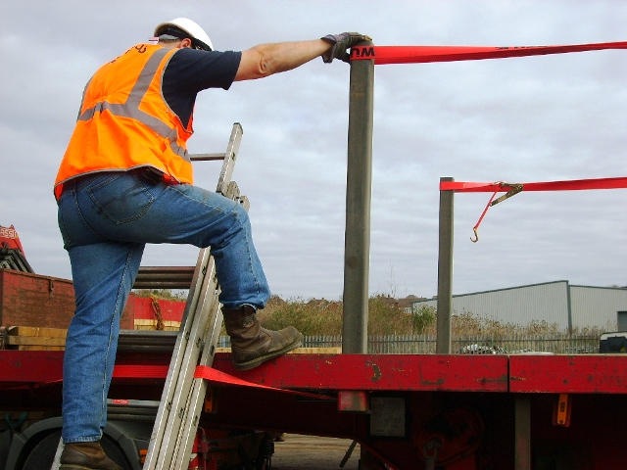
What is this about?
Falls from vehicles are among the most common accidents involving workplace transport.
Common accidents include falls from trailers, tail-lifts and truck cabs.
There are over 2000 ‘Falls from vehicle’ accidents reported to HSE each year.
Major injuries are usually broken arms or legs, resulting in weeks off work.
Notes:
Look up company accident history for falls from vehicle incidents to use as illustrations.
Our company goal is to ensure the safety of persons around vehicles, which can often involve working at height. More than 2000 serious injuries to people falling from vehicles are reported each year and on average, five of these are fatal. Many of these injuries are broken arms or legs, resulting in weeks off work and possible loss of earnings.
The 2000 accidents include ‘over 3 day’, major and fatal injuries reportable under the RIDDOR Regs.
The unreported ones will be less serious – where people have had fewer than 3 days off work.
Common accidents include falls from trailers, tail-lifts and truck cabs. The majority of falls from tipper lorries occur during sheeting and unsheeting
By law as a driver, it is your responsibility to make sure that you are taking practical measures to reduce the risk of yourself and others around you from falling while working at height and/or prevent falls from vehicles
Emphasise on the statistics in the slide to drivers, highlighting the importance of taking extra care when carrying out any work that involves being at height

Slide 6
Getting on and off your vehicle & keeping your vehicle safe
DON’T jump down – this is bad for your knees and you are more likely to fall
Always use steps and handholds if provided
Take a few seconds to climb down from the cab, load area or catwalk facing the vehicle and use the handhold
Report missing or damaged equipment
Before stepping off the vehicle, check for uneven surfaces such as potholes or kerbs which may cause you to slip
Use 3 point contact rule
Notes:
Getting on and off your vehicle
DON’T jump down – this is bad for your knees and you are more likely to fall
Always use steps and handholds if provided
Take a few seconds to climb down from the cab, load area or catwalk facing the vehicle and use the handhold
Report missing or damaged equipment
Before stepping off the vehicle, check for uneven surfaces such as potholes or kerbs which may cause you to slip
Use 3 point contact rule
Keeping your vehicle safe
Carry out pre-use checks on your vehicle. For example, check any steps or handholds are in good condition
Report broken boards and any other objects that could cause a fall
Keep the load area tidy – pick up loose ropes, packaging etc
Check that the straps are safely stored on curtainsiders so people don’t trip on them
Clean up spills and dirt such as diesel or mud on the catwalk or load area to stop people slipping in them
On refrigerated vehicles, check the floor conditions for ice or water and follow any systems in place for reducing the amount of water produced

Slide 7
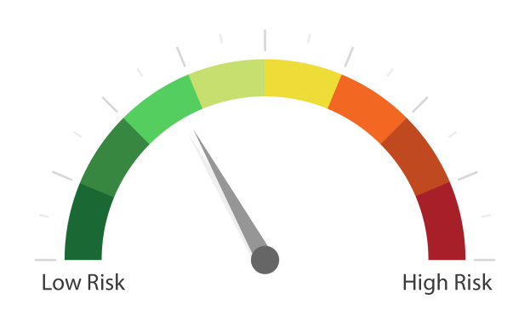
How you can work safely at height
Think safety:
Plan your loading and unloading to avoid the need to work at a height
Avoid working at height unless it is essential
Minimise the impact of any fall.
Select the right sole for the surface and contamination type.
Don’t jump of vehicles
Notes:
Avoid working at height unless it is essential
Wear well-fitting, slip-resistant safety footwear when working on vehicles
Keep the soles of your footwear clean to reduce the risk of slipping
Follow safe systems of work for loading and unloading vehicles
Make sure you have been trained in and follow the company’s safe ways of working if you have to use equipment such as tail-lifts or lorry loader cranes
Use the ‘three-point hold rule – keep at least three points of contact with the vehicle you are climbing, moving one limb at a time and testing the new hold before moving on
Use safe ways of getting on or off the vehicle when carrying out maintenance above ground level, for example by using gantries or tower scaffolds
Look at what other companies do – if you see a good idea suggest it to your safety adviser or supervisor

Slide 8
What can you do? Cont...
Most common area of vehicle for people to fall from:
load area
cab access steps
fifth wheel catwalk
REMEMBER: Sometimes the simplest task can be the most dangerous one.
Never lose concentration!
Notes:
Causes of falls include:
Slipping and falling from loads and access steps and ladders
Broken ropes or torn sheets causing overbalancing;
Inappropriate footwear;
Bad weather; and
Lack of awareness and training

Slide 9
How to manage the risks
When planning work at height you need to carry out a 'risk assessment'. This should supplement your overall health and safety risk assessment.
You don't need to overcomplicate the process. The risks for working at height are usually well known and most necessary control measures are easy to apply.
A risk assessment is simply
A careful examination of the work at height task to identify hazards and
A consideration of whether the hazards pose a risk that could cause harm to people.
Notes:
This slide explains how you should manage risk when working at height. Make sure that drivers are familiar with the company’s risk assessment for working at height and that they sign it.
In addition, as an operator you can do the following to minimise risk:
Authorisation:
Only give permission to gain access on to vehicles to people who cannot avoid doing so.
Protective equipment:
If the work at height cannot be avoided, it is best for people to be protected by equipment and site or vehicle features that prevent falls. If equipment to prevent falls is used, the best solutions are those that protect everyone, not just individuals. If only one person is at risk, harness systems, for example, might be most appropriate.
Instruct and train
workers to use the work equipment competently, and provide information for workers. Safe ways of working should always be part of managing risks.
Visibility
Assess how much light there is for people climbing into or on to vehicles, or walking on vehicles. Poor visibility can lead to accidents. Hand-held lights or torches would not normally be an effective way of lighting places where people need to use their hands.

Slide 10
Benefits
Planning loading and unloading activities and working safely at height can help:
Reduce the likelihood of accidents and their associated cost, time and reputation loss
Improve our safety record
Promote a positive health and safety culture
You better understand what risks are involved
Notes:
Planning loading and unloading activities and working safely at height can help:
Reduce the likelihood of accidents and their associated cost, time and reputation loss
Improve our safety record
Promote a positive health and safety culture
You better understand what risks are involved

Slide 11
Understanding the toolbox talk
What are the common causes of falls?
What is a risk assessment and what should it cover with regards to working at height and preventing falls from vehicles?
What must you do when getting on or off a vehicle?
What things can you do to help keep your vehicle safe?
What can you do to help you work more safely?

Slide 12
Working at height and the prevention of falls from vehicles summary
If you have to work at height:
Use an existing safe place of work to access work at height - don't cut corners, if there is already a safe means of access such as a permanent stair and guard railed platform use it!
Provide or use work equipment to prevent falls, such as scaffolding , mobile access towers or mobile elevating work platforms which have guardrails around the working platform.
Minimise distance and consequences of a fall, for example by using a properly set up stepladder or ladder within its limitations for low level, short duration work only.
You do not have to fall far to land hard!
Notes:
To sum up, we need to ensure the safety of persons around vehicles which can often involve working at height. Avoid working at height unless it is essential and if this is unavoidable make sure that all work carried out at height is properly planned, supervised and carried out by people who are competent to do the job.
Remember, getting on and off the vehicle safely, keeping your vehicle safe and working safely at all times will help to prevent yourself and your colleagues from getting injured whilst working at height and promote a positive health and safety culture.
By law as a driver, it is your responsibility to make sure that you are taking practical measures to reduce the risk of yourself and others around you from falling while working at height and/or prevent falls from vehicles.
Risk assessments are again required by law and are an essential part of identifying sensible measures to control the risks in your workplace. They help you decide whether you have covered all you need to. It is essential that you are familiar with the risk assessment for working at height and have signed it.
The consequences of not taking these practical measures could mean you need time off work due to a fall, however, things could be a lot more serious, so why take the risk?
Thank you for your time – and now I would like your feedback.

Slide 13
Any questions ?
Notes:
Ask drivers if they have any questions. If you have difficulty with any questions, seek further advice from your manager.
Encourage discussion at the end of the presentation so drivers can interact with one another.
Follow up any points that are raised at the presentation, eg by holding a further, perhaps more specific session on issues in relation to working at height and the prevention of fall from vehicles which may have been raised in the presentation
Issue out a toolbox talk register and remind drivers to complete this, as their attendance record will be important.
Thank them for their time and ask for feedback.

