Slide 1
Eliminating Risk from the Outset PDWG Task Group Recommendations
Supporting Home Safe and Well

Slide 2
Eliminating Risk from the Outset - Scope
Home Safe and Well
Health, safety and wellbeing by design
“Implement new and innovative methods of road design and construction that eliminates risk to those constructing them, maintaining them or driving on them.”
Outset
As far back as you can get in the decision-making process
Notes:
This task group is considering the pre-construction phase, using Principal Designer expertise at aiming to eliminate risk through design.

Slide 3
Swiss Cheese Model
PCF Stage 0
to
PCF Stage 7
to
Maintenance and Operation
Notes:
To prevent gaps or omissions made from Stage 0 being followed through the ‘holes’ resulting in an incident or accident in maintenance or operation.
Services as an example – holes left all the way through until Stage 6 – construction – lost opportunities to reduce/mitigate risks.
Ropes cut safety alert as an example.

Slide 4
Ease v Impact
Difficult
Programme – client controls
– adequate time for design reviews
Feeding back lessons learnt
Identifying root cause(s) of safety alerts
Standards – design – record of hazards
Red line boundary / working space / HE boundary
Ease to Implement
Road worker safety
Buildability (construction, ops, maintenance)
– Stage 0/1 onwards
Buildability in EAST sifting tool
Lighting standards
Design Phase Plan
Easy
Low
Impact
High

Slide 5
Standards
Early design influenced by standards and specifications
Standards and specifications to include a record of H&S considerations
Include H&S considerations to application of standard/spec
Additional consideration where standards/specs interface
Notes:
H&S decisions are holistic.

Slide 6
Lessons Learnt Affecting Road Workers
Stage 0 - include road worker safety review – MRSS started
Stage 1 – include road worker safety in option selection
Review industry wide lessons learnt
Involve maintainers to understand how maintenance of proposed design will be undertaken
Consider health of road workers equally to safety
Understand why the construction/maintenance activity is necessary
Stage 6 and Maintenance – provide feedback for early stages of new projects

Slide 7
Working Space (incl. red line boundary)
Early decisions to consider working area, access etc.
Create a Preliminary Whole Life H&S Assessment
ECI from Stage 0
Capture lessons learnt on working space and share
3D/4D digital construction rehearsals
Residual risk database – inputs to PCI

Slide 8
Design Phase Plan
Design Phase Plan template
Initially produced by Client in Stage 0 (part of client brief)
PCF Product
Reviewed at each project stage
Aims:
Improve client understanding
Early identification of issues
Evidence for resourcing and costing of PD role
Increased participation in undertaking duties.

Slide 9
Buildability
Identify and appoint CDM duty holders from the outset
Identify high level PCI at the outset
Include buildability in EAST appraisal
Hold early design workshops with operations and maintenance
Consider early start SCRG sessions
Stage 0 Client brief to include how H&S will be managed for the project
Stage 1 to include updates to Safety Plan, PCI, Client brief, design risk register etc – form part of Stage 2 tender pack.
Notes:
EAST – Early Appraisal Sifting Tool – Strategic, economic, managerial, financial and commercial considerations.

Slide 10
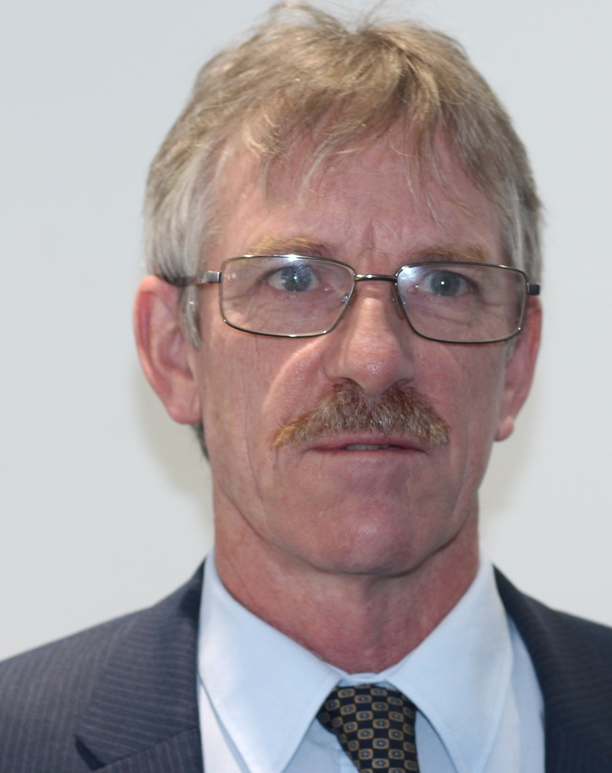
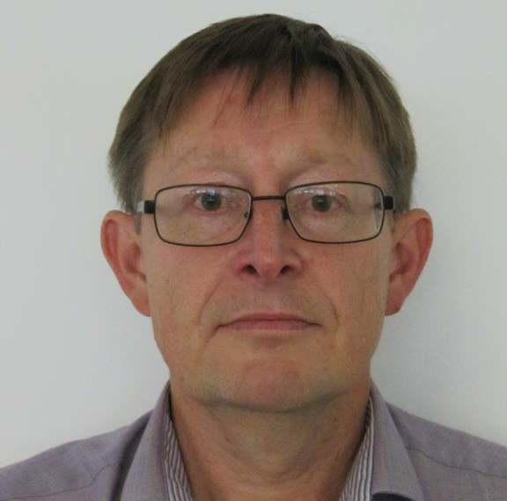
The Task Group Team
Toria Thomas
Arup - Chairperson
Liz Bennett
Habilis
Paul Boddy
Interserve
Mike Boyland
Highways England
Paul Brown
WSP
Tim Goddard
Arcadis
Doug Potter
Arcadis
Mark Riordan
Amey
Roger Swainston
Jacobs

Slide 11
Customers. Employees. Supply Chain.

