Slide 1
DUST
Highways Health and Safety Hub

Slide 2
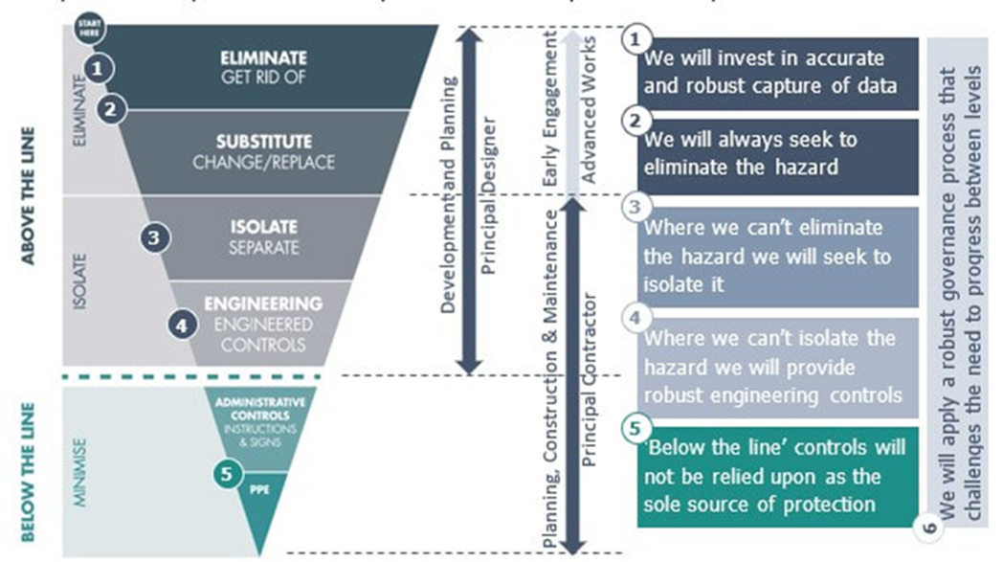
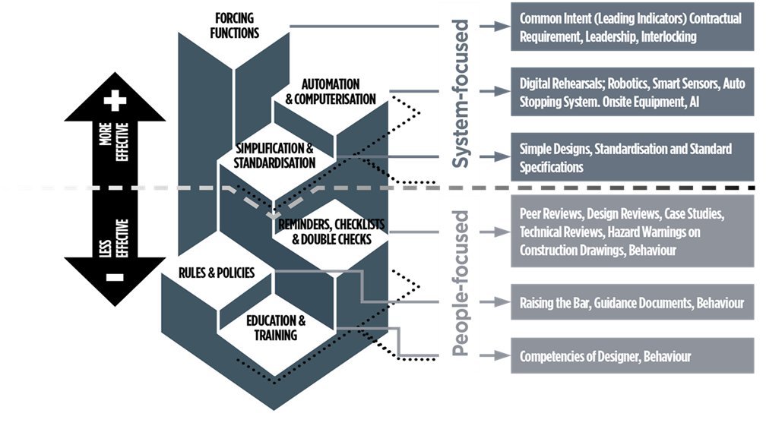
Highways Health and safety Hub
DUST
The latest Hub health and wellbeing campaign is aligned too the strategic direction of the Supply-Chain Safety Leadership Group (SCSLG) ‘Health and safety by design’ common intent document and significant risk thinking focusing on ‘Above the line’ controls and the ‘Hierarchy of intervention effectiveness’.

Slide 3
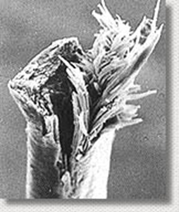
Highways health and safety hub
DUST
WHAT IS DUST?
Dust is defined as a collection of particles of one
or more substances with a particle size of between 0.1 and 100 μm (1 μm = 0.001 mm).
Inorganic fibres – asbestos & man-made
mineral fibres
Inorganic dusts – silica, metals, minerals
Organic dusts – wood & MDF
Gases, vapours & mists – resins/ solvents
Fumes – e.g. Diesel

Slide 4
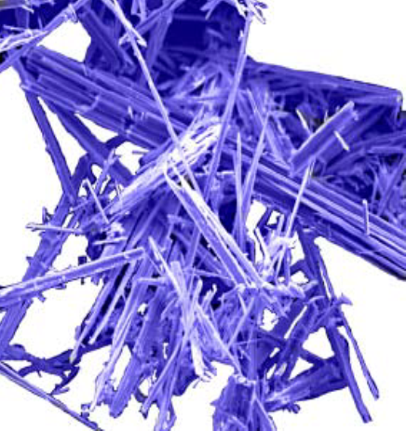
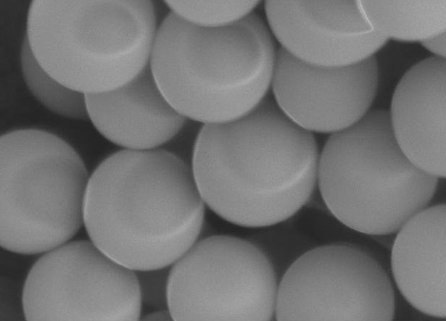
Highways health and safety hub
DUST
Asbestos fibres, if inhaled, can cause severe health damage incl. asbestosis, lung cancer and mesothelioma
There is no known safe exposure limit for asbestos. It may take up to 30 years before you develop symptoms of disease.
Silica is one of the most abundant materials on earth. Used throughout all sectors of the construction industry.
Most commonly found in bricks, blocks tiles & concrete.
Risk to health when particles of dust enter the lungs.
Invisible particles 5microns (0.005mm) or less embed in lung tissue.
The dust you can see is not the most dangerous.
Particles can remain suspended for up to 8 hours.

Slide 5
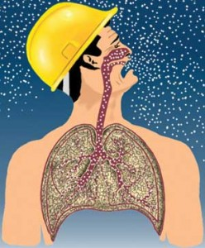
Highways health and safety hub
DUST
The main issue
450,000 UK workers regularly exposed to Respirable Crystalline Silica (RCS).
Over 500 deaths a year directly linked to silica
All trades in construction encounter RCS.
Minimise health risks of all dusts to operatives.
Minimise health risks to co-workers.
Recommended method of compliance by HSE.
The Effects of exposure
Silicosis – A slow progressive irreversible illness causing breathing problems and deterioration of the lungs.
Occupational asthma.
C.O.P.D.(chronic obstructive pulmonary disease)
Rhinitis.
Skin irritations

Slide 6
Highways Health and Safety HUB
DUST
Below are some examples of above the line thinking during design regarding dust
Design
Eliminate - Limit number of cuts during design / layout - Design out high dust methodologies / Specify non-hazardous materials / use of off-site manufacture
Substitute – Silica free abrasives to reduce the risks when blasting
Isolate – Bursting, crushing, cutting, sawing or other techniques / consider where waste material is created and how frequently removed / Identify where silica may exist throughout stages of project and ensure physical barriers are used such as containment
Engineering Controls
Admin Controls – PC to identify additional control methods for any residual risk

Slide 7
Highways Health and Safety HUB
DUST
Below are some examples of above the line thinking during Construction and Maintenance regarding dust
Construction and Maintenance
Eliminate – Limit number of people that need to be in work area / use remote controlled equipment
Substitute – Use a different tool – e.g., a block splitter instead of a cut off saw
Isolate – a different method of work altogether – e.g., a direct fastening system
Engineering Controls – dust suppression / on-tool extraction / Local exhaust ventilation systems
Admin Controls- Occupational health surveillance / rotating those doing task / assurance of tasks being performed / dust monitoring / training
PPE – RPE / maintenance of face fit testing compliance (clean shaven etc.)

Slide 8
Highways health and safety hub
DUST
The Health and Safety Executive’s current health campaign is called ‘Dust kills ’. And is focused and dust exposure in the construction industry. The campaign contains lots of useful resources for employers and employees. Including video clips and information relating to how to focus on eliminating exposure – by focusing on ‘Above the line’ controls.
https://workright.campaign.gov.uk/campaigns/construction-dust/
HSE Videos on Dust

