Slide 1
Services Campaign
In Too Deep

Slide 2
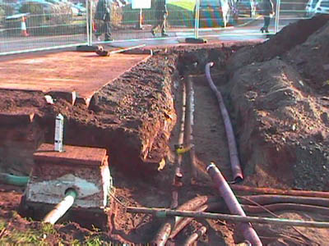
Today marks the start of the ‘In Too Deep” campaign
To help raise awareness of the risks associated with working near underground services, please take part in a special ‘In Too Deep’ Stand-up today. The stand-up is based on a real life film and is aimed at all employees and suppliers.
Please ensure that your team sends a completed attendance sheet to your local health and safety administrator.

Slide 3
Today we will cover
Why we are running this campaign
An outline of the campaign
Campaign resources
Obtaining feedback from the campaign
What we need from you

Slide 4
Why are we running a campaign?
PLAY ‘DOUGS STORY’ HERE

Slide 5
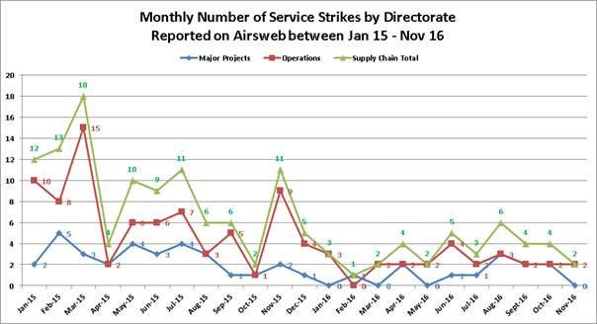
Why are we running a campaign?
We are continuing to have an issue on Highways England projects with service strikes as detailed below

Slide 6
High Potential
Electrical injuries can be caused by a wide range of voltages but the risk of injury is generally greater with higher voltages and is dependent upon individual circumstances. Torch batteries can ignite flammable substances.
Alternating current (AC) and Direct Current (DC) electrical supplies can cause a range of injuries including electrical shock, electrical burns, loss of muscle control and thermal burns.
We have been fortunate that there have been no life threatening injuries or fatalities

Slide 7
Objectives of the campaign
A shift of focus on to Design and Planning of Works
A commitment to the USAG (Utility Strike Avoidance Group) Charter
The use of the USAG BPAUS toolkit
Re-cap on permits to dig and how we can make improvements to current systems when undertaking diversion work
Re-cap on processes for services in concrete
Standards for CAT and genny used on site and for training of staff
Sharing lessons learned and best practice
This should help achieve a reduction in the number of service strikes on the network

Slide 8
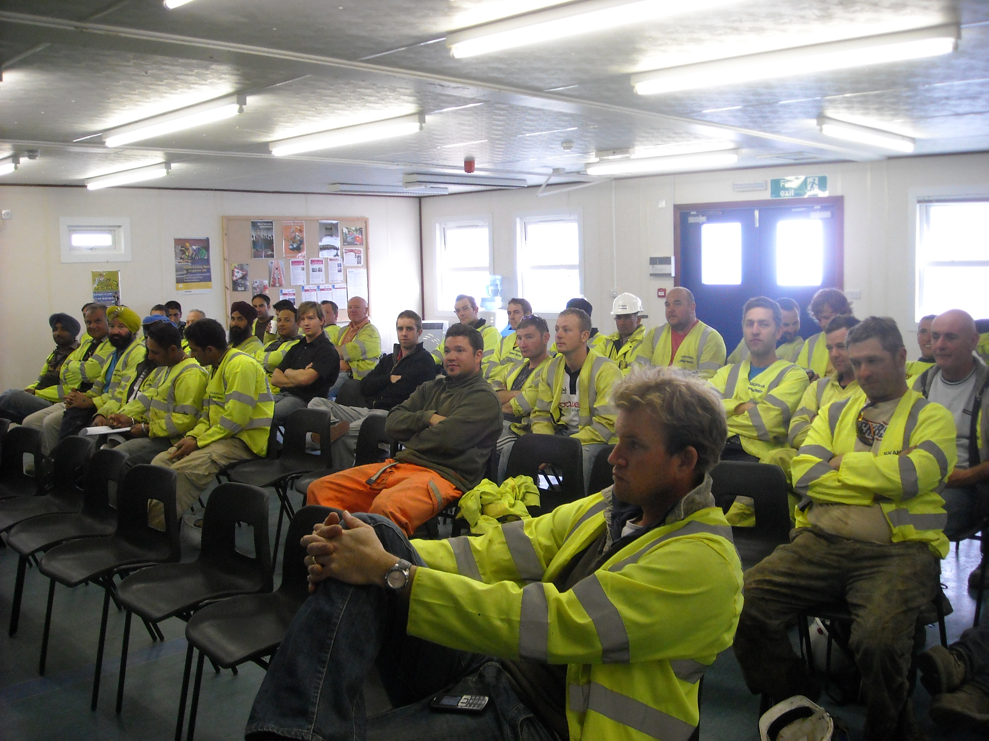
Supporting Materials
Resources will include posters, presentations, videos, tool box talks, Safety Alerts, best practice solutions from other projects for use of permits, selection of CAT & Genny etc.

Slide 9
What we need from you…
Promote involvement with the campaign and the use of the resources provided
Take photos of the campaign in action
Feedback during or after the campaign to help us review Raising the Bar 9 – Avoidance of Underground Services
Notes:
Daily emails

