Slide 1
Improving Health & Safety- National Highways PD WG CDM, the PD Role and PIR’s!
Gordon Crick, HSE
Construction division 13th October

Slide 2
Many DRM Approaches
One Principal designer
Design Brief
Design Plan
PD Role
CLIENT has a project
H&S PIR’s
Lead Designer
.
PCI
.
.
.
Business Need
Designers
Hazard Analysis and Safety Review(s)
Embed into Contract & Information Requirements
Early PD involvement
Procurement Strategy
Design Targets
& DRM requirements
The varieties of designer’s DRMs
all comply
Hazard Analysis
From Options to Justified Design Solution
PCI
Notes:
The survey indicated that respondents agreed that design risk management was improving as the project progressed from feasibility (40%) through concept design (58%) to detailed design (69%). At the construction stage, the level of agreement remained at a similar level (67%).

Slide 3
Routine risks
Common to scope /ECI
Proven standard solutions /treatments
Routine mitigation and elimination
CAD Technicians
Graduate engineers
Design team managers
Provision of accurate models
Escalation Process
Selection of a single design solution for detailed design
Risk Tracking, elimination, reduction, control by
subsequent design information
Principal Designer – Design Plan - foreseeing risks and ensuring collaboration
Elevated
(significant) risks
Ownership
Signing off designs
Senior engineers
Discipline experts
Specialist suppliers
Third party checking
Collaboration between disciplines
Specialist input
Difficult problems solved

Slide 4
PD Role in
Construction phase
PD & PC Role in preparing Handover information and Health & Safety File
Information needed for future projects
Risks not eliminated by design
As built information
Relevant information abour repair, maintenance or replacement of plant and equipment
Design change/ deviation
Specialist design knowledge required
PC Role in
Design phase (ECI)
Unforeseen constructability issue
Routine activities
Skilled Workforce
Competent Supervision
PCI
Escalation Process
Principal Contractor Role in
Construction phase
Risk Tracking, plan, manage’
Co-ordinate and monitor
CPP
Principal Contractor – Construction Phase Plan
Elevated risks
Challenging activities
Site Engineers
Construction Managers
Supervision
Monitoring compliance
Detect and correct non compliance
Risk assessments
Safe systems of work
Manage temporary works and major risk activities
H&S File

Slide 5
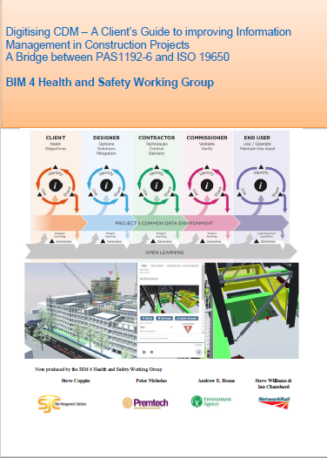
BIM 4 H&S Working Group Guidance for Clients
Available soon on UK BIM Framework Website

Slide 6
The Best Mix Approach
….using digital techniques, which integrate structured and unstructured information with geometrical models.
Most effective mix of;
3D & 4D Models
Coded standardised information
Free text narrative

Slide 7
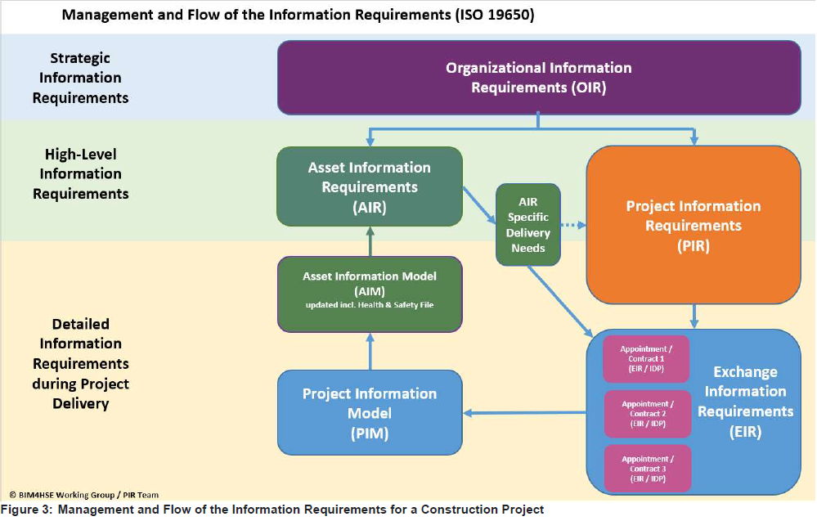

Slide 8
Asbestos
Temp Works
Lifting Ops
Set of 14 PIR’s Derived from PAS 1192-6:2018 The Project Information Requirement (PIR)
1. Provide and maintain digital Pre Construction Information
2. Appointing Party compliance and monitoring requirements
3. Establish a cross project digital H&S Information RACI matrix
4. Create a digital catalogue of lessons learned
5. To establish a project specific digital Skills and Training Matrix
6. Integrate elevated risk information into models and tracking tools
7. Maintain a schedule of risk studies and findings for the project
8. Maintain a table of H&S information shortfalls and gaps
9. Prepare a project specific design Plan for DRM,
10. Maintain safety critical digital design risk information for sharing and use
11. Integrate digital elements into Construction Phase Plan
12. Maintain validation and verification information, as built records
13 Capture and maintain details of all safety critical services and equipment.
14 A Health and Safety File that is appropriate to the characteristics of the project
Structural
Safety
Fire

Slide 9
8 Temp Works PIR’s
1 A project specific (digital) Temporary Works Pre Register (TWPR) shall be established by the permanent works designer
2 Designers or specifiers of temporary works shall produce 3D or 4D visualisations or digital rehearsals,
3 A minimum of one early design phase Temporary Works Risk Study (TWDRS),
4 The Principal Contractor, and Contractors where applicable, shall develop and make available a project specific Temporary Works Procedure (TWP)
5 A minimum of one Construction Phase Temporary Works Constructability Risk Study (TWCRS),
6 An Implementation Plan shall be prepared, including Safe systems of work, involving Risk Assessments and Method Statements,
8 A list of Temporary Works for O&M use in the built asset shall be established at design outset and handed over on practical completion
7 Digital monitoring techniques shall be utilised for temporary works

Slide 10
B.2 Information that will enable us to become an exemplar for health and safety
Note: the focus here is on putting in place “class leading” standards of Health and Safety information management to demonstrate that in this project, elevated risks (as defined in PAS 1192-6 Specification for collaborative sharing and use of structured health and safety information using BIM, BSI 2018 are managed using digital techniques, which integrate structured and unstructured information with geometrical models.
B.2.1 Organizational information requirements (OIR)
Policy: To be an exemplar organization for Health and Safety. Organization X aims to put into place “class leading” standards of Health and Safety information management in order to demonstrate that project risks are managed using digital techniques.
OIR The organization needs to maintain information systems that enable the identification and tracking of foreseeable elevated risks in design, installation and operation. This needs to be done at the earliest opportunity. Treatment and management of these risks shall be to an exemplary standard.
B.2.2 Asset information requirements (AIR)
Organization X has reviewed this OIR and has identified the following AIR as a result:
AIR To require the asset information model (AIM) to contain current elevated risk information complete with an audit trail, in a way that integrates structured and unstructured information with geometrical models. The information must include health and safety information that significantly affects the safe and healthy operation of the asset.
B.2.3 Project information requirements (PIR)
Organization X has reviewed its OIR and has identified the following PIR as a result:
PIR To require the project information model (PIM) to contain current elevated risk information complete with an audit trail, in a way that integrates structured and unstructured information with geometrical models. The PIM shall enable sharing and collaboration in risk management in order to optimise risk treatment in the project.

Slide 11
Delivery of IR’s --Moving Detail from PIR to EIR
From PIR to EIR – using ISO 19650-2 , 5.2.1
PIR
5.2.1b
Level of Information Need
5.2.1c
Acceptance Criteria
5.2.1d
Supporting information
5.2.1e
Key Dates
establish the level of information need required to meet each information requirement;
NOTE Other metrics to describe the status of information, such as level of accuracy, can be added to
these metrics as considered appropriate.
establish the acceptance criteria for each information requirement, and in doing so shall consider:
— the project’s information standard,
— the project’s information production methods and procedures, and
— the use of reference information or shared resources provided by the appointing party;
establish the supporting information that the prospective lead appointed party might need, to fully understand or evaluate each information requirement or its acceptance criteria, and in doing so shall consider:
— existing asset information,
— shared resources,
— supporting documents or guidance material,
— references to relevant international, national or industry standards, and
— exemplars of similar information deliverables
establish the dates, relative to the project’s information delivery milestones and appointing party’s
key decision points, that each requirement has to be met, and in doing so shall consider:
— the time needed by the appointing party to review and accept information, and
— the appointing party’s internal assurance processes.
From ISO 19650 -1 Level of Information need is .. determination of quality,
quantity and granularity of
information

Slide 12
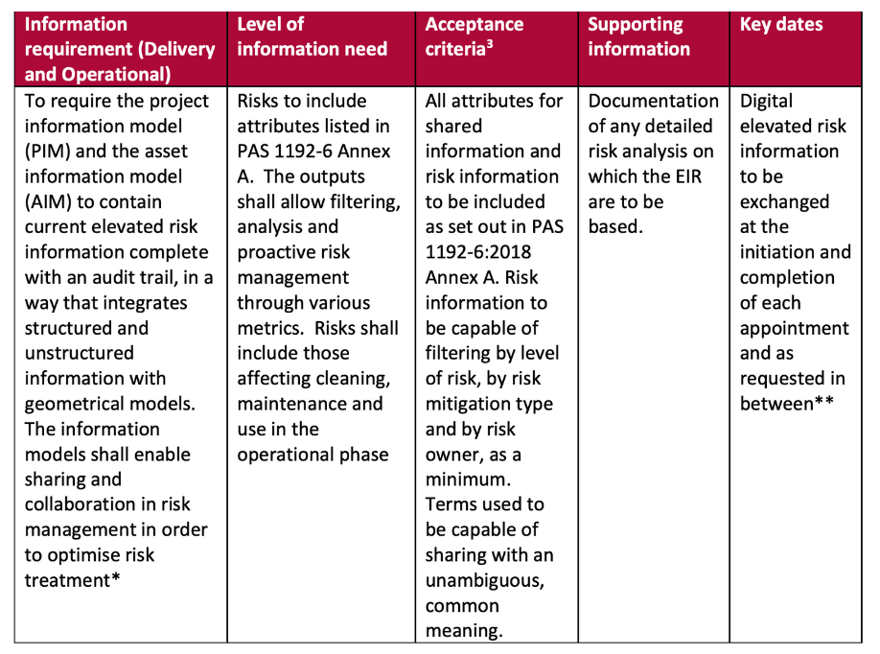
*Note that because it is likely that multiple appointments may be working with risk information then this EIR will appear multiple times (i.e. for each relevant appointment).
** Risk information may be required by the appointing party at any time during an appointment.
Acceptance criteria- In addition to any requirements set out in the information standard and information production methods and procedures

