Slide 1
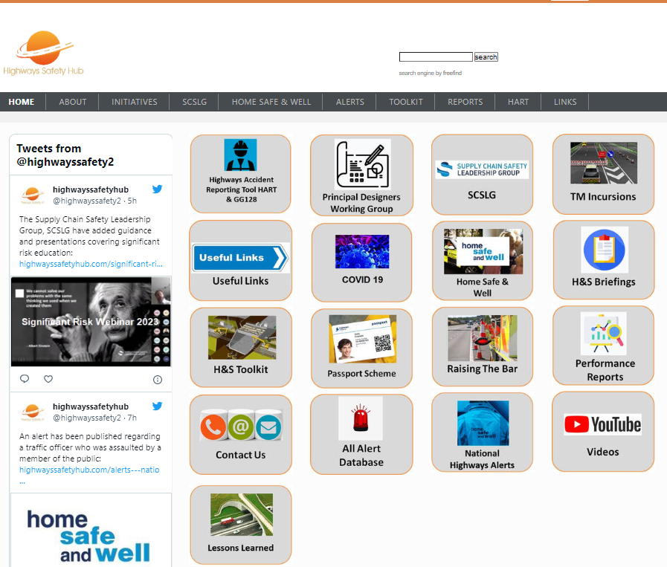
PDWG Task Group – Safety Shares Summary on a page
Purpose of the Meeting –
to review next 4 draft safety shares 18, 19, 22, 23 to finalise or for 2nd draft, , and
to review status of other draft shares that have been potentially identified.
Attendees
Martin Partington (Jacobs) - Chair
Doug Potter (Arcadis)
Sophie Gwynne (Arcadis)
Pav Singh (Arcadis)
Attendees
Jim Gallagher (National Highways)
Sam Allin (Jacobs)
Paul Brown (WSP)
Apologies
Rob Butcher (Jacobs)
Meeting Summary -
Paul Brown joined the group in February, bringing value from his work within the Hub and the RtB 26, and bringing in a new draft share around designing verge channels
February session also reviewed 2 other new shares
Designing to reduce occ health issues for strimming
Instability conditions for formwork design
March then reviewed 3 shares
1 finalised
019: risks associated with drones
2 need more work
022 danger to travelling public – temporary works access/egress points
023 cables on strategic road network during temporary works design phase
Pav shared several case studies relating to drone use, that can’t be found elsewhere on the SafetyHub website at the present time: a new drone lessons leant area to be set up for the information
Next Meeting: Next meeting on Tues 25th Apr
17 shares finalised
Hit Lessons Learnt button

Slide 2
Finalised

Slide 3
DRAFT
Notes:
The shares don’t all just focus on how permanent design changes could be improved, but also information that designers can provide to the next phases through improved PCI information as in this case. The group is still exploring some of the safety share issues as to whether these are covered under the safety shares or whether they are covered under a construction safety alert.

Slide 4
DRAFT
Notes:
The shares don’t all just focus on how permanent design changes could be improved, but also information that designers can provide to the next phases through improved PCI information as in this case. The group is still exploring some of the safety share issues as to whether these are covered under the safety shares or whether they are covered under a construction safety alert.

Slide 5
Very DRAFT
Notes:
The shares don’t all just focus on how permanent design changes could be improved, but also information that designers can provide to the next phases through improved PCI information as in this case. The group is still exploring some of the safety share issues as to whether these are covered under the safety shares or whether they are covered under a construction safety alert.

Slide 6
Very DRAFT
Notes:
The shares don’t all just focus on how permanent design changes could be improved, but also information that designers can provide to the next phases through improved PCI information as in this case. The group is still exploring some of the safety share issues as to whether these are covered under the safety shares or whether they are covered under a construction safety alert.

Slide 7
Very DRAFT
Notes:
The shares don’t all just focus on how permanent design changes could be improved, but also information that designers can provide to the next phases through improved PCI information as in this case. The group is still exploring some of the safety share issues as to whether these are covered under the safety shares or whether they are covered under a construction safety alert.

