Slide 1
PRINCIPAL DESIGNER WORKING GROUP (PDWG)
Workshop
25th July 2019
Pav Singh
Associate Technical Director CDM HSEQ Services

Slide 2
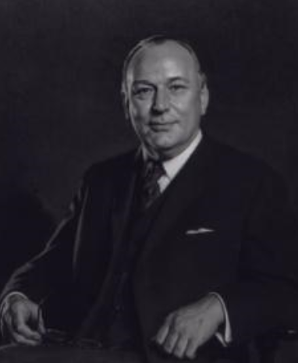
Design Risk Management Working Group
‘Those that create risk are best placed to manage it’. (Lord Robens)
The Designer is Accountable for the risks they create under CDM 2015.
‘The biggest single reason for accidents is Apathy (Lack of interest) in Health & Safety.’ (Lord Roben’s)
Proposal is to create Design Risk Management (DRM) as second working group.
Aim high but make it bite-sized pieces! (David Thomas TWF)
Notes:
BIM & it’s characteristics:
BIM evolves throughout the project life cycle; Plan, Design, Built, and Manage

Slide 3
Actions
We need your buy in today !
Who is the Chair for Design Risk Management Subgroup ?
Interface with HE Richard Wilson
Interface Andrew Finch - Whole life Subgroup
What are the outputs & how do we take this forward
Who wants to lead subtasks groups ?
What are the priorities ?
Who wants take ownership for delivery ?
Lets look at some topics and agree !
?
Notes:
BIM & it’s characteristics:
BIM evolves throughout the project life cycle; Plan, Design, Built, and Manage

Slide 4
DRM Development
Development of standardised DRM document integrating LEAN.
Improve consistency in mitigation undertaken by designers
Effective communication of risks on drawings including Significant Unusual and Difficult to manage by competent contractor.
Feedback from operation and maintenance
Including Safety Alerts and near miss
Communicate findings to industry via Safety Hub and CIRIA
Notes:
BIM & it’s characteristics:
BIM evolves throughout the project life cycle; Plan, Design, Built, and Manage

Slide 5
DRM – HE Standard Projects - Excel

Slide 6
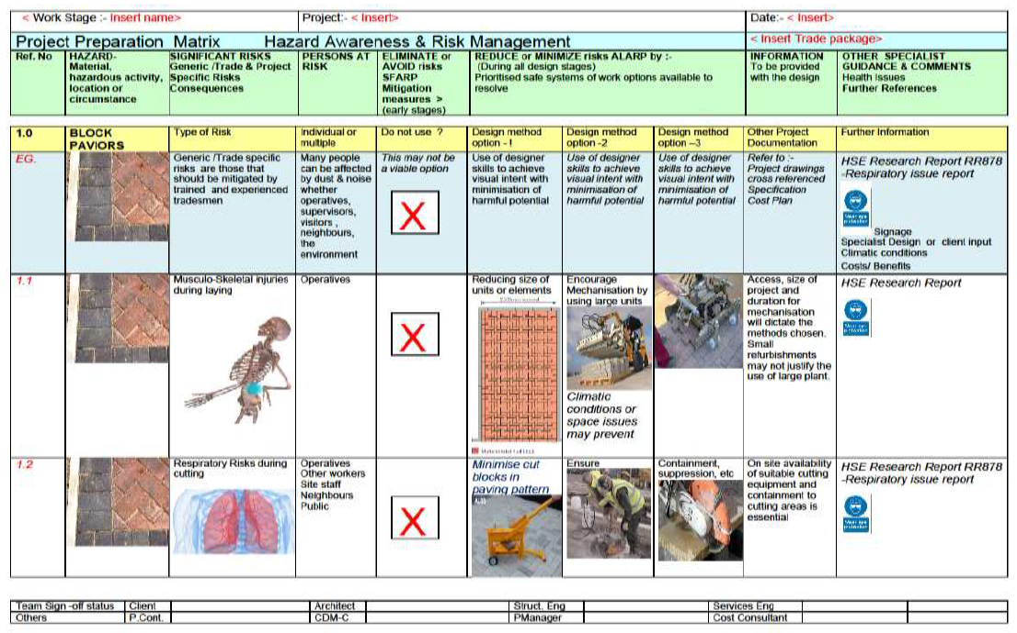
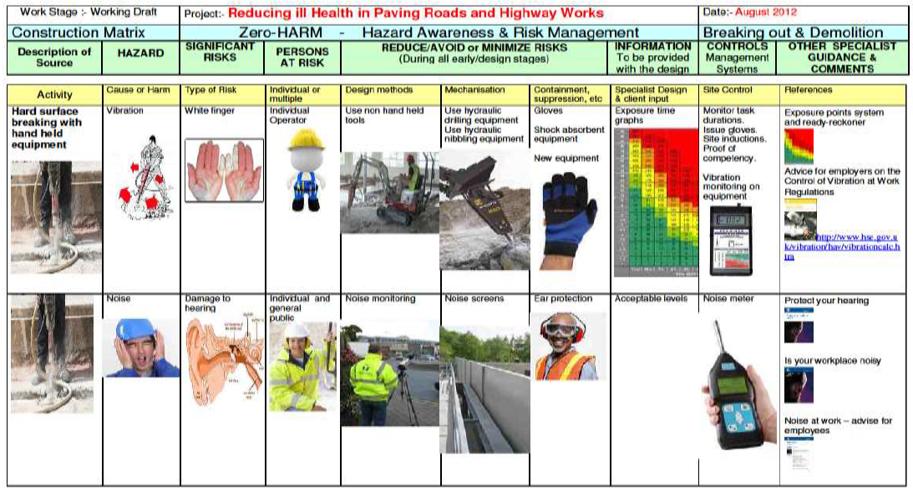
DRM – Visual Development

Slide 7
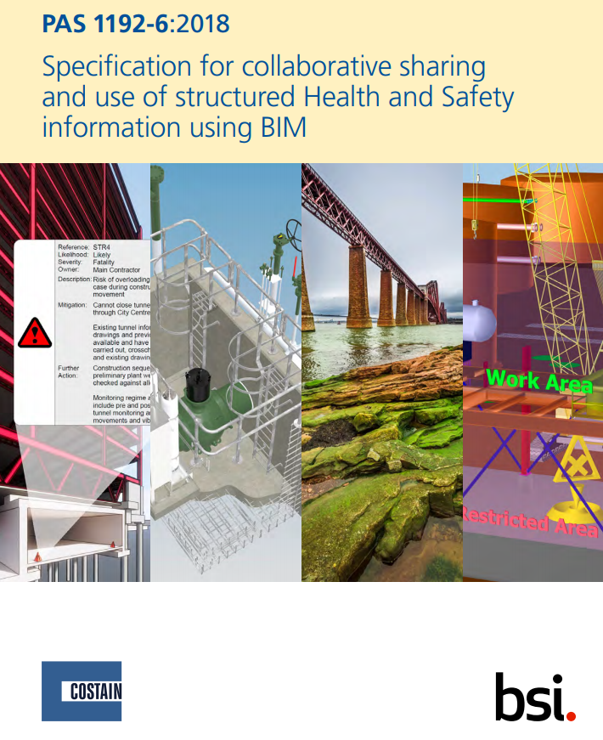
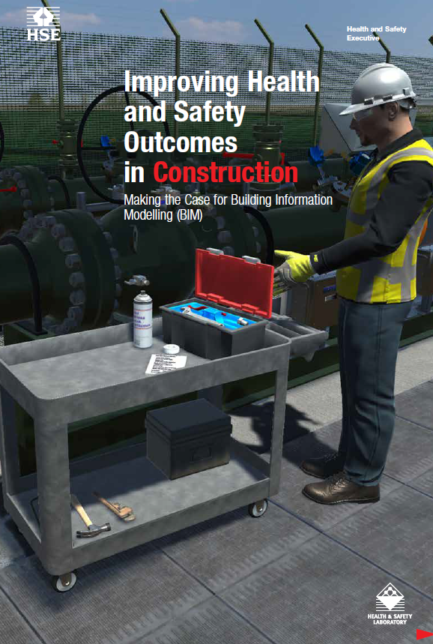
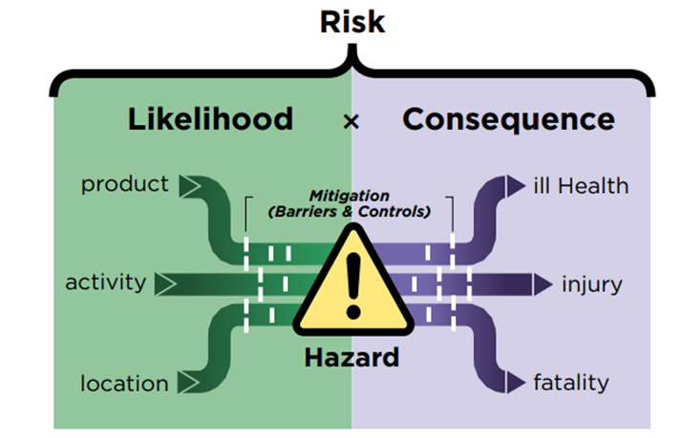
DRM using BIM and H&S
Clash detection
Coordination of Risks
Implement PAS1192-6
HSE Support
http://www.hse.gov.uk/Construction/lwit/bim.htm
Notes:
BIM & it’s characteristics:
BIM evolves throughout the project life cycle; Plan, Design, Built, and Manage

Slide 8
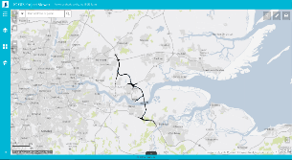
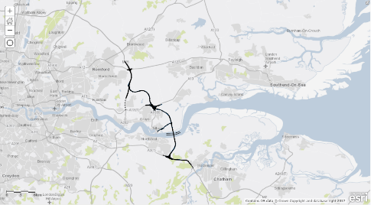
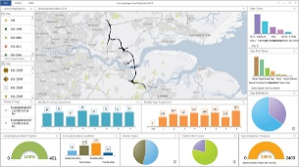
BIM GIS & H&S Future
Web Viewers
Vision –
Single source of truth
Maps
Operations
Dash boards
Mobile Apps
Subgroup looking at Design risk management using technology BIM and GIS – Feed into CIRIA ?
Notes:
BIM & it’s characteristics:
BIM evolves throughout the project life cycle; Plan, Design, Built, and Manage

Slide 9
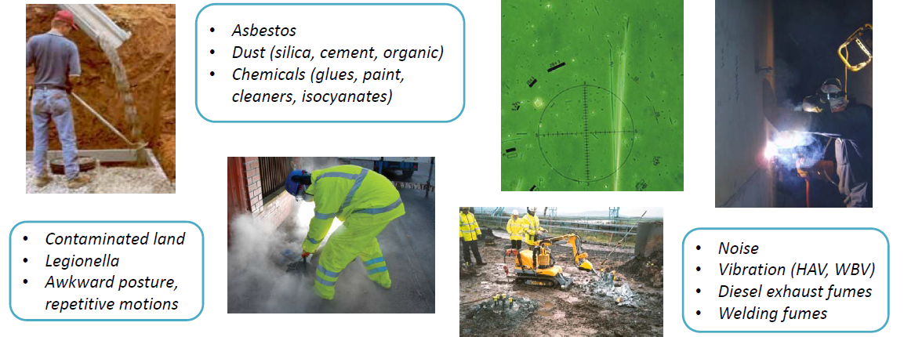
DRM – Health & Ergonomics
DRM working with Liz Bennet – Health by Design?
Notes:
BIM & it’s characteristics:
BIM evolves throughout the project life cycle; Plan, Design, Built, and Manage

