Slide 1
Principle Designers Group
Suicide Prevention

Slide 2

Welcome
Health Assured
Contact Health Assured 24-hour helpline – 0800 783 2808
Or go to the Health Hub
username: highwaysengland password: highways1
Call 116 123
Email Jo@Samaritans.org

Slide 3
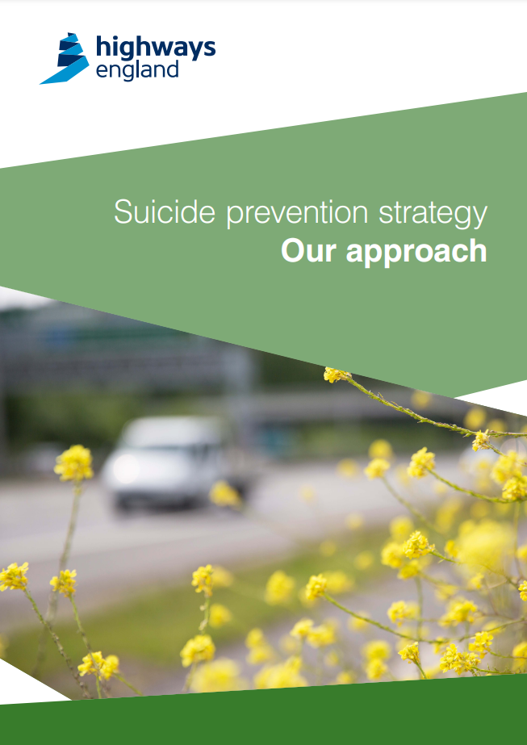
Strategic Case
4, 500 suicides in England each year. Suicide rates in under 25s are increasing.
Part of a cross-government approach.
The National Strategy committed to tackling suicide in six key action areas. One key area is reducing access to means.
In 2017 launched our suicide prevention strategy recognising suicide as a road safety issue.
As part of our Strategic Business Plan.

Slide 4

What do we know about suicides on the SRN?
2351
2796
2847
Estimated 50 suicides per year on our network.
Even more suicide attempts
Regional differences
Demographics similar to national statistics
We can identify specific locations and bridges where suicide attempts and suicides occur.

Slide 5

Road Related Risk
Middlesex University Research
Multiple research techniques
Accessibility, Familiarity, Lethality
Impact on others, intervene

Slide 6
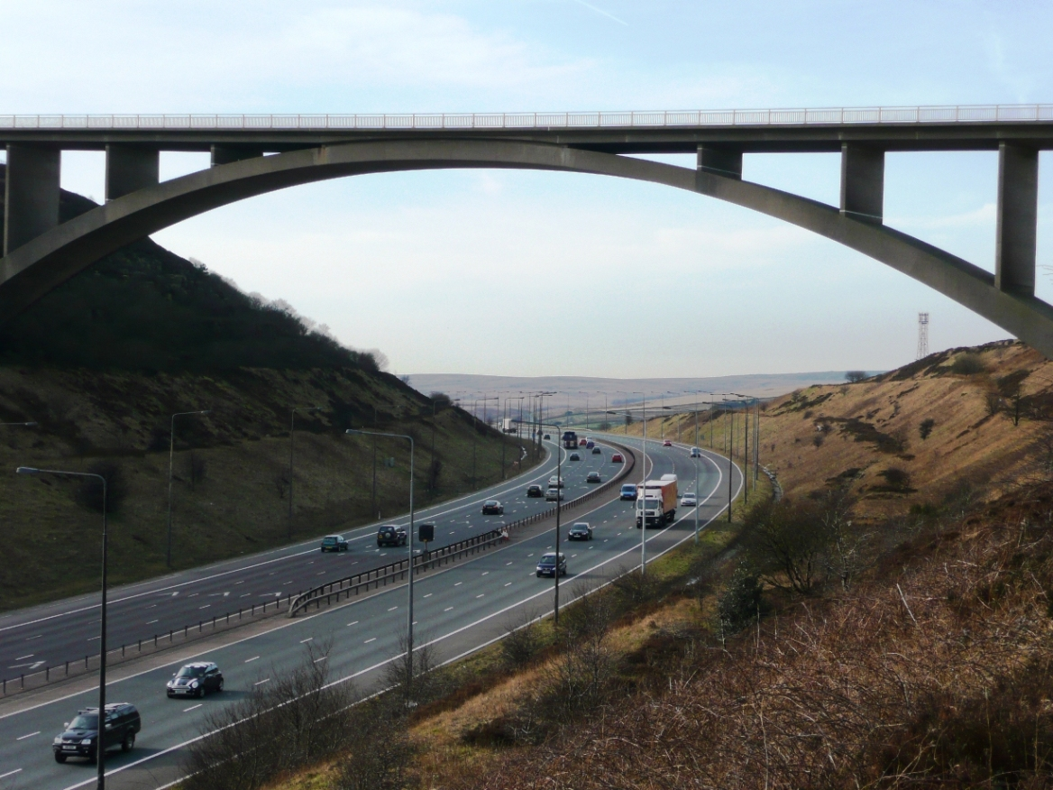


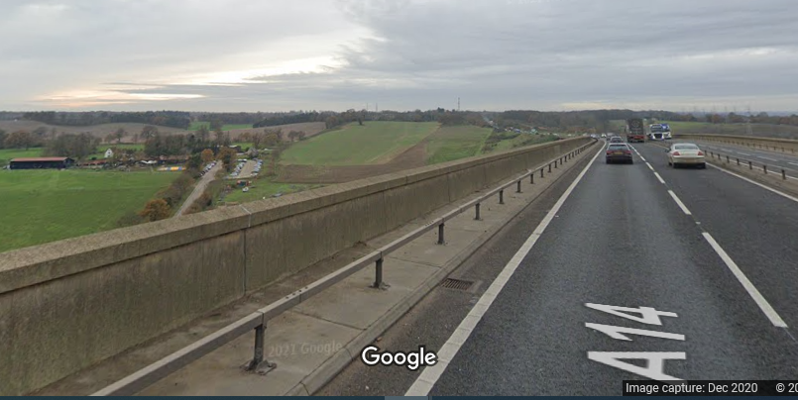

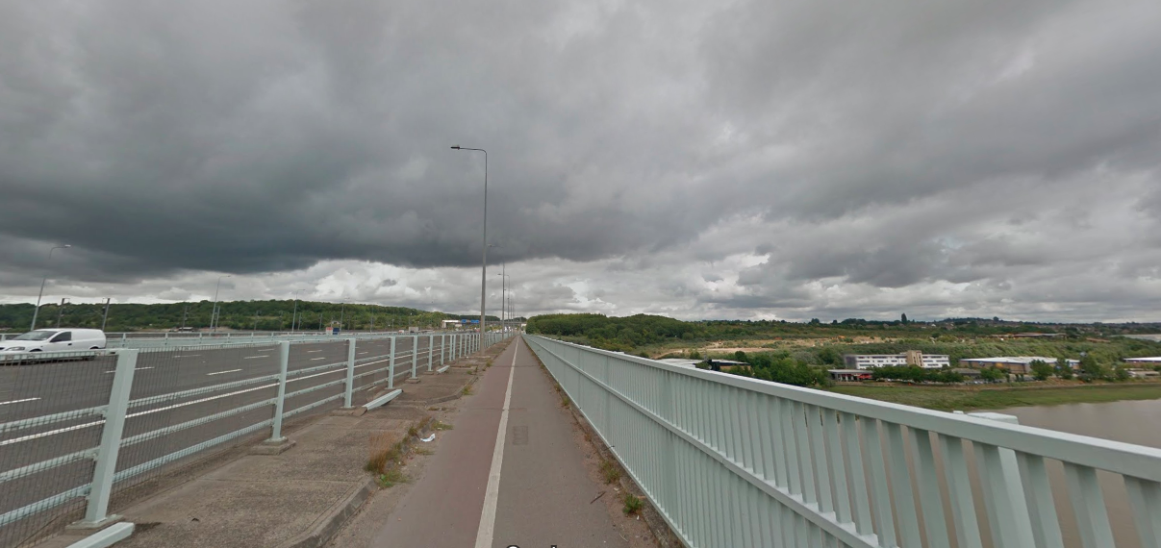
High Frequency Locations

Slide 7
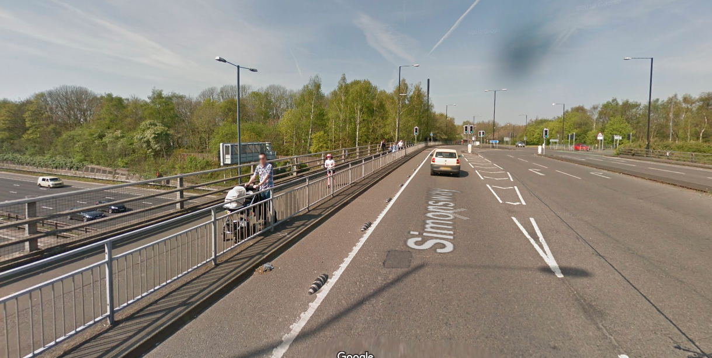
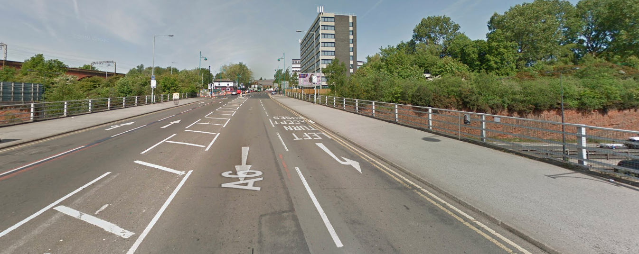
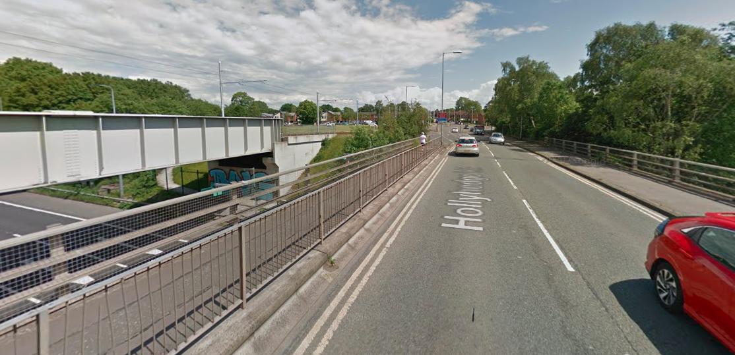
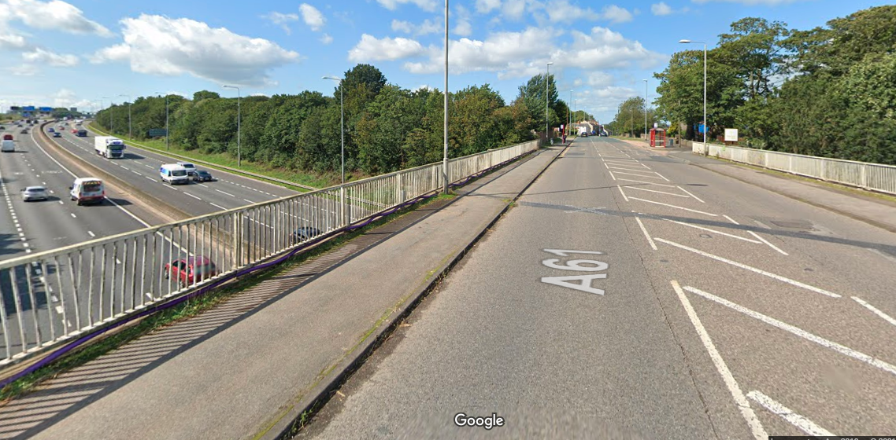
High Frequency locations

Slide 8
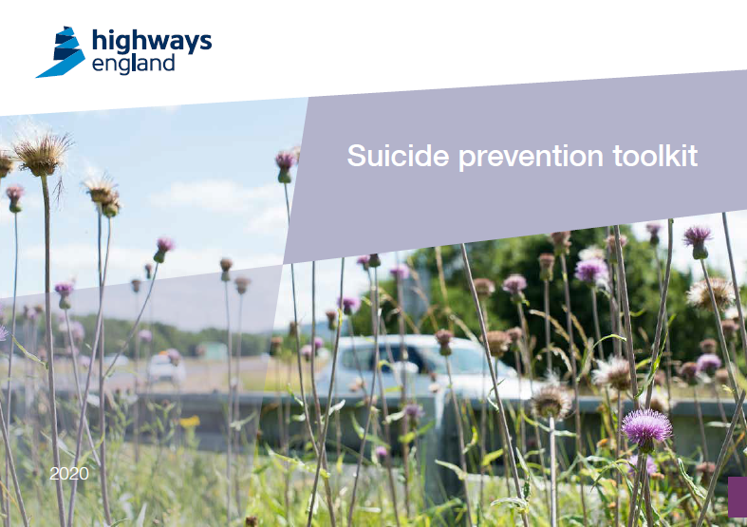
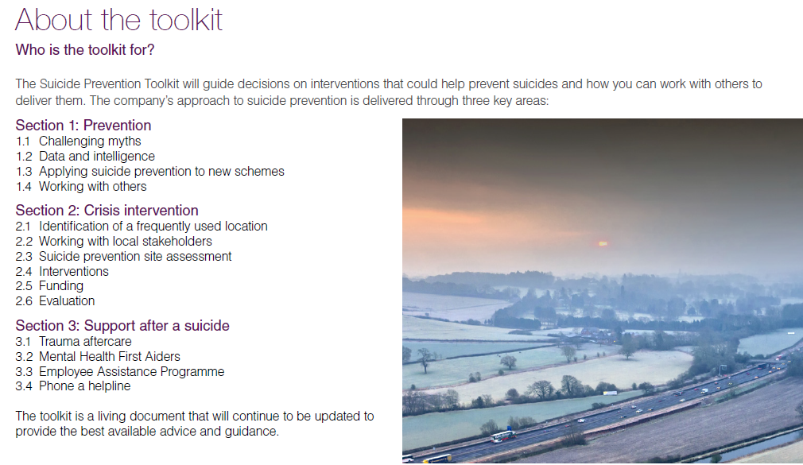
Suicide Prevention Toolkit

Slide 9
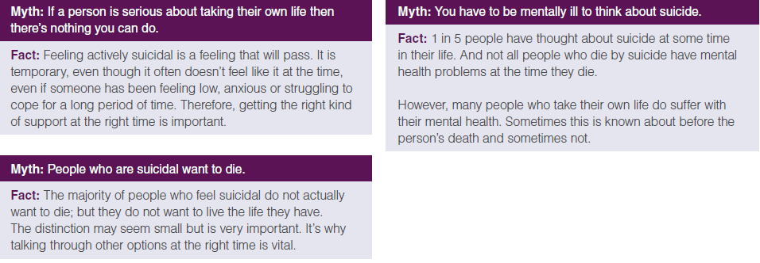
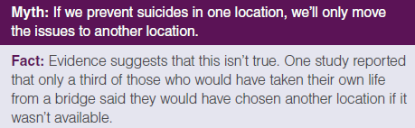
Breaking the myths

Slide 10


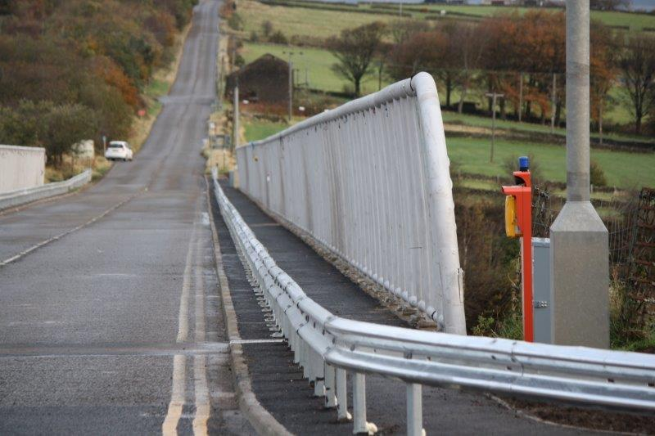

Interventions
Encourage people to seek help
Reduce access to means
Improve opportunity for intervention
Change the public image of a site

Slide 11
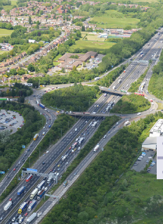
Thoughts to take away
Suicide risk should considered on the outset
Harder to retrofit - cost and design
Bridges designed for people
Balance –Safety and security with enjoyment and place making
‘Designing out Suicide’
Suicide Prevention Toolkit, site assessment and interventions.

Slide 12
Thank you – Any questions?

