Slide 1
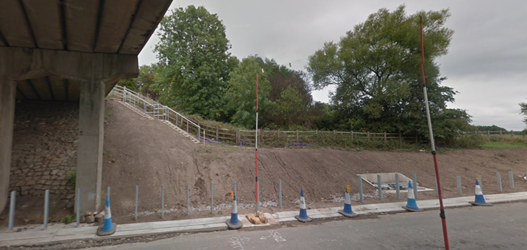
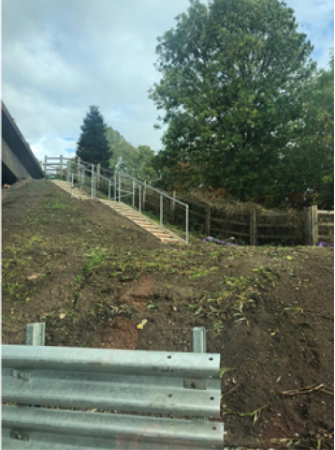
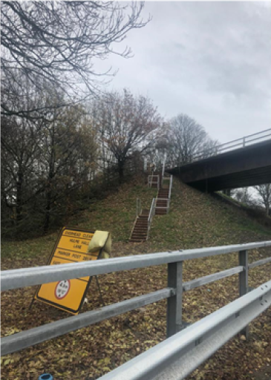
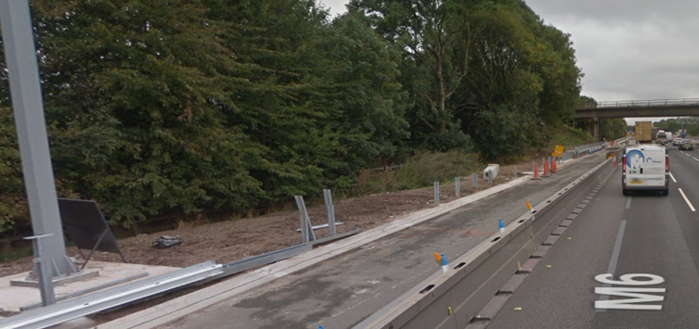
Off Network Access Considerations

Slide 2
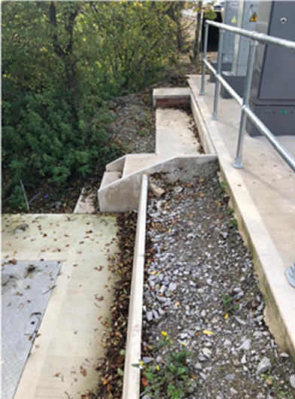
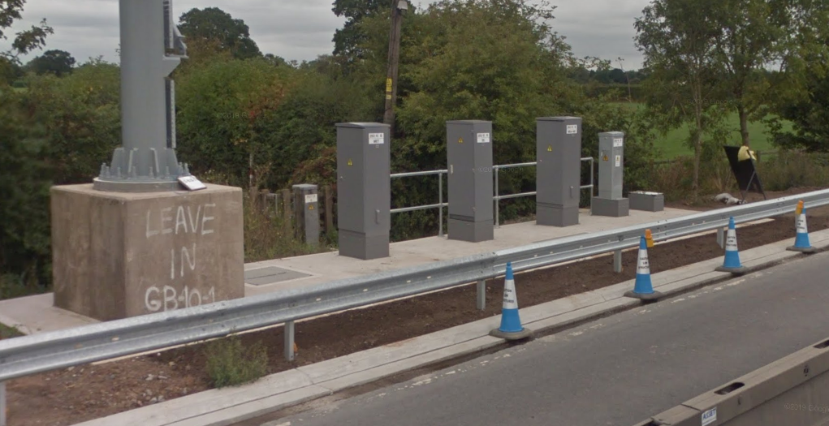

Slide 3
CDM Compliance
Route designed by the scheme to provide off network access.
Steps stop without a dedicated pathway.
Routes require operative to walk close to VRS adjacent to a live lane.
Some access is considerable distance away from asset.
Areas at height are unprotected.
Maintenance of steps and handrails essential to safe access – ASC/AD?
Condition of access/walking routes essential to safe access – ASC/AD?
Who within HE H&S Teams inputs to these designs?
Is the Health and Safety File detailing these access arrangements available?

