Slide 1
Ground Investigation Framework Activities
Richard Wilson, HSW Lead for Commercial & Procurement
May, 2021

Slide 2
Content
Overview
Areas of focus - engagement
Project update
  A66
  A27 East of Arundel
  A66
  M62 – Smart Motorways
LTC – lessons learnt exercise
RPS update

Slide 3
Overview
Since we commenced this focus upon Ground Investigation (GI) activities within the business, we have gained a better understanding of how the suppliers operate, their approaches, ability and how we can improve our approach
Engagement via the GI Community, those contributing to the GI Common Intent and LTC GI lessons Learnt review is beginning to open doors and allowing more challenging conversations regarding Health and Safety, and also the type of technical approach
Projects on site are progressing well and where we have questioned / commented upon standards or concerns they have led to discussion and revised approaches where necessary
GI lessons learnt on LTC is currently work in progress but is delivery some useful lessons learnt
Development of the SCSLG GI Common Intent is complete and the document is being shared with the SCSLG at the May meeting
Work is commencing on the GI Raising the Bar document with a publishing date of August / September

Slide 4
Areas of focus - engagement
The HE GI Community meets on a rolling two monthly basis and has healthy discussions regarding many topics including Health and Safety challenges themselves in a collaborative manner
HE GI Community has been actively attending workshops to develop the GI Common Intent, this work is now completed and a draft for approval will be presented to the SCSLG 17th May
Work is commencing on gather the thoughts for the Raising the Bar and a workshop is being held on 19/05/2021
We aim to deliver a good working draft by the end of July, 2021
The a launch August / September GI Community meeting
We are also encouraging the capture of lessons learnt which links into the lessons learnt exercise on LTC

Slide 5
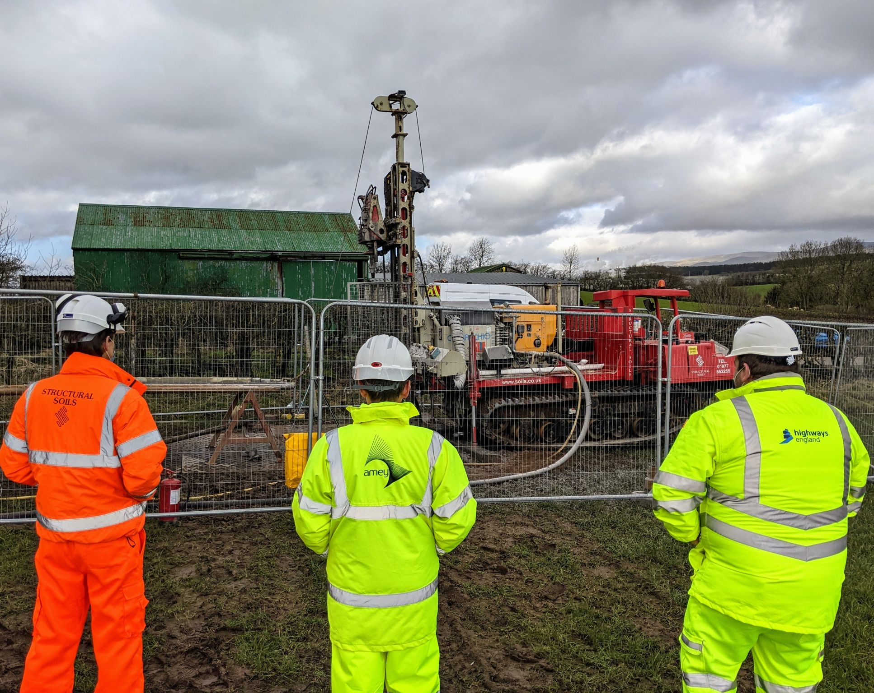
Project update

Slide 6
A 66 – contract let to Amey Consulting & (RSK) Structural Soils
Recent assurance findings:
The SSL site compound was well organised and tidy, with suitable welfare in place. Feedback was provided on aspects of cleanliness in toilets, but facilities were otherwise good.
SSL demonstrated the good relationships that had been made regarding land access and the team were clearly focused on minimising their impact. The Site Induction emphasized all the relevant health, safety, environment and stakeholder topics.
Sites were established with clear boundary fencing and activities observed were being well managed. Discussion with the teams about safe working methods indicated that appropriate control measures and suitable training were implemented.

Slide 7
A27 East Arundel
Second project to be appointed via the Highways England GI framework.
Arcadis have been appointed as Principal Contractor for the Phase 2 works.
Project is on site:
  Positive feedback from HE Project Delivery
  Number of HE assurance inspections have been undertaken upon the site, these items have been addressed quickly and effectively, typical findings being:
    Plant people interface, site layout modified
    Confused management of permits to work, resolved via new process
    Management of external repair team working in compounds
  Overall, encouraging and when issues are raised they are not repeated and the site is reported to have a positive safety culture.

Slide 8
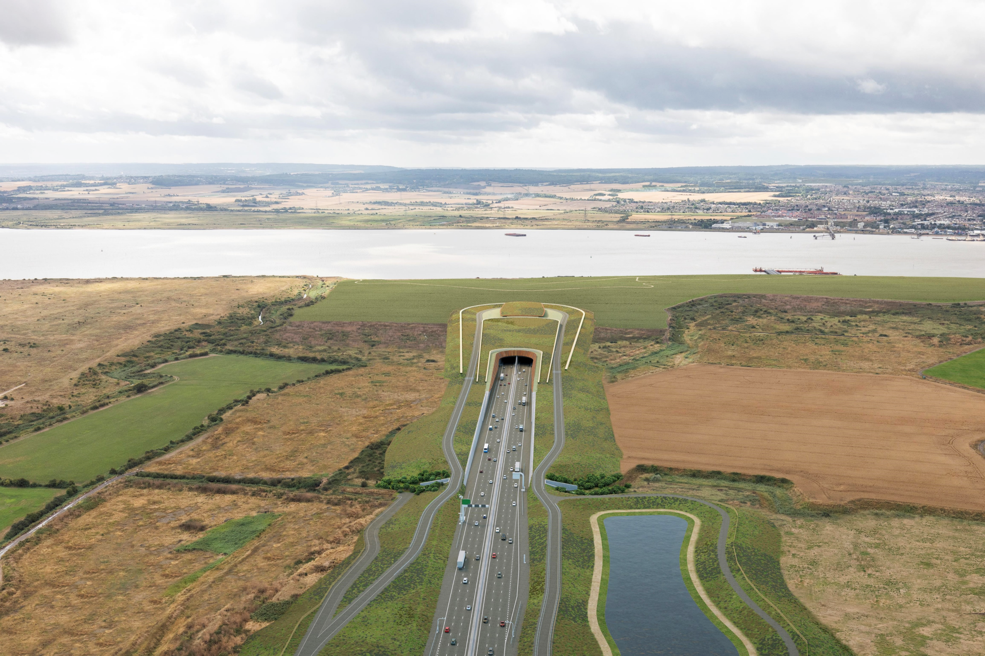
Lower Thames Crossing (LTC)
Lessons learnt exercise on the three phases of the GI works;
  interviewing all the GI contractors
  plus the Principal Contractor
  the output from the task will be shared via:
    HE GI Community
    HE GI Framework Management Team
    HE GI SES Team
    HE Ops and MP as appropriate

Slide 9
Lower Thames Crossing (LTC)
GI package was appointed via the LTC Cascade to AECOM
We are currently undertaking a lessons learnt exercise with the GI contractors and Principal Contractor (PC), we aim to have this programme completed by mid May. The lessons learnt from this task will be shared at the GI Community meeting in June, 2021.
High level lessons learnt:
Positives
  ECI – worked well and was welcomed by those GI contractors who were appointed in a timely manner
  Phase three of works – welfare facilities and site setup were very good and welcomed
  EPIC training provided an opportunity to reflect on a different approach to addressing Health & Safety
  One site independent plant checks were useful but not everyone agreed with the findings
Negatives
  Re-writing method statements , etc into Perfect Circles format added work and created confusion to the workforce
  Phase one and two – Perfect Circle struggled with the role of PC in site setup, articulating expectations and their teams were learning on the job
  Design information was not always detailed enough or timely
ADVICE
ASSURANCE

Slide 10
RPS - update

Slide 11
RPS – HE GI Framework Contractor
RPS have completed their works on A303 Stonehenge feedback from project team and the independent Health and Safety inspections who undertook weekly reviews, highlighted:
  the low risk activity of pumping tests were completed without any lost incidents or HIPOs
  in reviewing the performance of the contractor with the project team, Health and Safety inspectors and the GI Framework Management Team, a decision has been reached to continue the suspension of them from the framework
  It was felt that whilst RPS has further developed their process / procedures to reflect the role of PC, the behaviours and culture were not to the standard we expect from our supply chain partners
  We continue to work with RPS to support them to address their approach.

