Slide 1
Supply Chain Maturity Matrix
Author: Teresa Moss
January 2021

Slide 2
SCMM
Previous version 228 questions using an excel spreadsheet
Revised to 30 Questions
Aligned to Home Safe and Well focus areas / Hudson Parker Model
2 Beta tests carried out with supply chain members – feedback incorporated into new version
New version is via Microsoft forms
Automatic Power BI Reporting (based on submission responses)
Provides overall rating based on submission
Areas for action plan
Action Plan template created

Slide 3
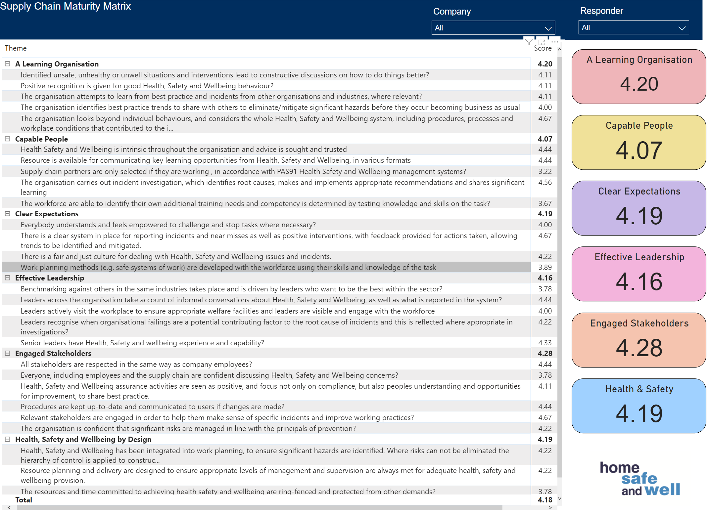

Slide 5
Next Steps
Communication of new SCMM Plans and guidance
Go live February 2021

