Slide 1
PDWG Highways Safety Hub Update
May 2022

Slide 2
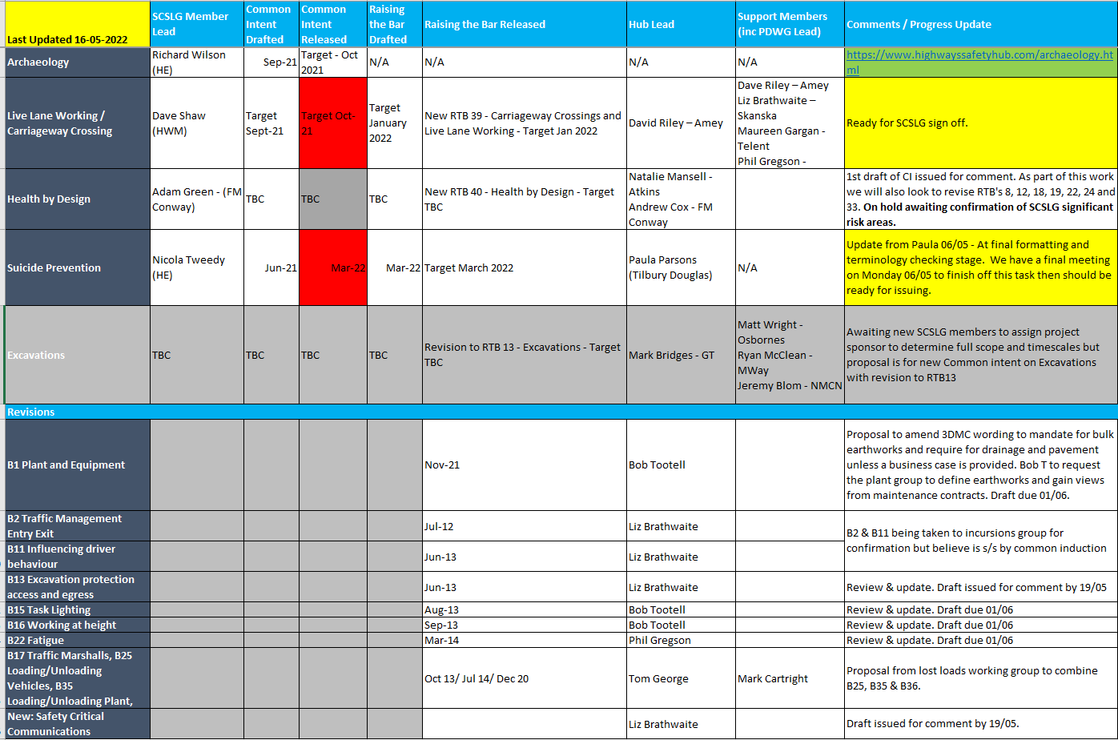
Common Intent & RtB Progress

Slide 3
Key Topics (April & May):
Carmont learnings – applicability to Highways.
https://youtu.be/6iP0PJMu_8s
Utility avoidance – M42 Learning – Skanska &
Augmented Reality Utility Avoidance – FM Conway
Highways Passport – agreement to add confirmation of medical and date of expiry.
Sub group to trial competencies for specific job roles.
Deployable IPV – Amey
Support request to pre review before review at NSCRG
Gantry Access – Handrail height.
Alert being produced to encourage reporting of sub standard handrails to understand the extent of the issue.
Newsletter
newsletter_april_2022.pdf (highwayssafetyhub.com)
Deployable IPV

Slide 4
SCSLG Significant Risk Areas
Next Steps: Topics being reviewed against HART data.
3-4 will be chosen to start, others will be later in program.
If you are in an existing working group in one of these topic areas please let Andrew Cox know.

Slide 5
Questions?

