Slide 1
Principal Designer Working Group Event No 26
Health and Safety Files Digital Development
Mark Lamport, Arcadis

Slide 2
Task and Finish Group Kick-Off Meeting
Task and Finish Group Kick-off Meeting held on 18/1/2022
Next meeting to be held in April 2022 - date TBC

Slide 3
Task and Finish Group Team
Mark Lamport – Arcadis
Doug Potter - Arcadis
Natalie Mansell - Atkins
Tim Bowes – Atkins
David Owens – WSP
Rob Butcher – Jacobs
Richard Wilson – National Highways, PDWG Chair
Kevin Clague - National Highways, Asset Needs Manager - Operations NW
Darren Allen – Telent
Jon Horrill – WSP
Jason Glasson (National Highways, Head of Asset Management ) to be invited to the next meeting

Slide 4
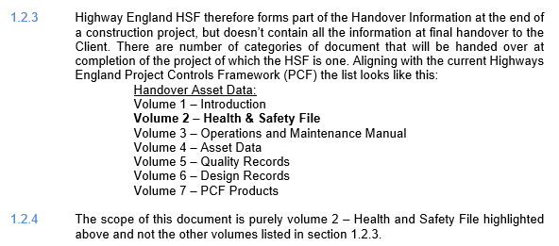
National Highways CDM Standard H&S File

Slide 5
Current Actions
Asset Information - H&S Improvement in Data Management Steering Group (last meeting on 22/3/2022) working on alignment of PCF products with new CDM Standards and H&S File Template eg Civils Maintenance (AD/MAC/ASC) Handover Document and Certificate (Stage 6) PCF product needs to be brought into alignment with the new H&S File Template (Stage 2 product)
IAN 105/08 likely to be withdrawn and not replaced
National Highways BC to be modified to reflect 7 volume handover asset data structure
Rationalisation of National Highways MP BC structure (?10 volume or 12 volume) with 7 volume structure in H&S File template
Terms of Reference (Scope, Objectives, Outputs and Timescale) for T&F Group is being developed for discussion and agreement
Interface with BIM 4 Health & Safety Working Group led by Andrew Rouse and Gordon Crick looking at integration of H&S into BIM

Slide 6
Future Actions
Establish which other National Highways groups are working on H&S File digitalisation, what have they done already, how can our T&F Group interface with/support them?
Establish what PDWG member organisations are already doing on H&S File digitalisation?
Establish end-user requirements:
What information do Principal Contractors and O&M organisations need from the H&S File?
In what format?
On what platform - GIS, BIM?
What should the information flow process look like?
How do we ensure a consistent approach?
Ensure alignment with National Highways 5 Year Digital Transformation Plan

