Slide 1
Topic 1 Innovation in the design of TM Steve Smith, Virtus TM (Steve to share slides)

Slide 2
Scheme Focus – 1 What have we been doing on our schemes Traffic Management wise? A46 Newark to Widmerpool A1 Morpeth to Ellingham A66 NTP

Slide 3
A46 Newark to Widmerpool

Slide 4
A46 Newark to Widmerpool
Good practice:
Construction of temp footway to permanent standard due to duration and use over winter – allowing significant separation of pedestrians from work area.
Implementation of safety camera van on first full closure to try to dissuade any incursions and record any that do occur.
Marshalling of pedestrians and homeowners through works during overnight closures to maintain NMU routes and access to properties.
Use of strategic MS3 to display message about closure on non-SRN road.
Lessons Learnt:
“Road Closed Ahead” signs on approach to works – 8 additional sets of signs implemented on road on approach to road closure due to non-compliance with diversion route by road users and high frequency of turn-arounds, despite signing previously being compliant. Issue with either diversion fatigue or lack of trust in signage for historic reasons.
Implementation of temp signals on “rat run” near road closure (not on formal diversion route) experiencing increased flow of traffic due to rerouting of traffic by google maps/satnav. Issues at existing bridge constraint.

Slide 5
A1 Morpeth to Ellingham

Slide 6
RIP North WH&S Forum
Jan 22: Traffic Management
A1 Morpeth to Ellingham
Scheme currently preparing for construction – due to commence site works c. October 2022
Key learnings to be taken from Costain wider business and specifically Testo’s & Downhill Lane, Scotswood and Birtley schemes
Focus areas for us in planning our TTM:
Use of stop vehicle detection on our temporary CCTV – to improve safety and customer experience
Priority green traffic signals – utilising data based learning to alter light timings to suit traffic flows
Smart temporary sign frames which will alert TM crews if blown over, removed or dropped.
Full length temporary VRS with built in refuge areas for improved customer and workforce safety
Enhanced rolling carriageway closures for the safer installation of TTM
Variable customer information signs – relaying pertinent and relevant information throughout the scheme for instance seasonal messages, updated construction messaging etc.

Slide 7
A66 NTP

Slide 8
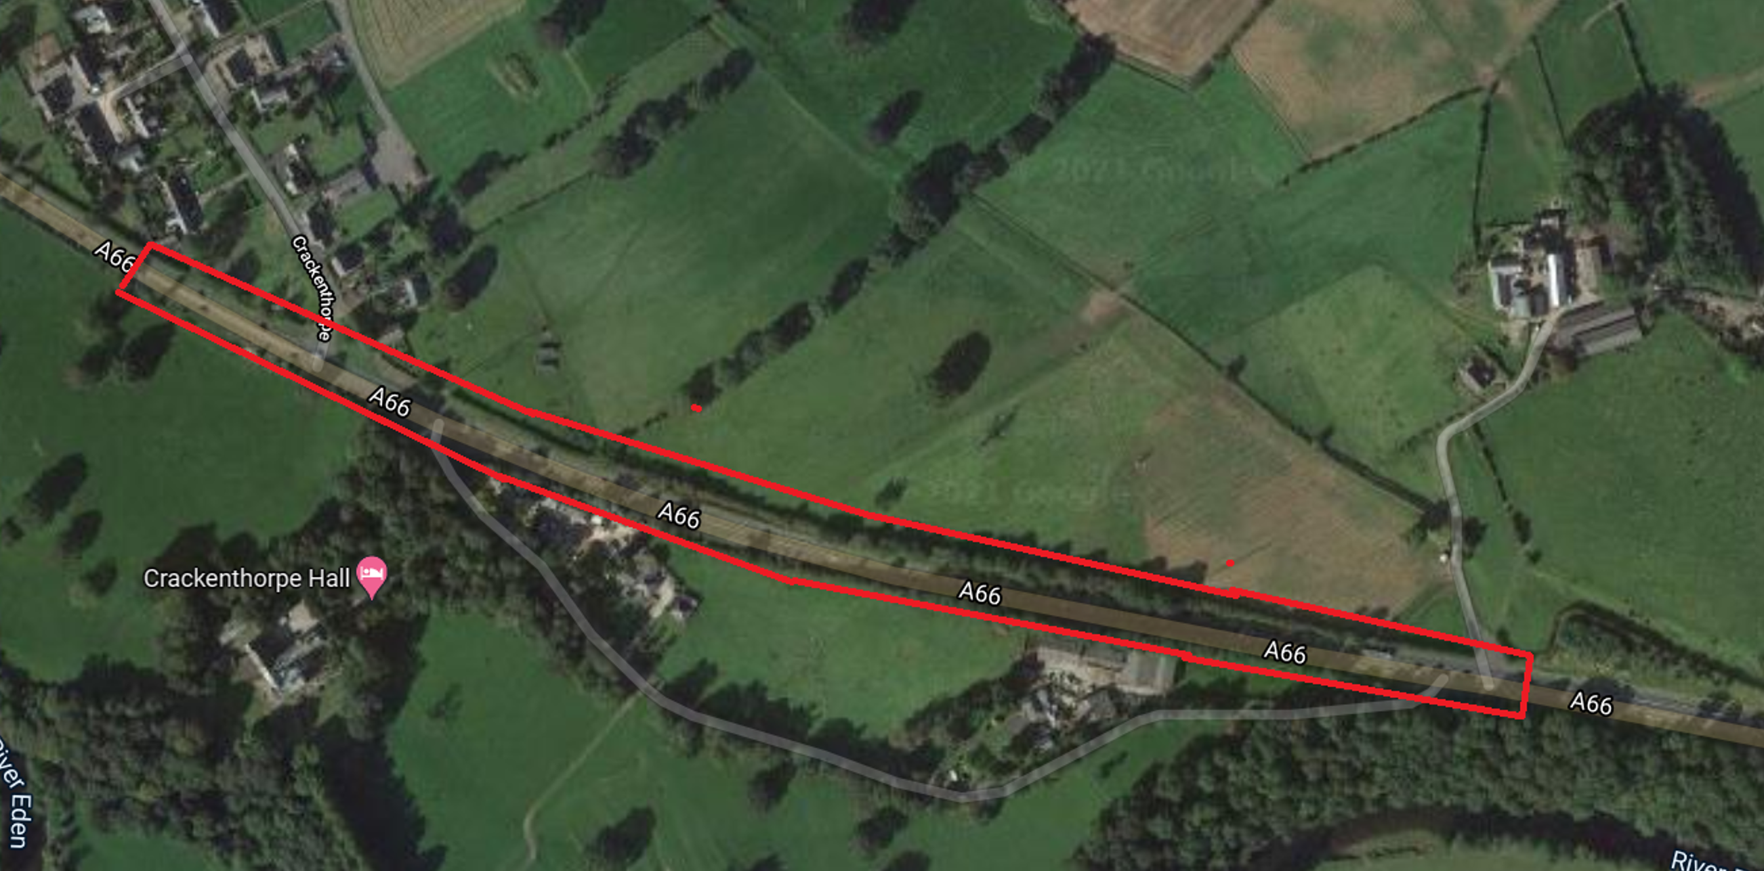
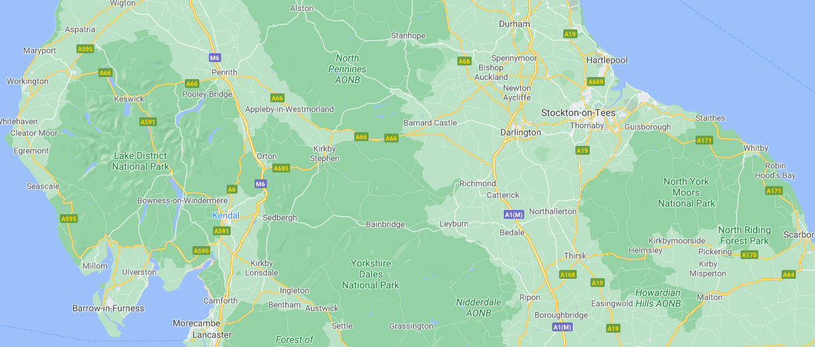
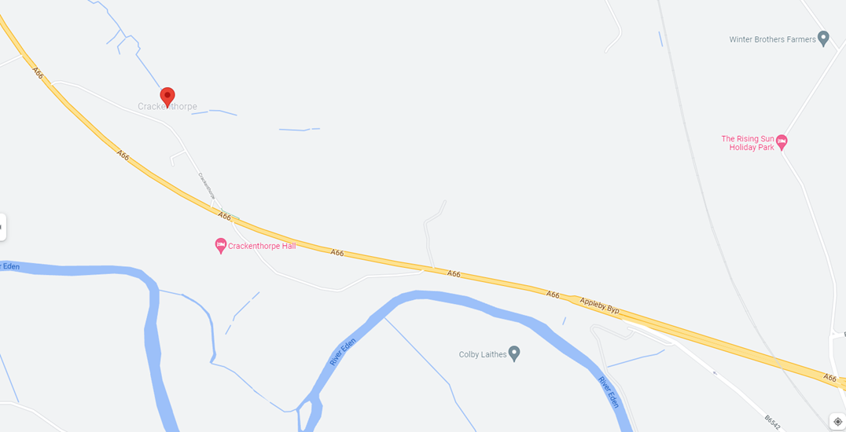
A66 NTP Traffic Management Incident 30/11/2021
Location – A66 NTP between Crackenthorpe and Temple Sowerby
LOCATION

Slide 9
A66 NTP Traffic Management Incident 30/11/2021
Overview

Slide 10
A66 NTP Traffic Management Incident 30/11/2021
Operational Equipment

Slide 11
Topic 2 Road Space Booking Jonathan Pizzey, SPM - Midlands

Slide 12
Refresher - Roadworks accuracy – 7 day KPI
In order to achieve our KPI, our roadworks must be:
On-time: Planned for 7 days in advance and started within 1 hour (either side) of the planned start time – PASS!
We need to make sure we don’t fall into these categories:
Did not go ahead: Planned for 7 days in advance but did not go ahead (cancelled)
Not on time: Planned for 7 days in advance but did not happen within 1 hour (either side) of planned start time
Un-planned: Not planned 7 days in advance but added and went ahead.
– FAIL!
Contact your KPI rep if you need any advice:
Simon Elliott (RIP South), Jonathan Pizzey (RIP North), James Gall (SMP), Maxine Wraith (CIP)
Notes:
Customers want to trust what they are being told. We are measured on our roadworks reporting accuracy.
By locking down the next 7 days of closures, our customers can better plan their journeys in advance and be confident in the information we provide.
Our target for Roads Period 2 is 90%.
The road works accuracy KPI aims to improve the accuracy of road works information so they can better plan their journeys.
Our roadworks need to be ‘on-time’: This means they are planned for 7 days in advance and started within 1 hour (either side) of the planned start time
If they aren’t planned, don’t go ahead, or don’t start within the hour window then we don’t achieve the KPI.
What can you do ?
Ensure your TM Planners:
Are aware of the KPI
Log bookings against your MP project number e.g. MPXXXX
Notify the Roadspace team of any changes to bookings asap
Liaise with Roadspace team and agree approach to any contingency bookings
Contact your KPI rep if you need any advice.

Slide 13
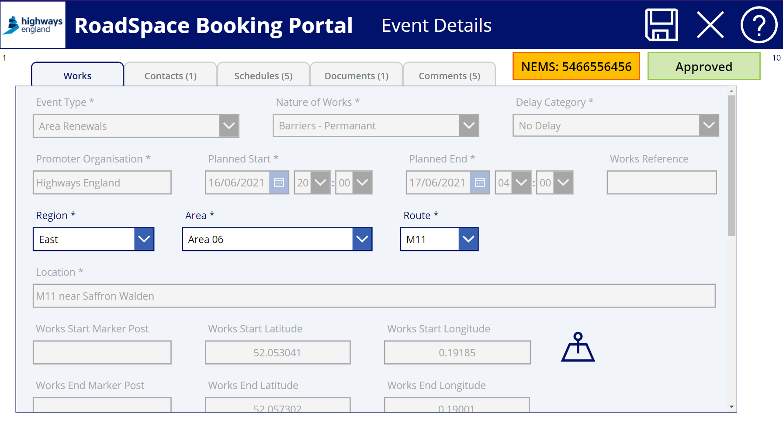
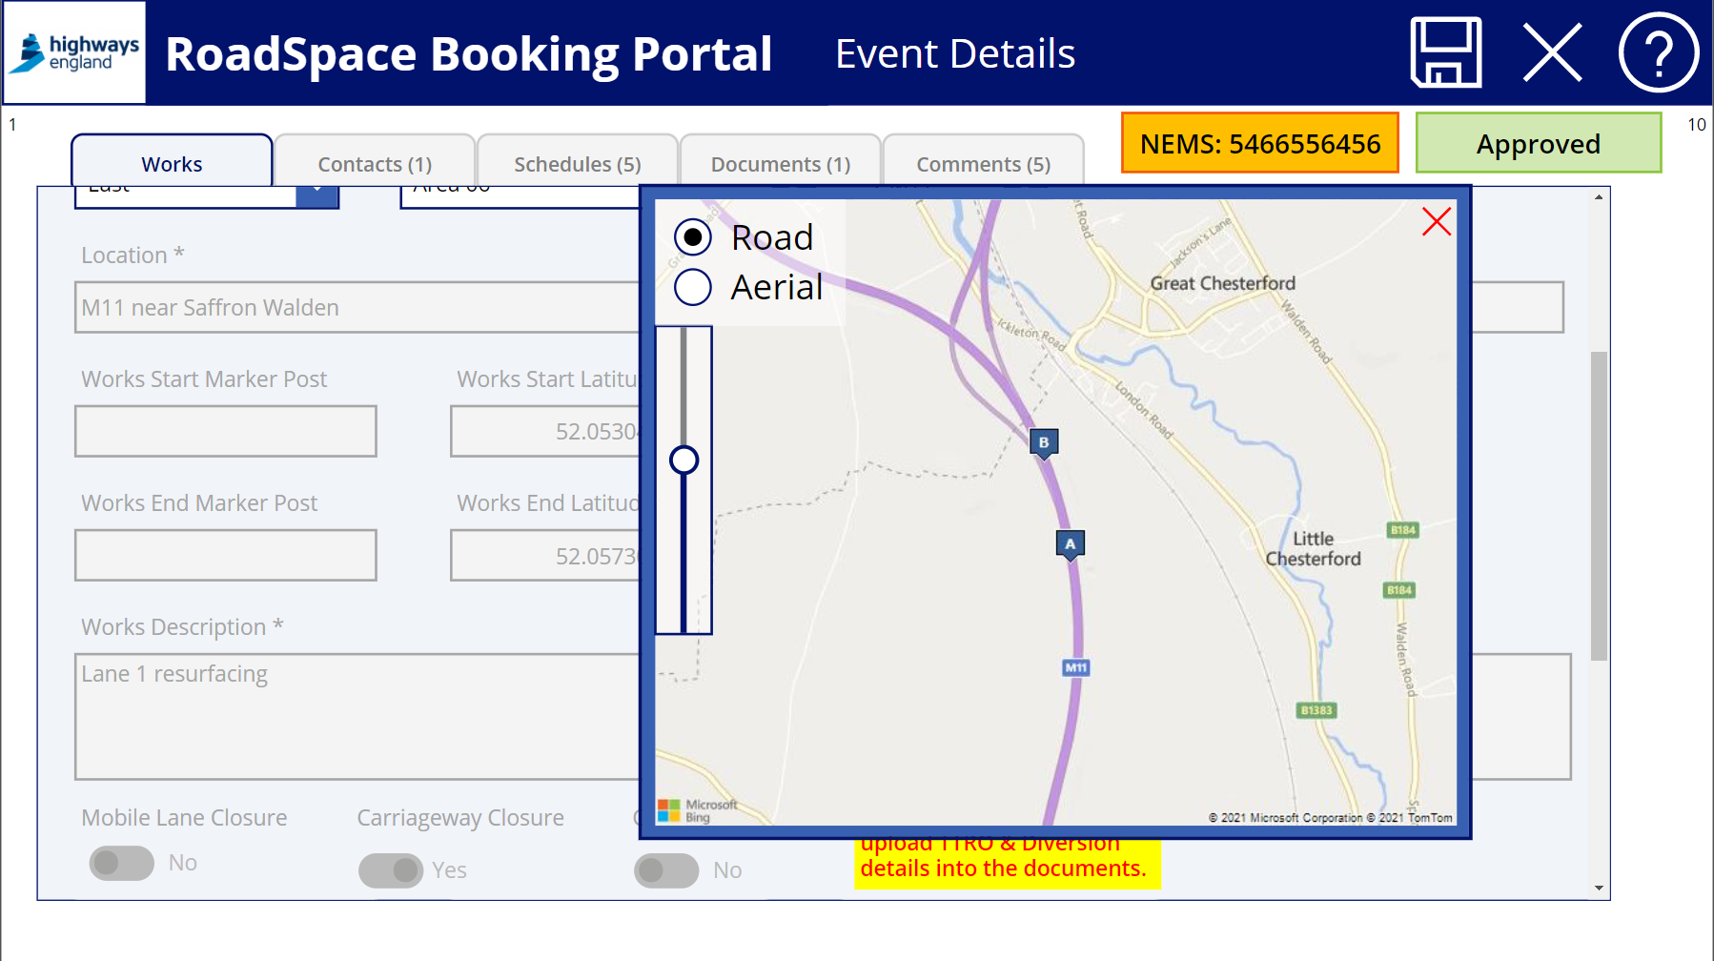
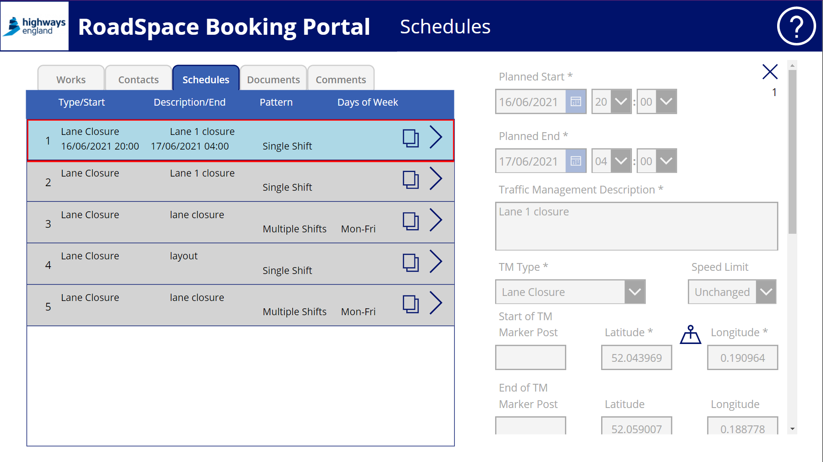
RoadSpace booking portal
We’ve launched a new portal to help us manage booking requests for works on the network. It will replace the offline road space booking forms used across regions.
What does it mean for us?
Safety: increased co-ordination of activities on the network in line with network demand to support safety of road users and crews on site.
Delivery: better visibility of planned road space occupancy
Customer: More accurate information to help customers better plan their journeys in advance and be confident of the information provided
Notes:
To help achieve our KPI we’ve launched a new roadspace booking portal
It is helping us to improve the way we plan, manage and control network occupancy.
The new portal replaces regional forms, giving consistency.
What does it mean for us?
Safety: increased co-ordination of activities on the network in line with network demand to support safety of road users and crews on site.
Delivery: better visibility of planned road space occupancy needs to optimise availability and enable efficient delivery.
Customer: More accurate information and reduced unplanned occupancy to help customers better plan their journeys in advance and be confident of the information provided

Slide 14
RoadSpace booking portal
Our suppliers, who predominantly book road space, will be using the new portal. Project teams should familiarise themselves with the new portal, to understand its functionality
Attributes
Uses Microsoft PowerApps
Desktop/laptop and mobile friendly
Facilitates all communications between applicant and occupancy teams
It captures all information required using dropdown boxes
Benefits
A single way of booking occupancy across all regions and directorates
Increased consistency and quality of road space booking requests
Reduced handoffs between applicants and occupancy teams
Traceability of all transactions end-to-end
Ability to track and report performance for continuous improvement
How do I get access to the Roadspace portal?
Contact: roadspaceportaladmin@highwaysengland.co.uk
Notes:
Suppliers predominantly book road space on our behalf, but project teams should:
understand the new functionality, and
ensure suppliers are using the portal to book road space
Key attributes:
Online standard form built in Microsoft Office PowerApps to enable easy access from desktop/laptop and mobile devices.
Facilitates all communications between applicant and occupancy teams providing traceability for all transactions.
It captures all information required with dropdown boxes to prevent errors.
Benefits
A single way of booking occupancy across regions
Increased consistency and quality of road space booking requests
Reduced handoffs between applicants and occupancy teams
Traceability of all transactions end-to-end
Ability to track and report performance for continuous improvement
Contact for further information: roadspaceportaladmin@highwaysengland.co.uk

Slide 15
Scheme Focus – 2 What have we been doing on our schemes Traffic Management wise? Westwood Roundabout A585

Slide 16
RIP North Wellbeing, Health and Safety forum
Traffic Management on Westwood Roundabout – A61 / A628

Slide 17
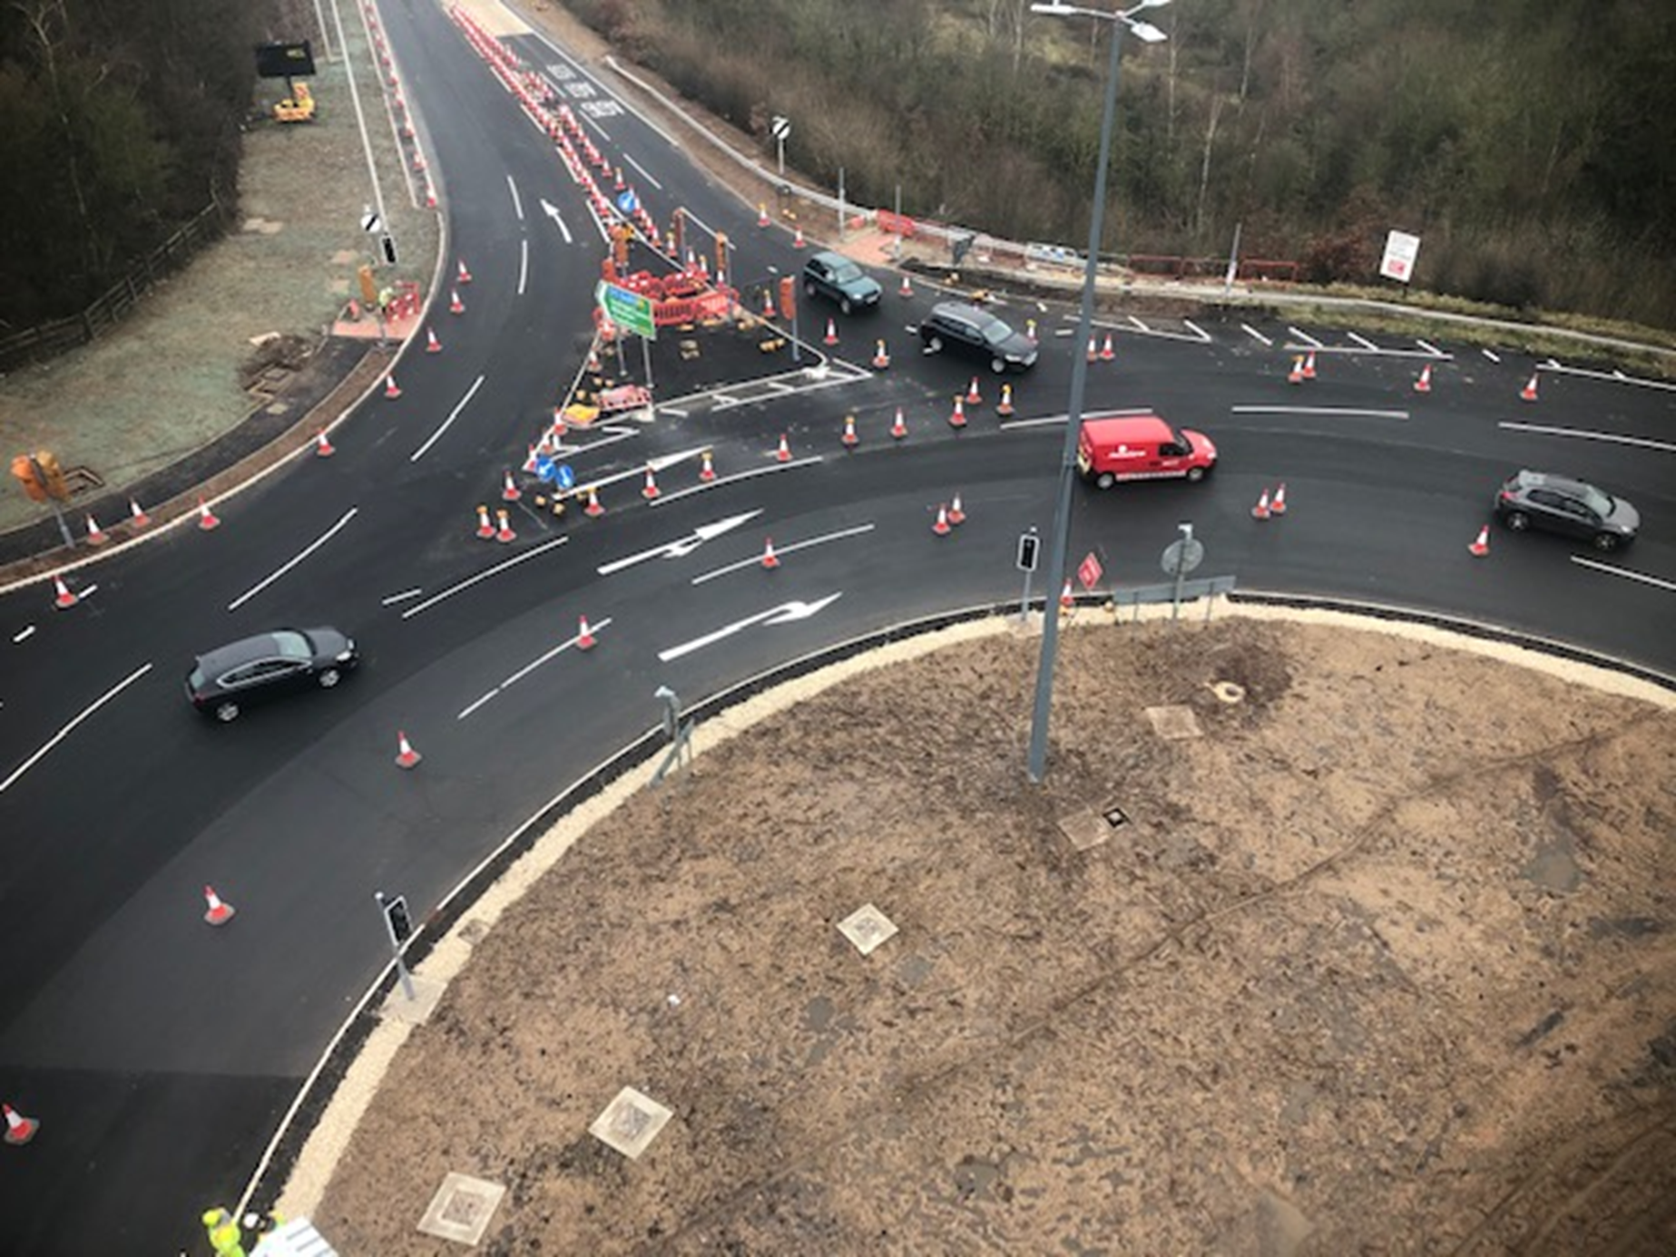
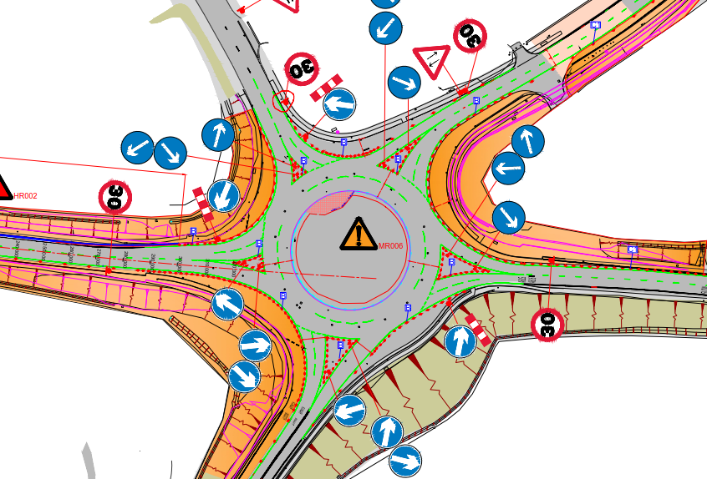
Westwood Roundabout Traffic Management - Efficiency
Developed TM Design to provide 24/7 work areas
Compiled a Business Case to increase our temporary TM working window on 2 key phases of the project (due to low traffic volumes during Covid restrictions)
Weekly monitoring of traffic flows/counts and reporting to Highways England Network Manager
Re-scheduled night shift works (splitter islands) to day shift, by introducing an additional TM switch which allowed surfacing works to progress on night shift

Slide 18
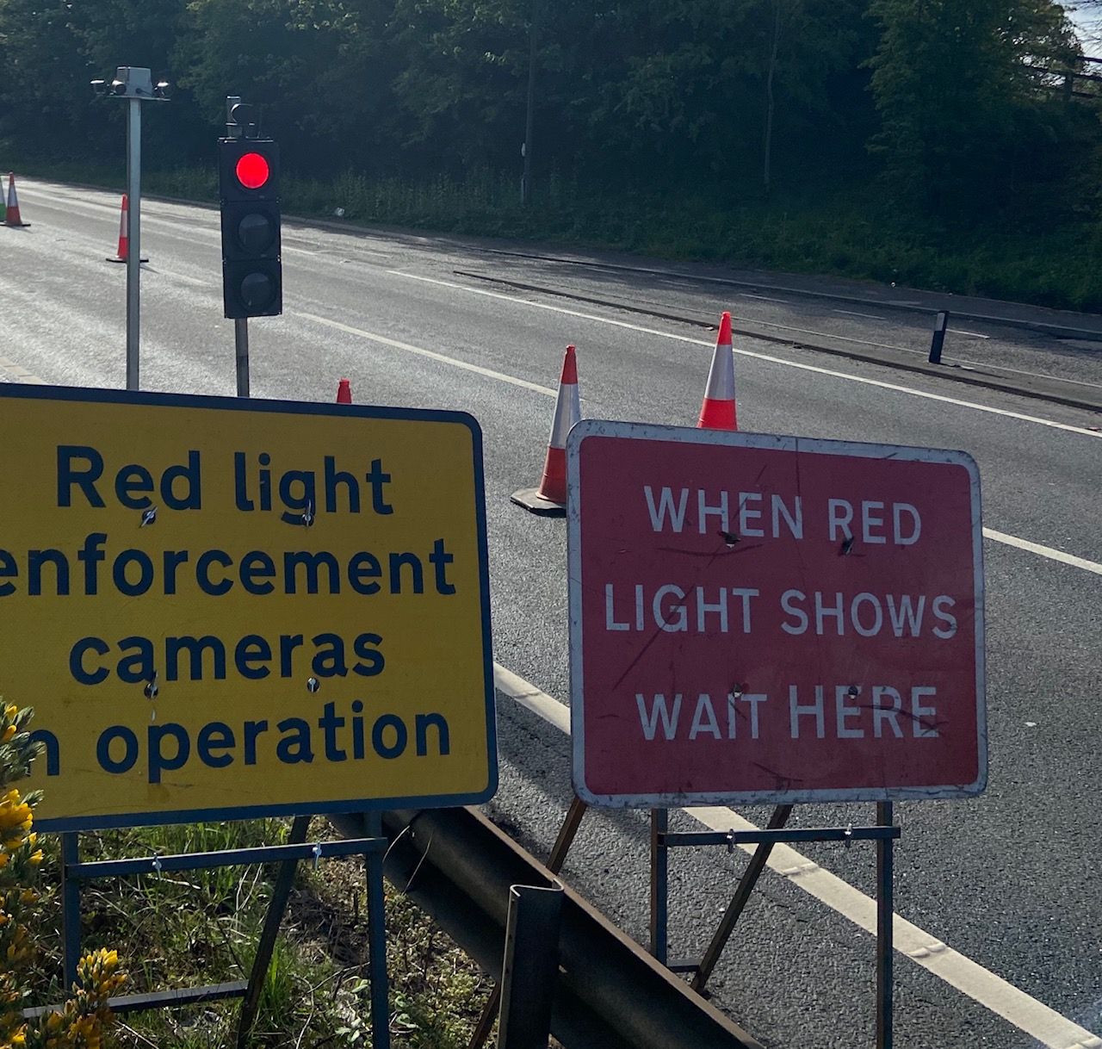
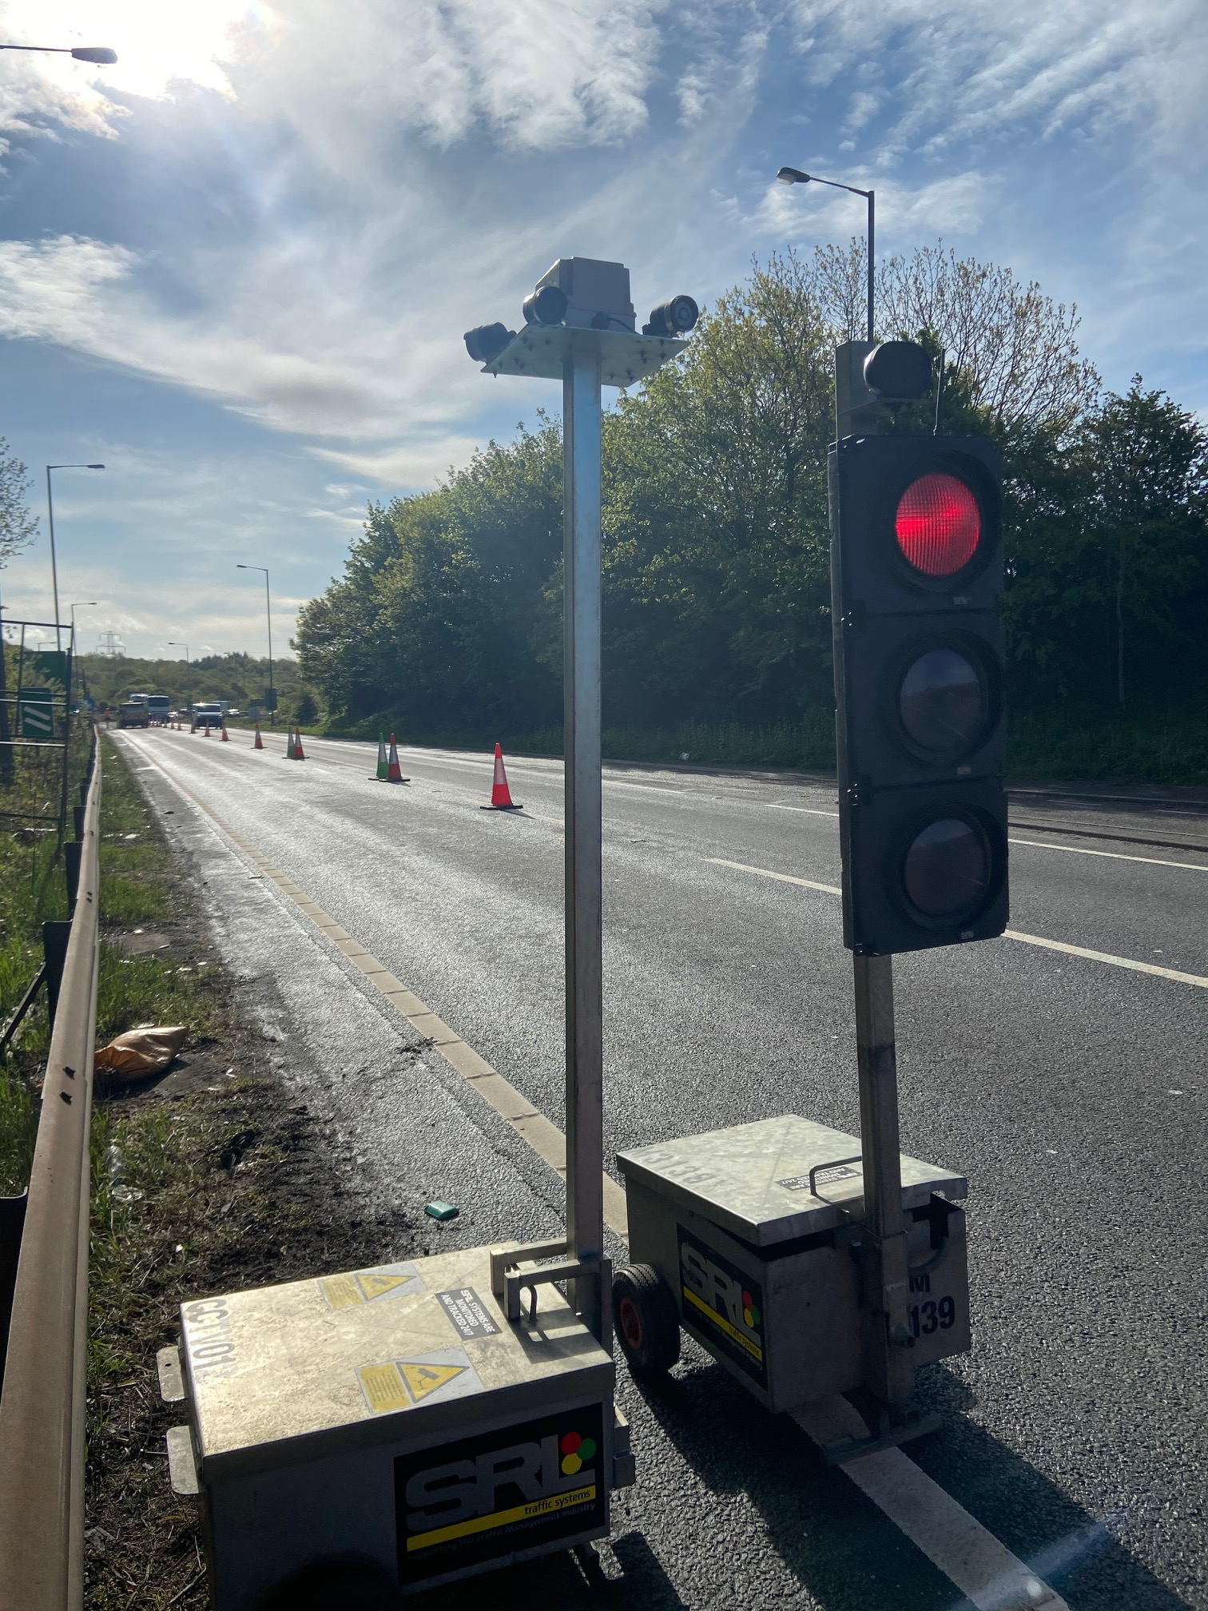
Westwood Roundabout Traffic Management - Safety
Utilising CCTV to deter road user offences
Installed temporary VMS to inform the travelling public of pedestrian crossing points
Re-scheduled night working onto day shift
Gained a NH blue star award for pedestrian management

Slide 19
Westwood Roundabout Traffic Management - Comms
Joined up and collaborative approach with Area 12 A628 scheme with regular meeting to identify clashes and opportunities early
Collaborative PIE events, newsletters and social media posts, use of strategic signs to update customers of road closures
Notice boards set up around site for the general public with scheme information and updates
Introduced mobile VMS signs on site warning motorist of upcoming works and potential for pedestrians to be in the carriageway
Introduced a site marshal to assist with public and workforce interface

Slide 20
A585

Slide 21
Scheme focus x 2

Slide 22
Comfort Break

Slide 23
Topic 3 A63 Castle Street, Hull - Pedestrian Management challenges Mark Sturdy-Bullock, Balfour Beatty

Slide 24
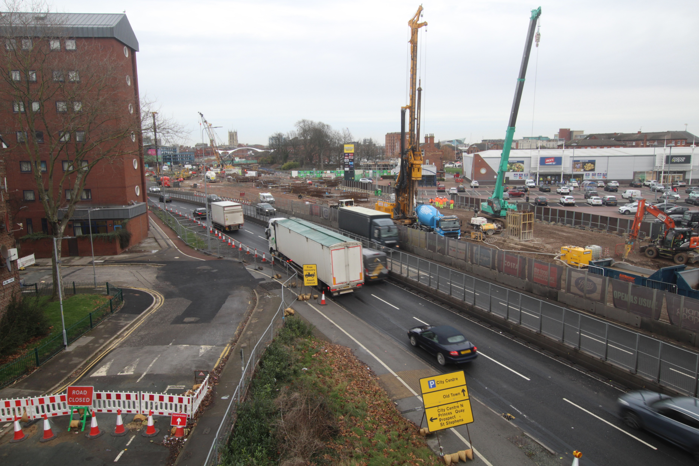
A63 Pedestrian management challenges
Pre construction assumptions
What happened in reality
Pedestrian Management/ communication
Further improvements
Monitoring of works
Lessons learnt / takeaways

Slide 25
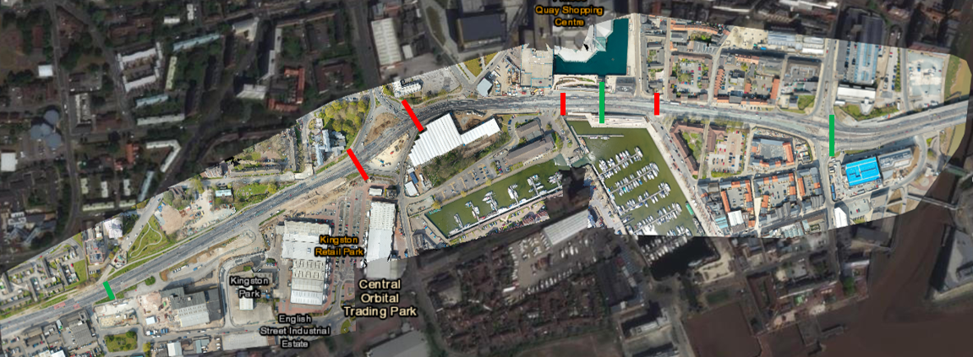
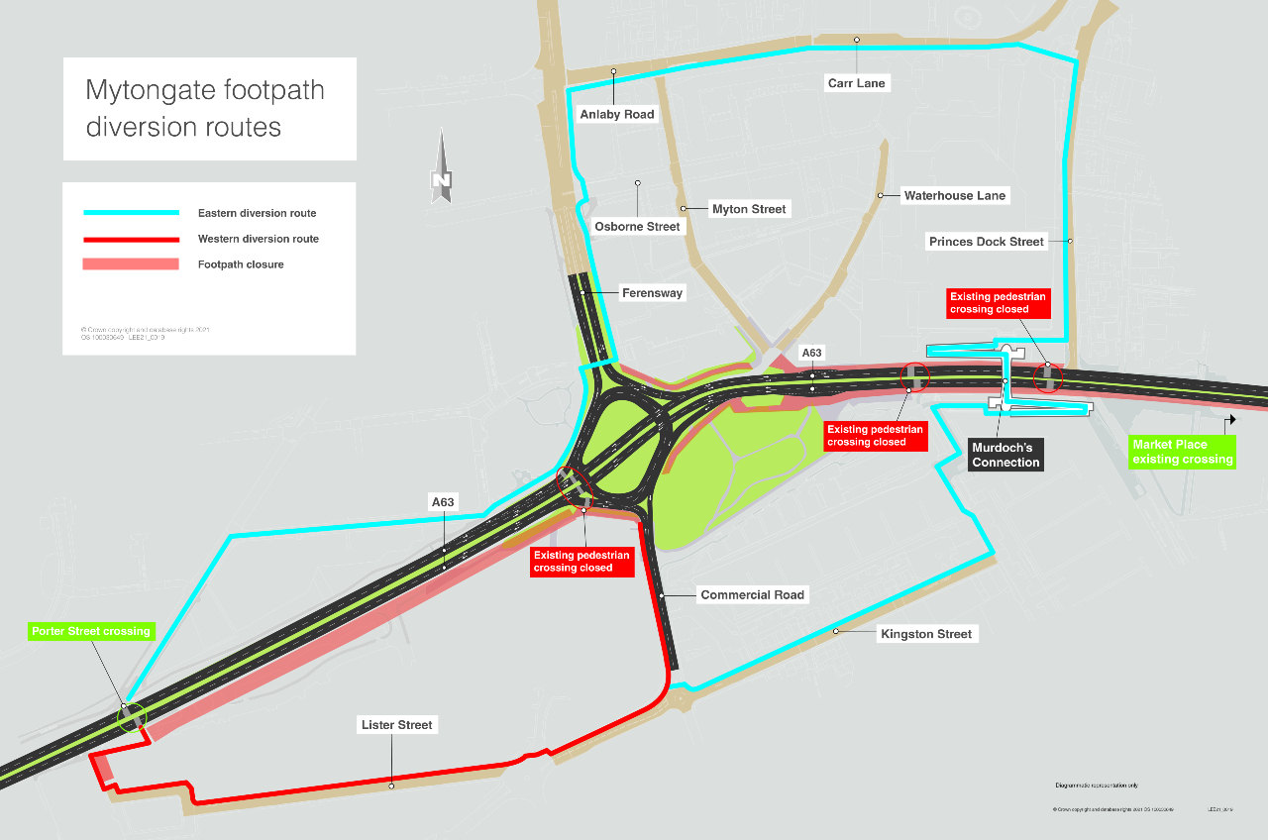
Pre construction assumptions
To allow works to progress of the construction of a city centre underpass we were required to permanently close a number of existing pedestrian crossing points (marked in red) and establish pedestrian diversion routes. This approach was extensively consulted & agreed on during the ECI phase with -
Hull City Council
National Highways
Arup
HAIG (local access group)
The General Public (through Public Consultation)
This planned management of pedestrians was communicated to the General Public in advance of the works through the NH website, newsletter drops and webinars.

Slide 26
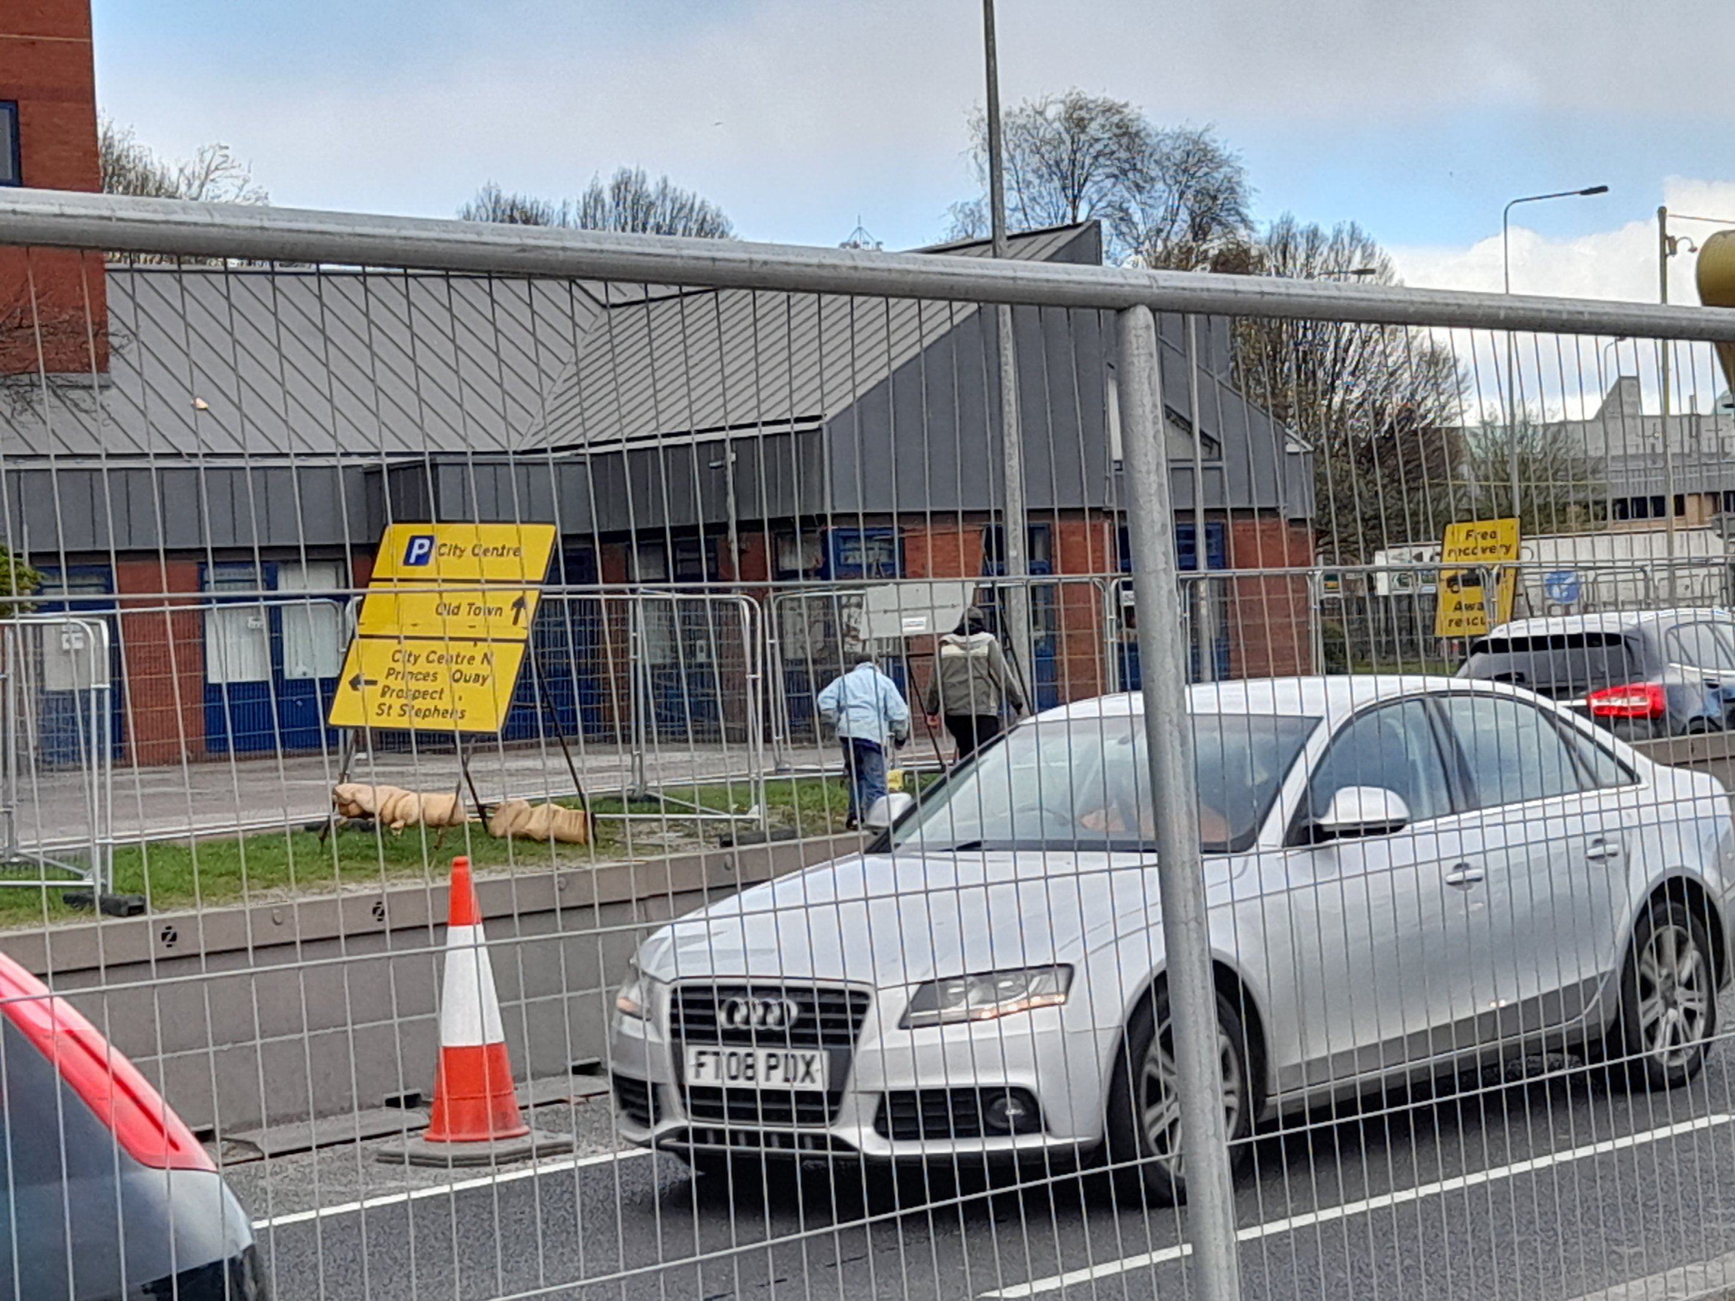
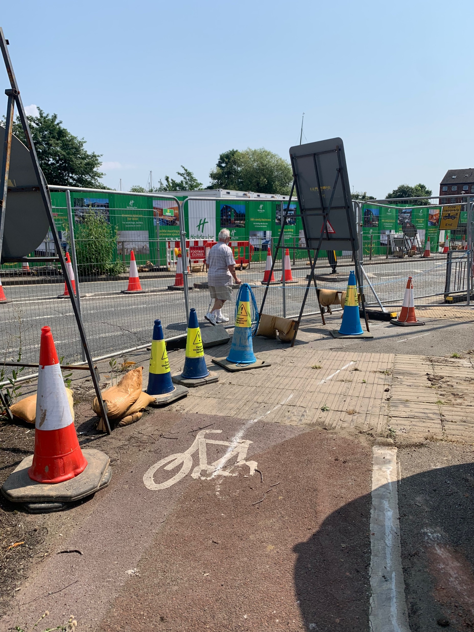
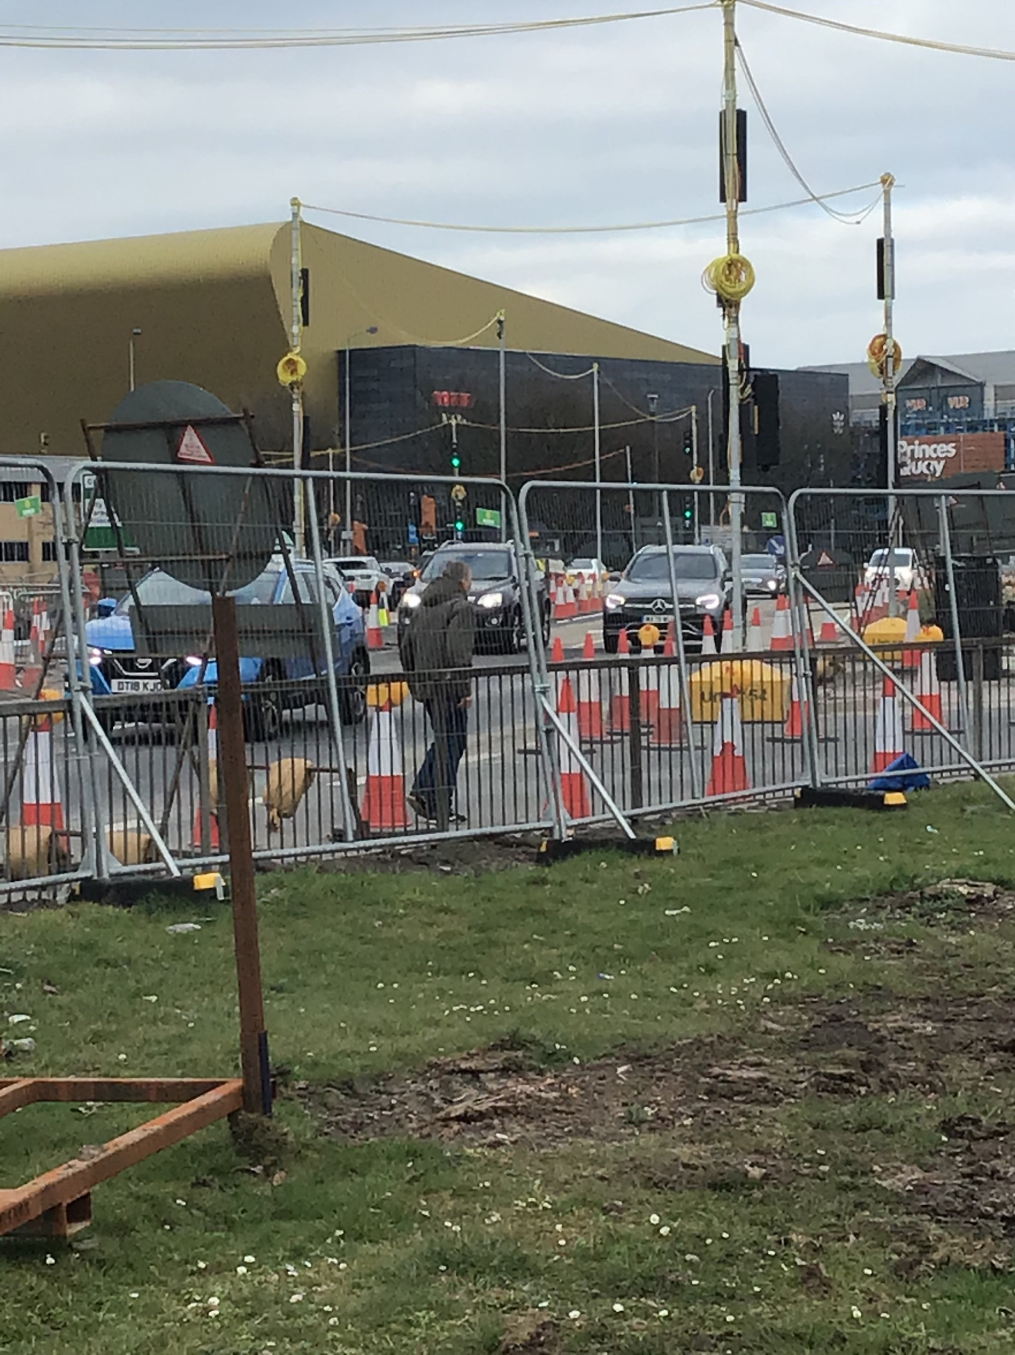
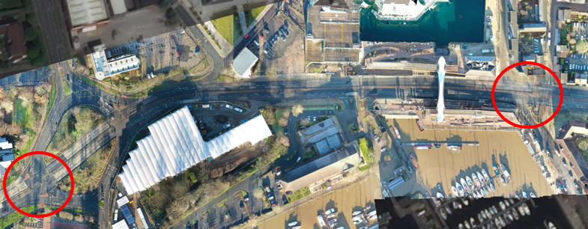
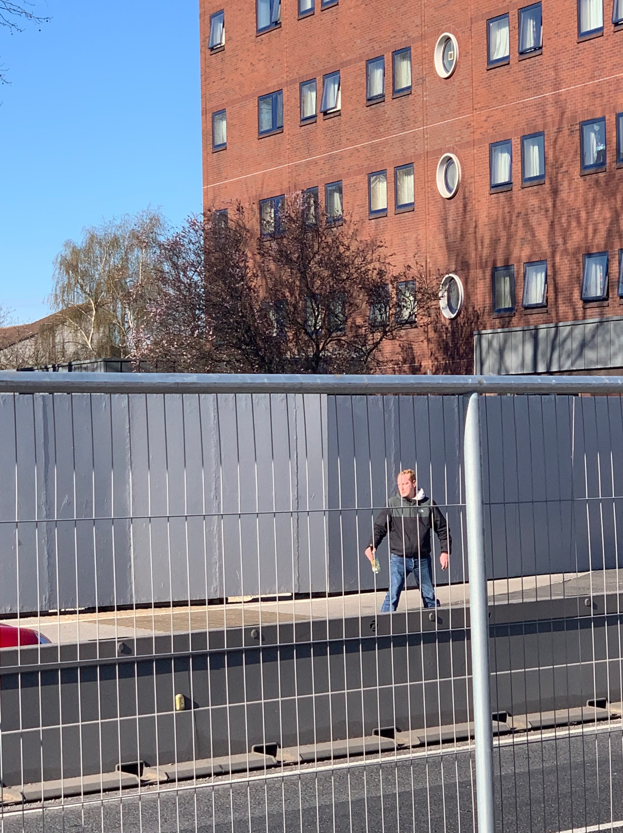
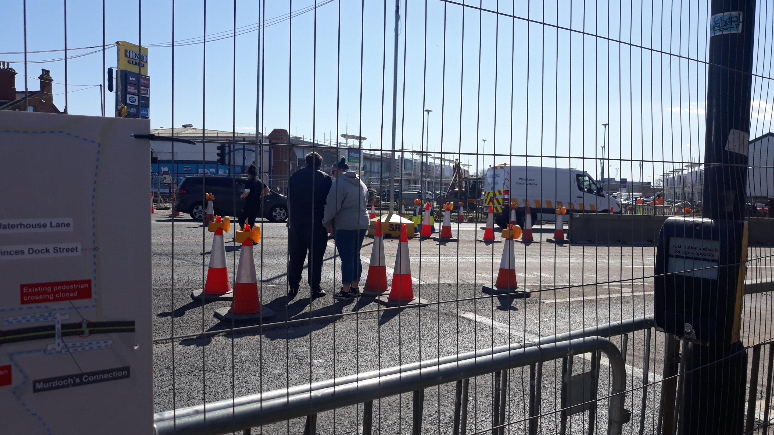
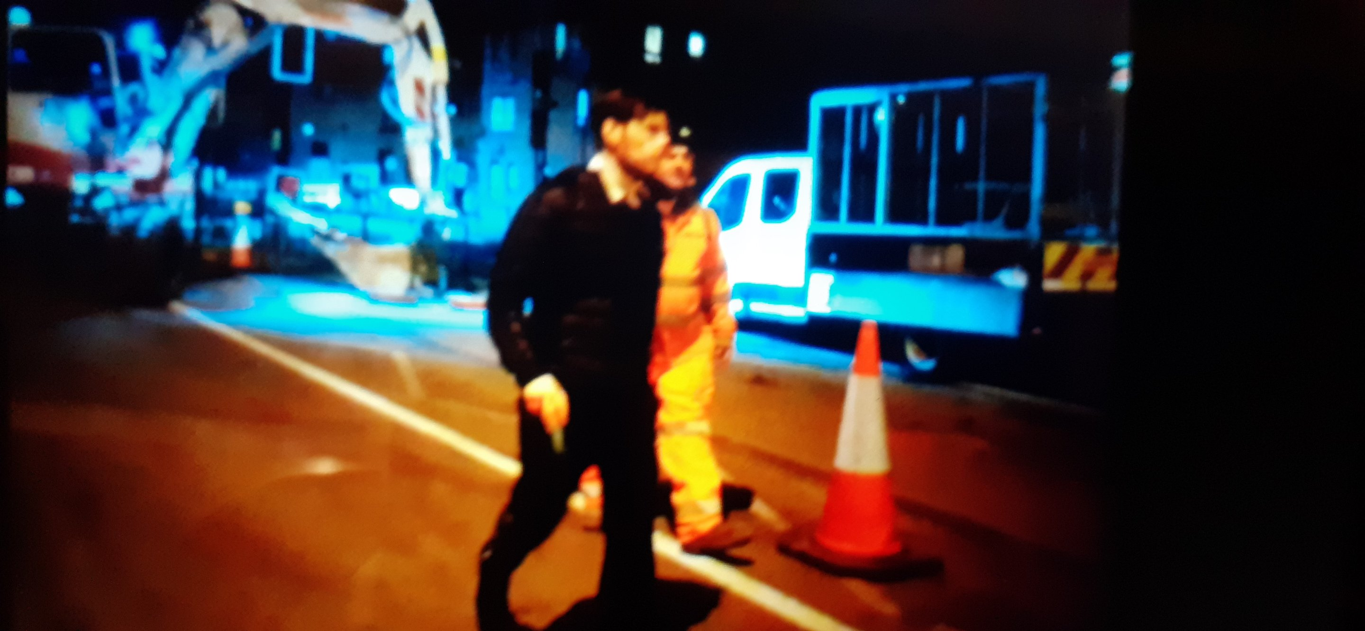
What happened?
Although fenced off and marked as closed, a significant number of members of the public continued to cross live traffic. This was noticed particularly around Mytongate and Humber Dock Street. We had a fatality around this time as well.
Issues were exacerbated by both the locality as well as anti-social issues. It was becoming a real issue and on the radar of senior stakeholders

Slide 27
What happened?

Slide 28
MP Wide Quarterly focus Service avoidance Jan – Mar 22
Aims
To push for the Common Intent and Raising the Bar commitments and approach to be adopted/displayed for Service Avoidance on all projects.
To explore, understand and help close the gap between what should be happening and what is happening.
To help NH colleagues engage, actively, in the theme.

Slide 29
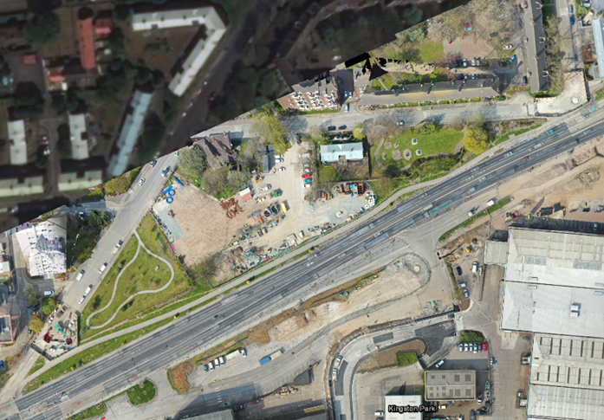
Pedestrian Management – Actions considered
Actions considered but not taken forward
Fencing the full extent of the A63 (verges)
Increases risk for the road used (breakdowns, cyclists) as no safe refuge provided
Leaves weak areas such as side roads where pedestrians can still access the network and attempt to cross. With potentially no safe refuge once they realise their error, they are exposed to greater risk.
Maintenance issue – potential to fall into the carriageway or be a hazard to the road user.
Existing A63 is not fenced – in many areas we have not changed the layout.
Additional temporary crossing between Porter Street and Mytongate
Concerns with increased risk to pedestrians and workforce by bringing pedestrians through our live work areas during this phase
Insufficient space in the central reserve to have a refuge, therefore red signals would need to stop both carriageways at once to allow crossing. This would create excessive congestion on the A63 and unsafe conditions for a crossing point.
Introduces a break in the C/R fencing close to Mytongate junction and increases temptation to walk in the carriageway directly from crossing point to WBH or Wittington & Cat
Closing the footpath north of the A63 between Porter Street and William Booth House and diverting via William Street and Porter Street.
Exacerbates the issue with long diversion route – potentially makes people more determined to cross A63 in unauthorized location.
Diverts people via less well lit route
Diverts people via higher risk residential area
Removes cycle route provision
Temporary footbridge across Mytongate junction
During ECI phase, the feasibility of a temporary footbridge across the Mytongate junction was explored. This was discounted at the time due to practicalities of land take required to provide an accessible solution, and costing made it prohibitive

Slide 30
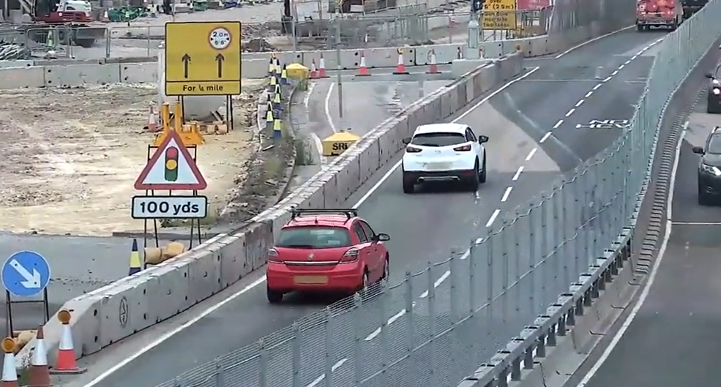
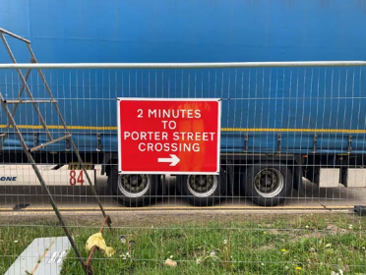
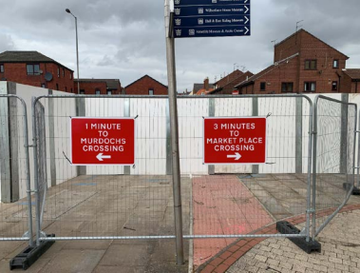
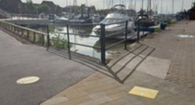
Pedestrian Management – Actions taken
Installation of 900 metres central reservation barrier fencing ​
Installation of 50 new floor signs plus 20 specifically designed for the retail park​
Installation of approximately 90 pedestrian direction signs
Independent Road Safety Audit of TM and pedestrian routes installed undertaken – no significant issues raised in relation to provision for pedestrian management. Enhanced signage with estimated times for diversion route recommended and installed.
Solid hoarding installed at Humber Dock Street to remove sight light across the A63. Further hoarding installed at Porter Street, William Booth House and the Whittington and Cat public house.
Engagement with BB Living Places and HCC – lessons learnt for urban TM.
Site walk round completed with Humberside Police casualty reduction officer & traffic management officer
Pedestrian diversion route walked with Hull Access Improvement Group and Access Association members
Feedback survey (via a QR code) included on the NH webpage ​
Google Maps updated with all pedestrian routes ​

Slide 31
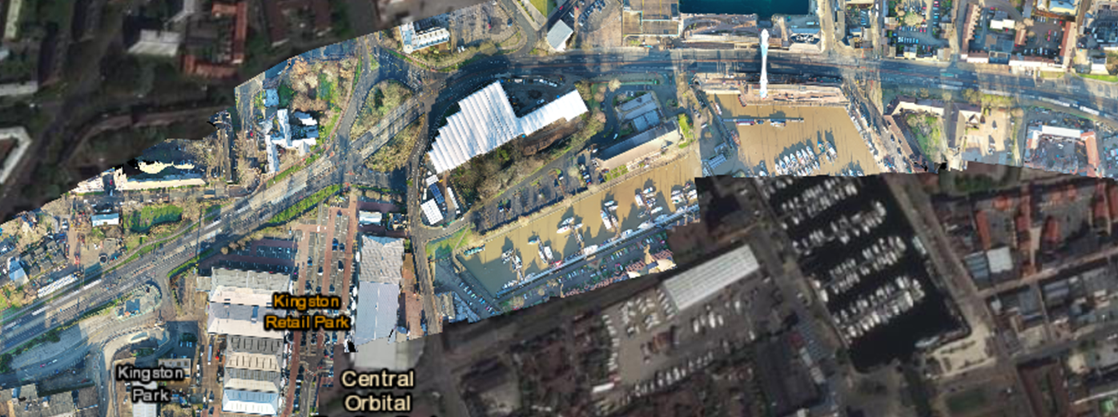
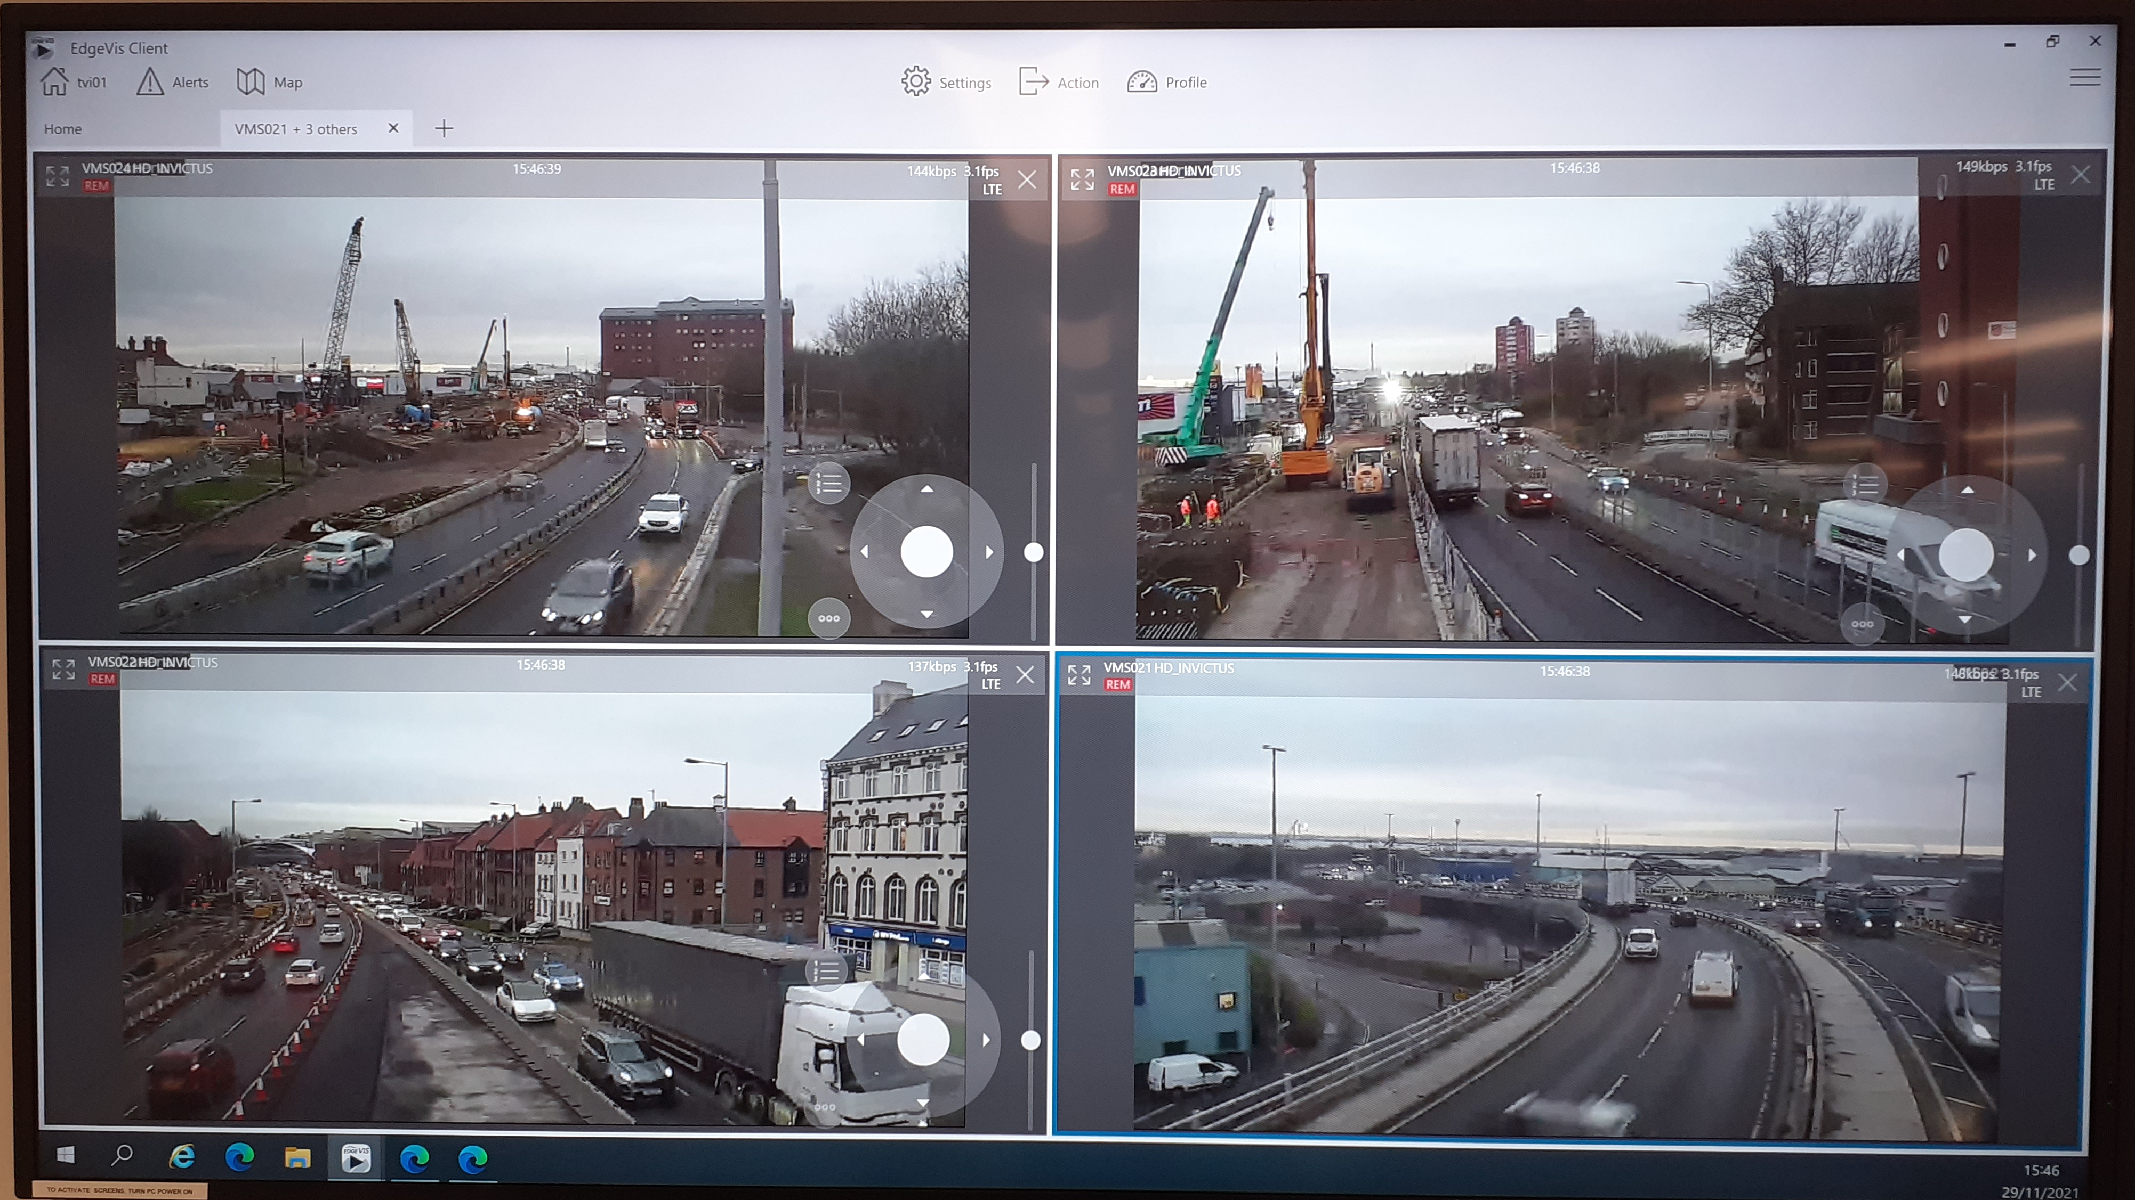
Pedestrian Management - Further improvements
Regular checks of all pedestrian signage installed. Additional HW Martin project manager brought into the team to increase audits and plan enhancement of pedestrian signage.
Site review by Balfour Beatty Highways H&S Director
Site walk undertaken with BB Project Team, HW Martins, BB Customer Lead and HE Regional Customer Lead to further develop enhanced pedestrian signage strategy
Engagement with staff at William Booth House (short-term supported accommodation) – PHE now prescribes methadone collections from pharmacies on the north of the A63 (negates need for residents to cross the A63)
Coverage of temporary CCTV being increased with more cameras deployed.
Spotters in place to obtain as accurate as possible record of numbers of people attempting to cross and identify 'hot spots’
76% drop in pedestrian incursions overnight between April 2021 and September 2021 and an 80% drop during the day.

Slide 32
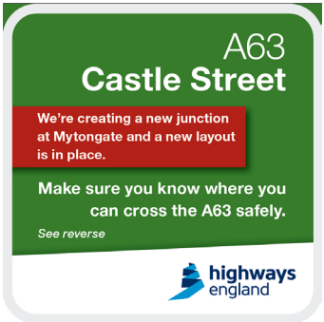
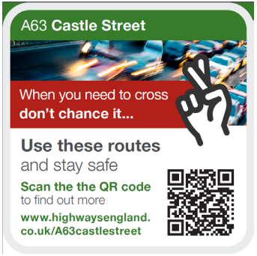
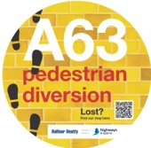
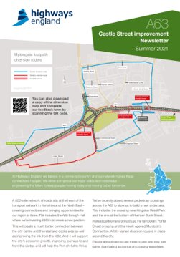
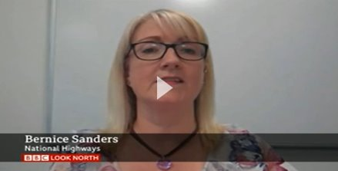
Communication was key
Working with National Highways communication team to develop posters and coasters that can be produced and distributed to pubs, restaurants etc.
Meeting held with Humberside Police regarding ongoing pedestrian management. Agreed with the approach being taken to protect the central reserve rather than rely on verges. Scheme praised for its enhanced measures.
Engagement planned with Humber Safer Roads
Six social media posts issued​
One newsletter to 5,900 residents, one MP and three ward councillors ​
Two news releases to news outlets including an incursion video ​
Issued 2,500 postcards to local businesses such as hotels and hairdressers​
2,500 drinks coasters were issued to local bars and restaurants and 200 posters were sent to local events venues​
Pedestrian diversion map included on the National Highways webpage
Around 65 articles run by the press (online, TV, radio or print)
Issue featured ten times on BBC Radio Humberside, either in bulletins, interviews or debate​
Five radio and TV interviews carried out project manager and Safer Roads Humber in partnership approach​
Featured on BBC News Online, ITV.com, BBC Look North, ITV Calendar and Highways Industry, among others ​

Slide 33
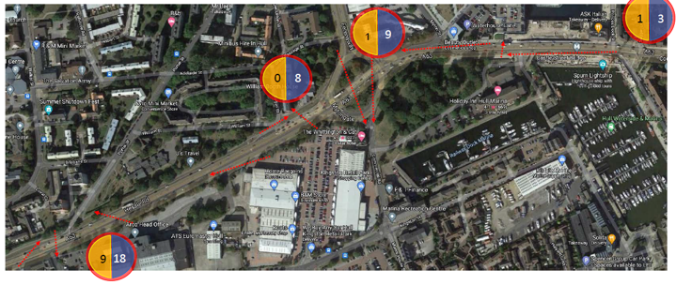
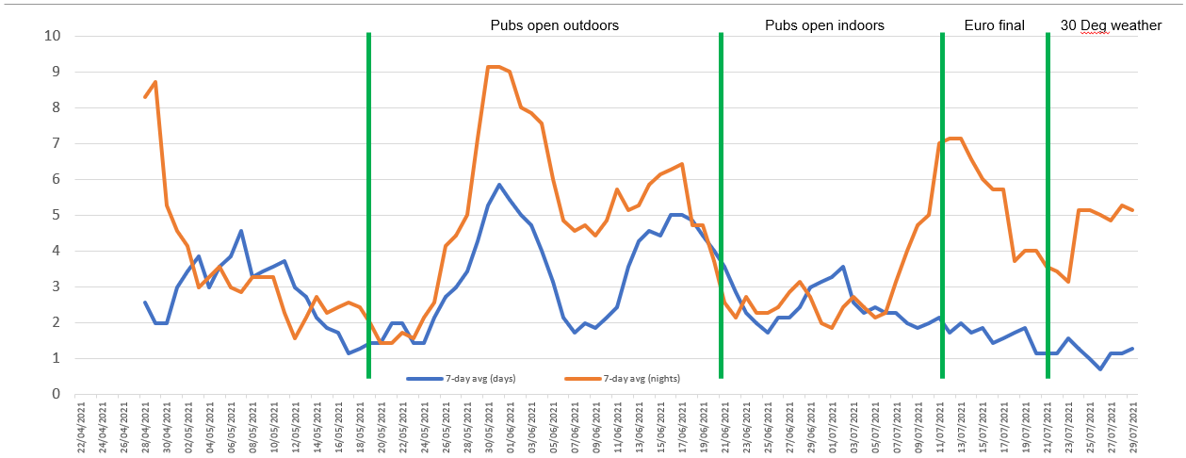
Monitoring of works
Monitoring of pedestrian incursions completed utilising recovery CCTV cameras.
Trends and hotspots reviewed on a daily basis
Weekly incursions recorded on Airsweb (heat map produced to identify hotspots)
Data analysed to identify potential causation (i.e. public events)

Slide 34
Lessons Learnt
Understand social issues related to the locality
Don’t overreact to individual incidents, gather the data / info first
Get key communications out as far and wide as possible, also ensuring the full use of social networking platforms.​
Consider the requirement for a full physical barrier/ deterrent, especially in urban areas. The central reservation fencing provided a visual deterrent making it clear to members of the public that access was not available.
Ensure all access groups are involved as early as possible in the process, pre DCO if applicable.
Engage with the local authority as much as possible before, during and post project review stage

Slide 35
Scheme Focus – 3 What have we been doing on our schemes Traffic Management wise? A19 Testos and Downhill Lane M6 J10 M6 J19

Slide 36
A19 Testo’s and Downhill Lane
Retropsective look at Social Media Interaction and Traffic Management

Slide 37
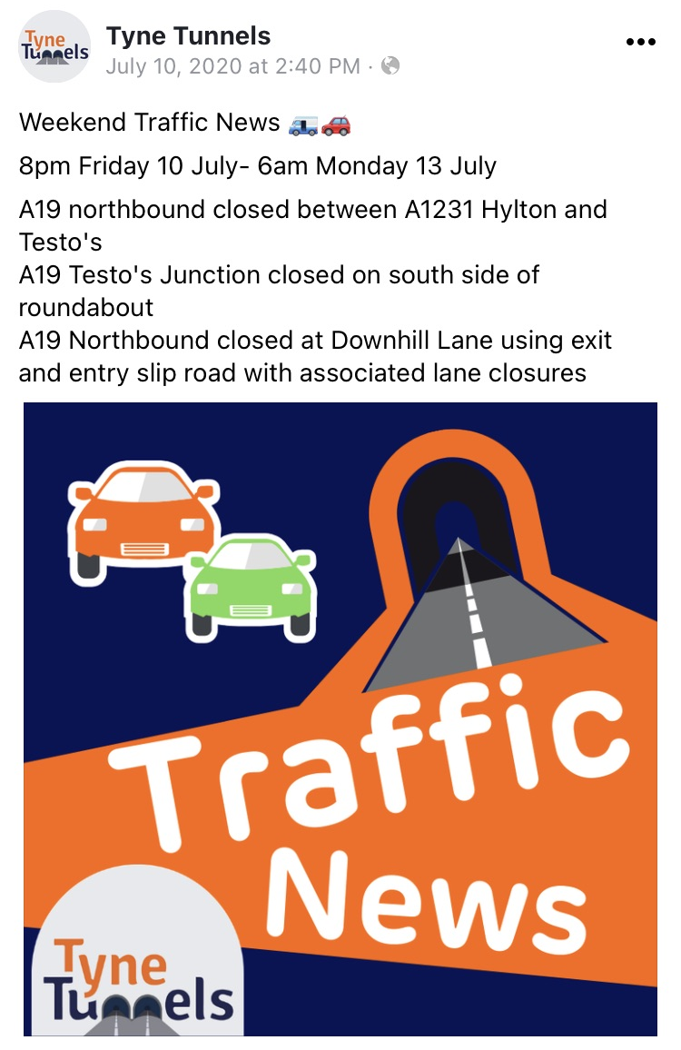
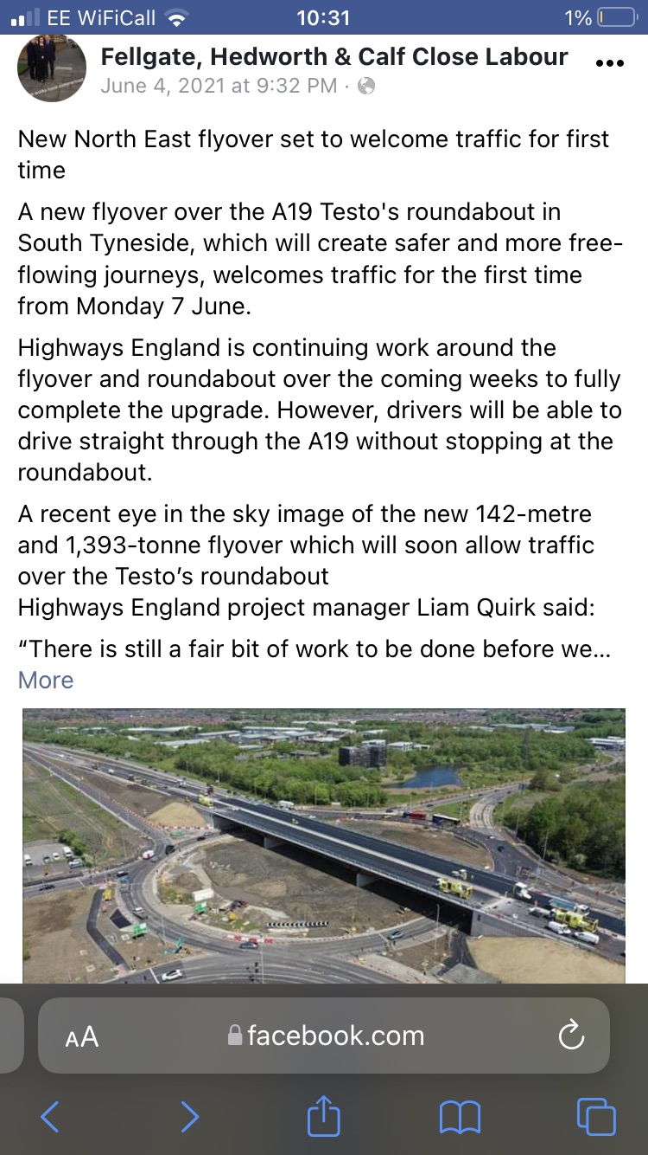
Stakeholder engagement
Early stakeholder mapping to understand impact
Weekly stakeholder TM bulletins, shared with over 300 groups across the region
Targeting social media influencers
Sharing positive updates / progress images
Regular updates with Nissan (UK’s largest car manufacturing plant):
Weekly bulletins for staff and suppliers
YouTube used to share BIM TM phasing drawings
Thanks for the e-mail update which I always read to make sure I can get home! In all seriousness the updates are important for our match planning.
Talking of which we are hosting the England Ladies team next Saturday, 27th, in a world cup qualifier against Austria (12.30pm) kick off. England are staying north of the Tyne and are using the Tyne Tunnel and then the A1231, I wanted to check that all was operational next Saturday - with it being England.
Steve Neill, Sunderland AFC, Safety Officer

Slide 38
M6 J10 Traffic Management
Project Manager – Annie Hyett
Traffic Management – HW Martin

Slide 39
What emerging TM technology are you looking to deliver?
N/A – replacing existing technology at the junction i.e. gantries, CCTV etc only.
What good TM practice has been successful on your scheme?
Dynamic working windows, utilising observed live traffic data to maximise safe working windows and reduce network impact.
Constant layout revision, minor adjustments improving visibility and understanding form a customer perspective.
Maintaining existing lane discipline as near to the current as possible, allowing regular junction users to navigate the works with minimal disruption
Clear input from design and conception to ensure only the required closures are implemented and unnecessary disruption can be prevented.
Existing lane widths maintained on M6 Motorway, No reduction throughout the duration of the scheme.
CCTV Live feed to WMROC.
Where is the TM innovation on your scheme?
Trials for Smart TM. Using existing infrastructure (OH Gantry’s and VMS) enabling the ROC to monitor congestion and make adjustments to the speed system through the works in conjunction with.
Using new carriageway construction to widen existing lanes and implement dynamic work areas that can be used off peak. Accelerating works where space is required while creating more carriageway to be trafficked during peak flows
Highest safe speed through roadworks initiative has been successfully delivered, with ongoing monitoring.
Lining detail adjustments during extended working windows to maximise vehicle movements through the junction while closures are in place.
Are there any barriers (pardon the pun) to improving TM on your scheme?
Restricted to night time TM switches as per request from local authority
How important is clear and consistent communication / social media plans for TM
North Bridge beam installation vs South Bridge installation gives full comparison and reduction in traffic by up to 2hrs following successful comms roll out.
Stakeholder comms and engagement with multiple highway authorities, has proved to be vital to ensure other essential works elsewhere can be correctly programmed and cause minimal delays to either network and/or J10 Improvements.

Slide 40
M6 J19 Improvement Scheme - How important is clear and consistent communication / social media plans for TM

Slide 41
M6 J19 Improvement Scheme
The area local to the M6 junction 19 Improvement scheme had been subject to a number of projects over the last five years.
It is, therefore, quite understandable that our customers – local residents, businesses, and road users – were tired of roadworks, i.e. they have roadwork fatigue.
Because of this, any major work that we did on the M6J19 was carefully managed and planned in a way that minimises the impact on our customers.
A major activity and eight months into construction of the new bridge, we needed to lift 36 steel beams into position over the motorway. The beams needed to be lifted as pairs with each set weighing upwards of 80 tonnes The only way for us to complete this herculean task safely was to close the M6 motorway and the A556 fully for two consecutive weekends.
Our programme showed that we’d be ready to lift the beams in early December, but we knew that closing the M6 motorway during the busiest trading period of the year would impact heavily on businesses, especially after an already challenging year due to the Covid-19 pandemic.
Another option would be to put closures in place on Christmas Eve/Christmas Day when traffic flows are typically lower, but this would impact families travelling to see loved ones after spending months apart.
A third option would be to push the work back to January, but this could delay the programme and prolong roadworks for local residents.

Slide 42
M6 J19 Improvement Scheme
We invited more than 50 key stakeholders and customers to take part in a survey to vote for their preferred closure dates – either early December, Christmas Eve/Christmas Day or later in January.
We had a fantastic response. Road users, local businesses, residents, parish councils and stakeholders including the Road Haulage Association, Royal Mail and DPD, as well as Manchester Airport Group (MAG), Cheshire East Council and the emergency services, all shared their views with us. The results showed that a January closure date would have least impact on the majority of our customers.
The customer insight we gained as a result of the survey was converted into a scoring system and reviewed alongside a number of other contributing factors, including delays to the programme and impact on cost.
Despite the scores showing that December closure dates would benefit both programme and cost, the insight we gained from customers was so overwhelming that January closure dates were agreed.
The aim of our customer insight strategy was to minimise the impact of the closures on our customers. The fact that we chose the January dates as a direct result of customer feedback proves that the strategy was successful, because those are the dates our customers told us would impact them least.
The views of our customers and stakeholders genuinely made a difference. Giving customers a voice in this way was something that, our client at National Highways said, had never to their knowledge ‘been done in this region before.’
For the first time, highways customers were part of the decision-making process and when the closures were later announced, our customers and stakeholders knew that we’d not only listened to their feedback, but acted on it. Having engaged customers early, we found that parish councils, residents and local businesses were more understanding about the closures taking place. As a result, no complaints were received in relation to the timing of the works.

Slide 43
Topic 4 A1 Scotswood to North Brunton Richard Webster, CJP

Slide 46
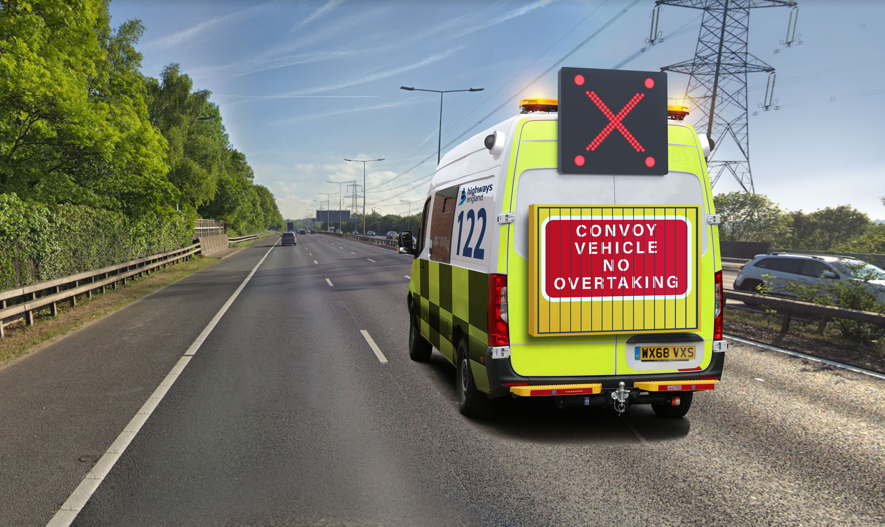

Slide 47
Use Case 1 – EMCC Process

Slide 48
Use Case 1 – EMCC Process
Convoy vehicle

Slide 49
Use Case 1 - EMCC Process
Convoy vehicle

Slide 50
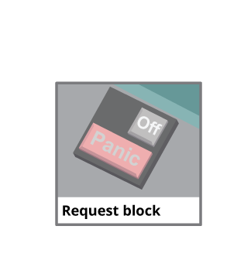
Use Case 1 - EMCC Process

Slide 51
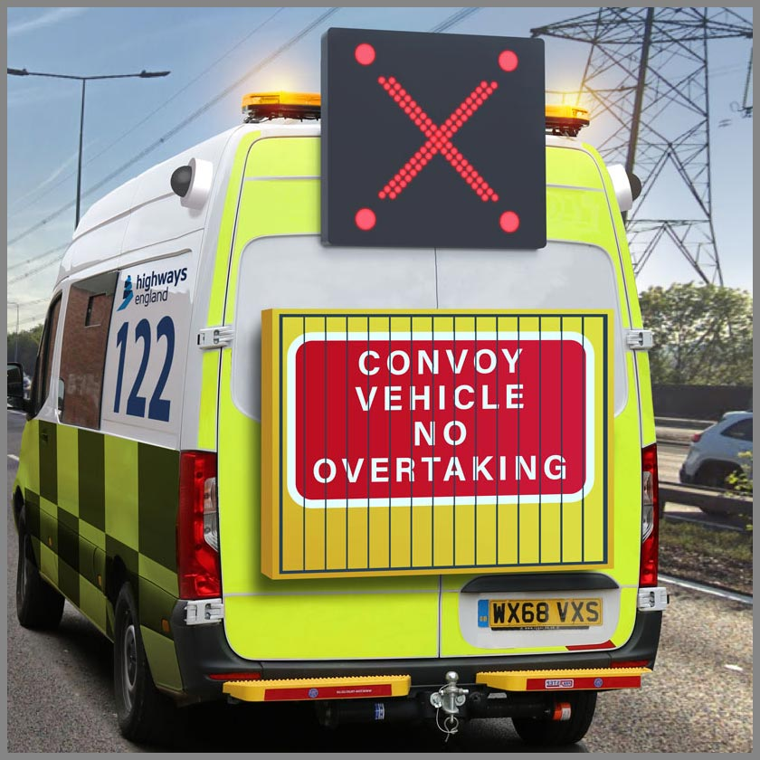
Use Case 1 - EMCC Process

Slide 52
Use Case 1 - EMCC Process

Slide 53
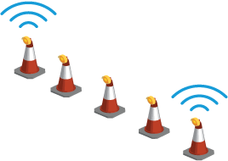
Use Case 1 - EMCC Process

Slide 54
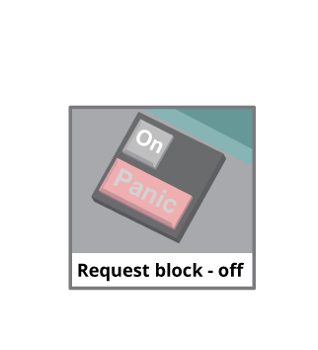
Use Case 1 - EMCC Process

Slide 55
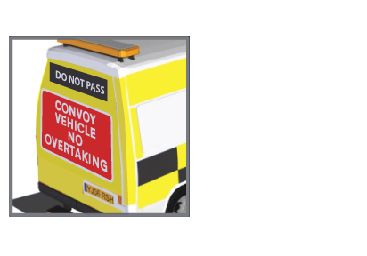
Use Case 1 - EMCC Process

Slide 56
Use Case 1 - EMCC Process

Slide 57
Use Case 2 - Incursion Warning

Slide 58
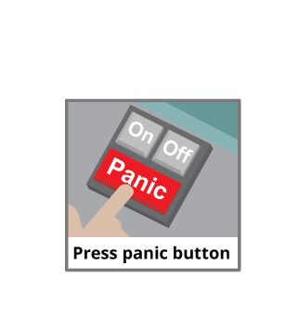
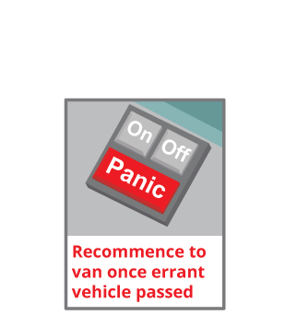
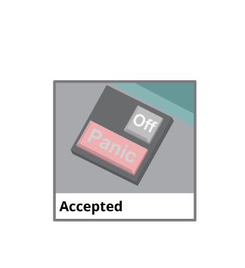
Use Case 2 - Incursion Warning

Slide 59
Use Case 2 - Incursion Warning

Slide 60
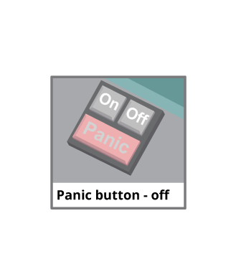
Use Case 2 - Incursion Warning

Slide 61
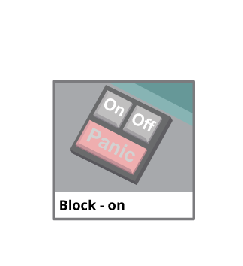
Use Case 2 - Incursion Warning

Slide 62
Use Case 3 - Block Approach Warning

Slide 63
Use Case 3 - Block Approach Warning
500m

Slide 64
Use Case 3 - Block Approach Warning
500m

Slide 65
Use Case 3 - Block Approach Warning
200m

Slide 66
Use Case 3 - Block Approach Warning
200m

