Slide 1
HE Passport Scheme Swiping Passport Cards – Information for Supervisors

Slide 2
Information on how to use this presentation
This is designed to be used on site for supervisors and any one else required to swipe or check Highways Passport cards.
It has been developed in a modular way so the presentation can be broken up and used on different days over a specified time period so as not to overload people with too much information.
This should also allow projects using the Highways Passport Cards to roll out the different available functions of the card in a gradual manner which suits the requirements of the Principal Contractor’s Health & Safety Management requirements.
Any comments, questions or requests for additional training for supervisors and site based staff should be emailed in the first instance to HEPassport@highwaysengland.co.uk
The presentation starts on Slide 3 with a brief introduction to the Passport – there is lots of other information on the Safety Hub website at http://www.highwayssafetyhub.com/passport-scheme.html

Slide 3
Highways Passport - Background
This is a supply chain initiative supported by Highways England and the Supply Chain Safety Leadership Group (SCSLG)
Highways England Endorsement at Safety Exec and SCSLG - Why its important? The Passport Scheme is seen as best practice
What is it?
The Highways England passport scheme offers a simple and more efficient way to manage the safety and competence of workers on our construction and maintenance sites
What do I need to know about as a Supervisor?
Supervisors can download an app onto a smart phone or other device to scan individual’s cards. Depending on the scheme you may be required to scan cards to check competency, to record task briefings or to swipe people in and out of site to provide a record of working hours. Each Principal Contractor will be operating the Passport Card Scheme at different levels so please ASK and be clear about what is expected of you.

Slide 4
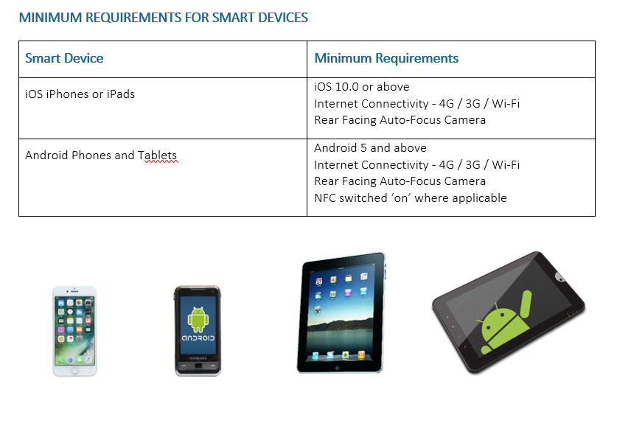
Step 1 – searching for and downloading the Validate App:

Slide 5
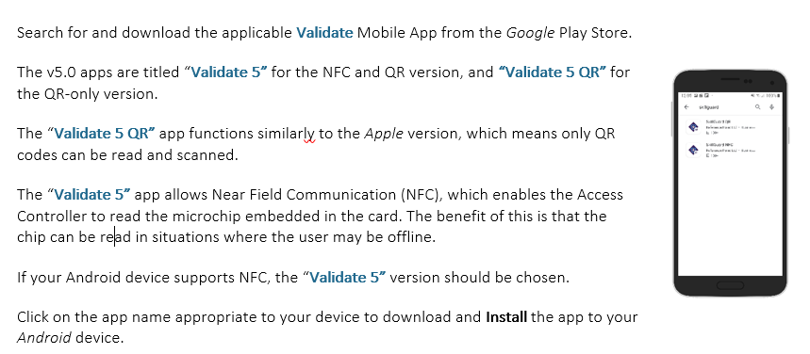
Apple phones and devices – search for and download the Validate 5 QR Mobile App from the Apple App Store. Click on GET to download.
Android phones and devices - a bit more detailed explanation required!

Slide 6
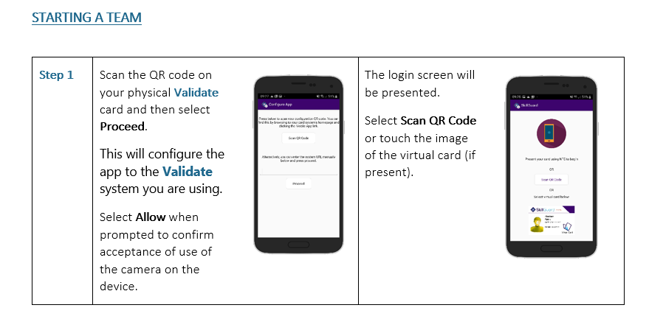
Have we all successfully downloaded the App? Let’s try it – HINT: you need a Passport card
COMMON FUNCTIONS: scanning in your team

Slide 7
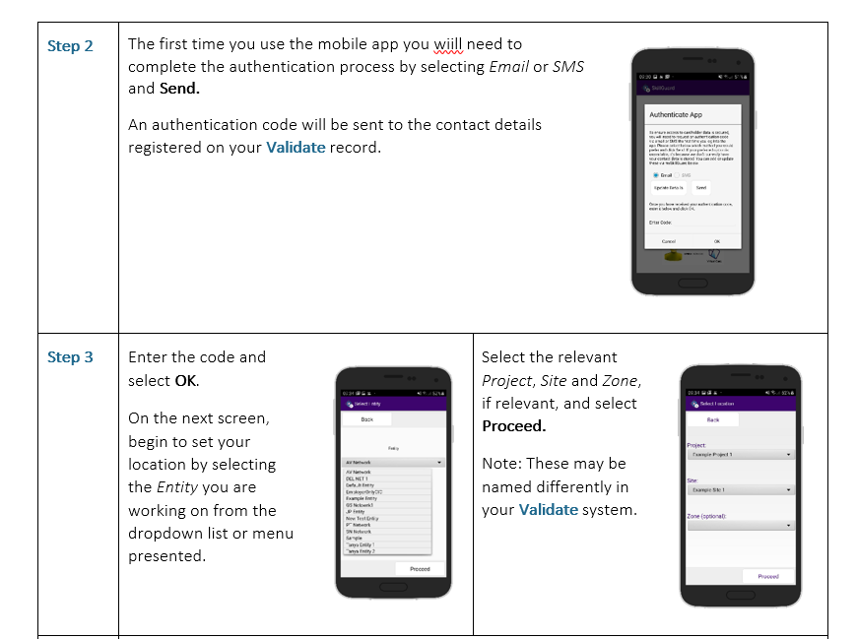

Slide 8
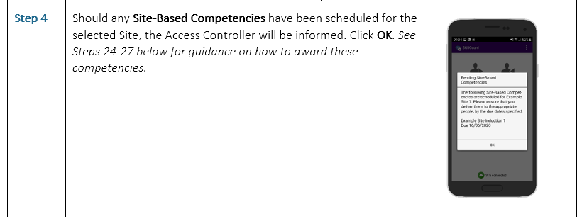
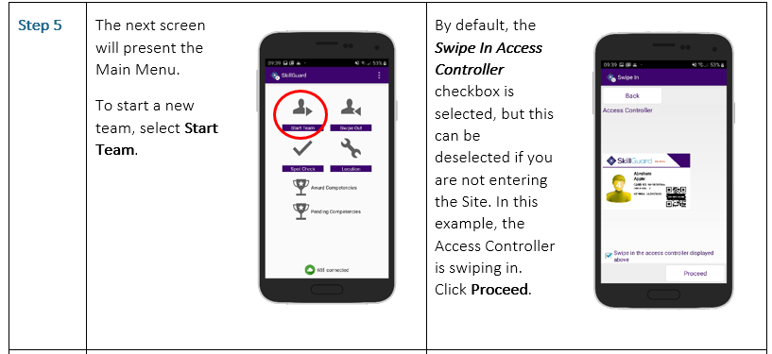

Slide 9
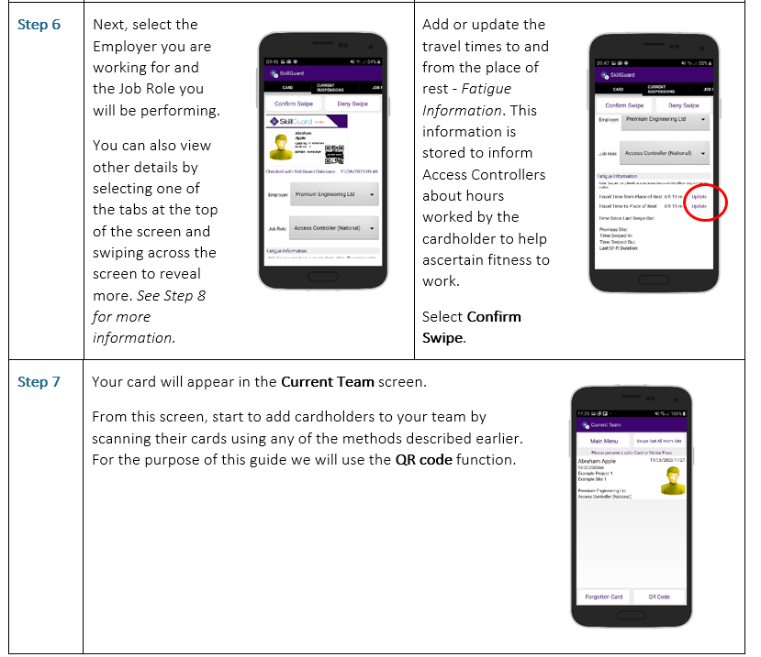

Slide 10
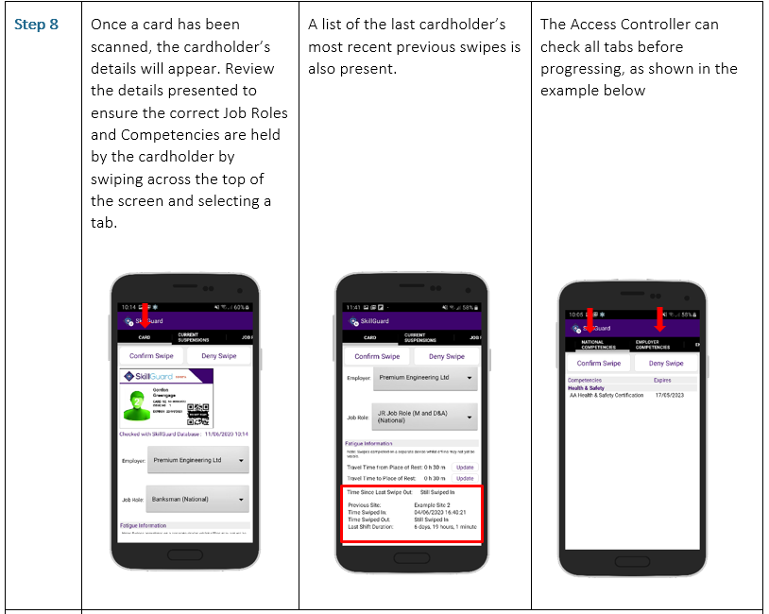

Slide 11
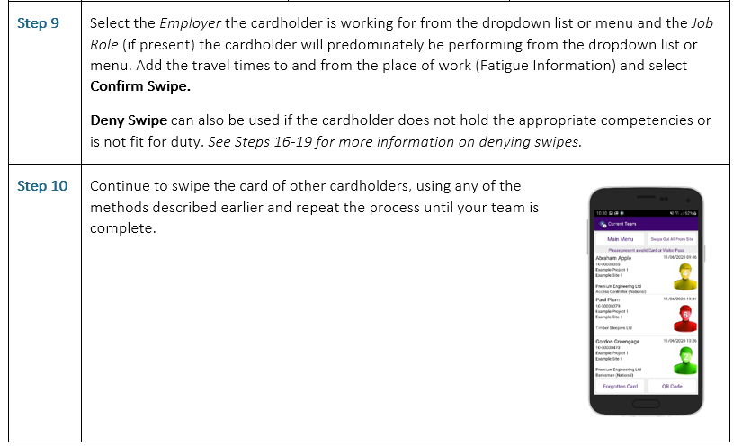

Slide 12
COMMON FUNCTIONS: Swiping Out (We skip to Step 31 – full guidance available at https://highwayspassport.co.uk/resources/supporting-materials/)

Slide 13
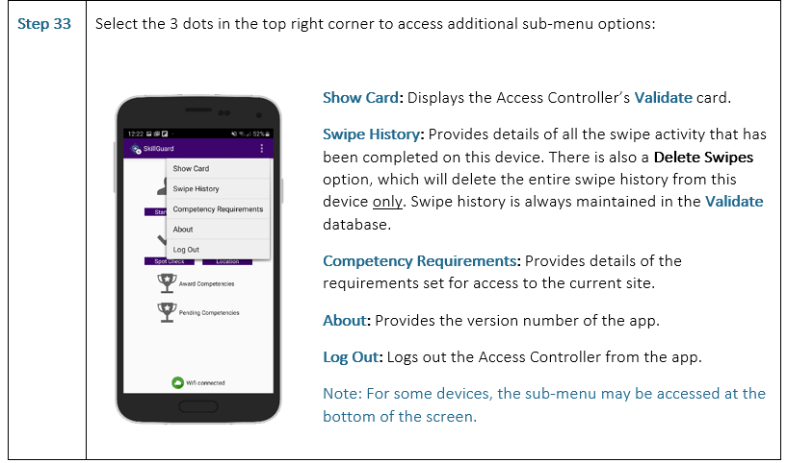

Slide 14
COMMON FUNCTIONS: Awarding competencies on site (we skip to step 20 in the Guidance, full guide available at https://highwayspassport.co.uk/resources/supporting-materials/)

Slide 18
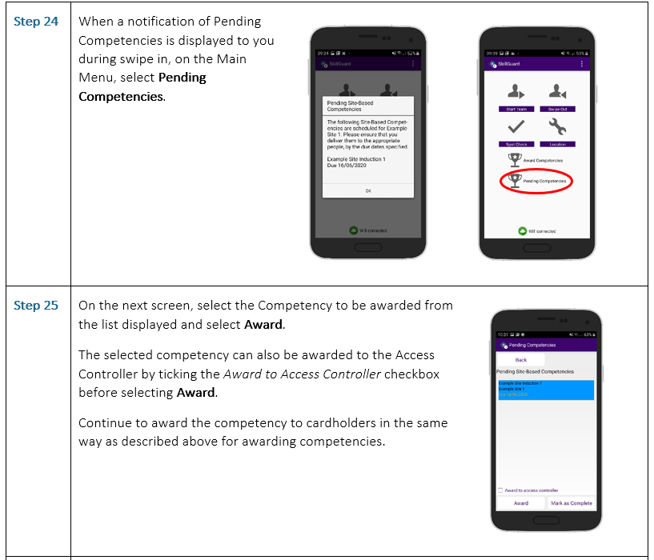

Slide 19
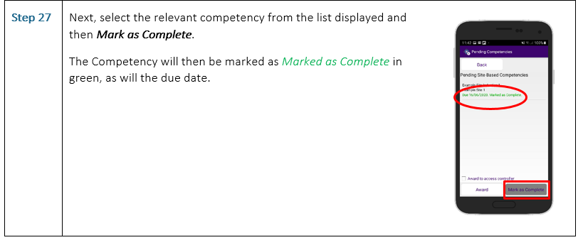

Slide 20
COMMON FUNCTIONS: Spot checking of cards (Full guidance available athttps://highwayspassport.co.uk/resources/supporting-materials/)

Slide 21
COMMON FUNCTIONS: Forgotten card (Full guidance available at https://highwayspassport.co.uk/resources/supporting-materials/ )

