Slide 1
In Too Deep
A CDM Perspective – Acting BEFORE Construction Begins

Slide 2
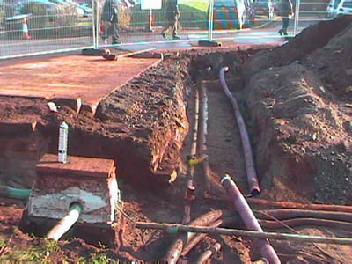
Today marks the start of the ‘In Too Deep” campaign
To help raise awareness of the risks associated with working near underground services, we are running this design and planning workshop to explore how we can affect works positively BEFORE they start.
PLAY ‘DOUGS STORY’ VIDEO HERE

Slide 3
Recap on CDM - Construction Work
CDM applies to all construction work. The definition of construction work is broad, it applies to the construction of buildings and civil engineering works and importantly in relation to avoidance of services includes:
Preparation for any intended structure including site clearance, exploration, investigation (but not site survey) and excavation (but not pre-construction archaeological investigations).
Assembly and removal of structures
Installation, commissioning, maintenance, repair and removal of mechanical, electrical, gas, compressed air, hydraulic, telecommunications, computer or similar services.

Slide 4
Client Responsibilities
Clients – organisation or individuals for whom a construction project is carried out
Main Duties : make suitable arrangements for managing a project ensuring that
Other duty holders are appointed
And adequate time and resources are provided
They must make sure that relevant information is prepared and provided to all duty holders
The Principal Designer and Principal Contractor carry out their duties
Be assured that adequate welfare facilities are provided

Slide 5
Questions ???
What information do we have about the asset from the client?
What information do we have from statutory undertakers?
Are we confident that this data is accurate?
Is there anywhere else we can try to get better data?
How are we going to prove or disprove this data is correct?

Slide 6
Designers Responsibilities
Designers are those who as part of a business prepare or modify designs for a building, product or system relating to construction work
Main Duties: when preparing or modifying designs to eliminate reduce or control foreseeable risks that may arise during
Construction
And the maintenance and use of a building or structure once it is complete
They must also ensure that they provide information to other members of the project team as necessary to help them fulfil their duties

Slide 7
Questions ???
Are all service risks on our design risk register?
Are they being eliminated where possible?
How are we controlling continuing works on site when diversions have been made? Have we updated site drawings quickly? Re-issued them? What is the process?
How is accurate information getting out to site teams and supervisors?

Slide 8
Principal Designers Responsibilities
Principal Designers are designers appointed by the client in projects involving more than one contractor. They can be an organisation or an individual with sufficient, knowledge, experience and ability to carry out the role.
Main duties: plan, manage, monitor and co-ordinate health and safety in the pre-construction phase of a project. This includes:
Identifying, eliminating or controlling foreseeable risks
And ensuring that designers carry out their duties
They must also prepare and provide relevant information to the Principal Contractor to help them plan, manage, monitor and co-ordinate health and safety in the construction phase.

Slide 9
Questions ???
Are design meetings happening with all design teams represented?
How is information being communicated and co-ordinated?
Is the most up to date information being provided to the Principal Contractor so they can plan construction works safely
Where there are any service strikes on site are designers being involved in investigations and improvement plans?

Slide 10
Principal Contractors Responsibilities
Principal Contractors are contractors appointed by the client to co-ordinate the construction phase of a project where it involves more than one contractor.
Main Duties: plan, manage, monitor and co-ordinate health and safety during construction including
Liaising with the client and principal designer
Preparing the construction phase plan
Organising co-operation between contractors and co-ordinating their works
They must also ensure that site inductions are provided, site is secure, workers are consulted and welfare is provided

Slide 11
Questions ???
Are permits being used correctly on site?
Are the right drawings being provided?
Are staff stopping works where there is any confusion about drawings or where there are unchartered services discovered? How is this fed back to the design team? Are drawings quickly amended?

Slide 12
Contractors Responsibilities
Contractors are those who do the actual construction work – can be an organisation or an individual
Main Duties: plan, manage, monitor and control construction activities under their control so that it is carried out without risks to safety
For projects involving more than one contractor they must co-ordinate their activities with others complying with directions given to them by the principal designer or principal contractor

Slide 13
Questions ???
Are CAT and genny regularly tested, calibrated, are staff trained in their use?
Is there the ability to interrogate the CAT if there is a service strike to check what mode it has been used in etc.?

Slide 14
Key Elements for Securing Construction Health & Safety
Manage risks by applying the general principles of prevention
Appointment of the right people at the right time
Make sure everyone has the information, instruction, training and supervision they need to carry out their jobs in a safe manner
Duty holders must co-operate and communicate with each other and co-ordinate their work
Consult workers and engage with them to promote and develop effective measures to secure health, safety and welfare
Notes:
Daily emails

Slide 15
General Principles of Prevention
The key principles are:
Avoid risks where possible (pre-construction and design issues)
Evaluate those risks which cannot be avoided
Put in place proportionate measure which control them at source
Notes:
Daily emails

Slide 16
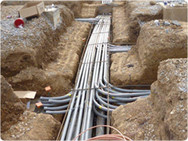
Action Plan
Have we now identified some areas which we need to improve on?
Identify tasks to be undertaken
Identify who is going to do them
Identify a realistic time frame
Develop and Action Plan and track this through Design Team Meetings, Progress Meetings and / or any other project specific meetings which are relevant
Notes:
Daily emails

