Slide 1
BAM Nuttall
Zonal working – Plant Person Interface

Slide 2
Zonal working
What are we trying to do?
One of the main hazards the construction industry face is being near to active plant equipment. Every year people are killed or seriously injured due to being struck by moving plant.
BAM Nuttall are working in partnership with Flannery’s to produce a short film to highlight the methods and benefits of zonal working
We recognise the importance of adequately controlling plant and pedestrian interface and through our zonal working standard the film aims to demonstrate this approach.

Slide 3
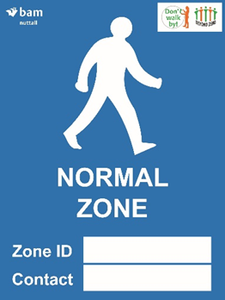
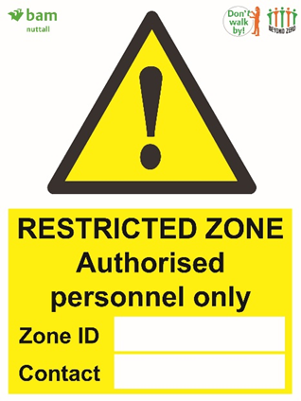
Normal and Restricted Zones
Normal Zone
Normal zones are default where an exclusion or restricted zone is not in place and are not controlled by Zone controller. Normal site restrictions apply such as mandatory PPE
Restricted Zone
Only personnel authorised by zone controller may enter.
Personnel must be trained and competent in activities within the zone.
Activities such as
Drainage installation
Archaeological trial trenching
Scaffold installation/removal

Slide 4
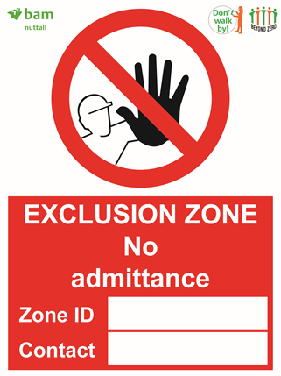
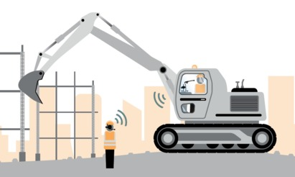
Exclusion Zone and DECT Comms
Exclusion Zone
No personnel are allowed within the exclusion zone
Example of activities within exclusion zone
Haul routes
Swing radius of an excavator
Lifting radius of a crane
Areas below overhead operations
DECT Comms
The use of DECT comms will be used as two-way communication between the plant operator and zone controller within the restricted and exclusion zones

Slide 5
Zonal Working Video
https://youtu.be/LpYnFDd7IAw

