Slide 1
SPaTS2 Eliminating Risk from the Outset - Home Safe and Well
Project update for PDWG
Paul Dennis
13 October 2022
Notes:
Workshop held on 24 August 2022 to gather feedback on the technical notes from our three work packages under this task group
42 attendees provided feedback either via marked up documents in advance, email or verbally during the workshop
Comments logs generated with 127 comments received across the three work packages in total
Comments either noted or taken into consideration for outputs to be delivered

Slide 2
WARNING!
Notes:
Aware you’ve been on this call for more than four hours already but WARNING! Your attention is required for a few more mins!
This update is important to you as our outputs are tools that will be useful on your projects in the future and PCF products that you may need to prepare for your schemes

Slide 3
WP2 – Design as a Process
Tangible output - Stage 1 Safe by Design Management Plan
Notes:
The template for this document has been drafted (incorporating comments) and will be populated with information from a live project which has just been through SGAR1 (A2, Brenley Corner)
Tom Merry (NH) will own this work package deliverable going forward
Discussions then to be held with NH Project Control Framework team regarding inclusion of the plan within the PCF product list for all schemes nationwide.
(Document name still tbc!)

Slide 4
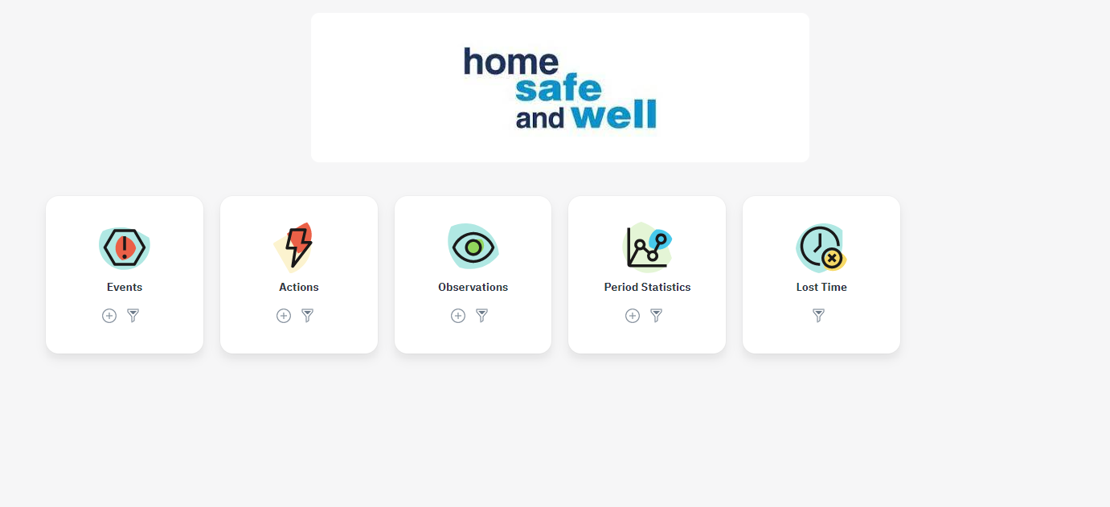
WP3 – Learning from Design
Tangible output – Safety alert tile on HART homepage
Notes:
Work with HART team to add tile with link to H&S alert database currently available through Highways Hub website but populated by volunteer.
Iain Rillie (NH) will own this work package deliverable going forward
Discussions then to be held with HART team regarding support to bring this in house and maintain/improve this alert database to include investigation data/designers root cause assessments information once available.

Slide 5
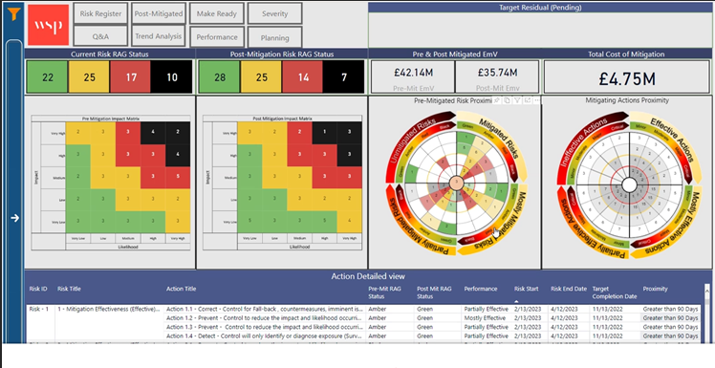
WP4 – Measuring Design Performance
Tangible outputs – Review of Design Strategy Record / Hazard Review Log and Xactium HSW Harm and effectiveness of mitigation measures tool
Notes:
Firstly, we will be reviewing CDM risk registers, Hazard Review Logs and Design Strategy Record to best capture and communicate CDM risks for a project
Secondly, I’d invite you to look to look at this image
This is the output from a new Xactium tool to monitor the proximity and priority of HSW harm and the effectiveness of proposed mitigation measures
We are planning to use live project data (A417 Missing Link) to trial this tool and, if beneficial, recommend that it is mandated across all schemes nationwide
Matthew Rowdon (NH) to continue to own the deliverables from this work package going forward

