Slide 1
Highways Safety Hub Update
October 2022

Slide 2
Safety Moment
Global Safety Stand Down Skanska USA Civils 22nd June 2022
A worker on the Green Tree Boulevard project was crushed by an excavator boom which struck the cab of the truck he was in.
Earthworks were under way to create the route for a new road. Trucks enter the work area off a public street into the cut area. The truck haul route is a one-way pattern. An excavator was being used to load tandem trailer units.
The trucks pull up next to the excavator to be loaded. On the day of the incident, the excavator operator had loaded three trucks at the same location prior to the incident occurring.
The excavator operator started work on the project January 31, 2022. He was trained and experienced.

Slide 3
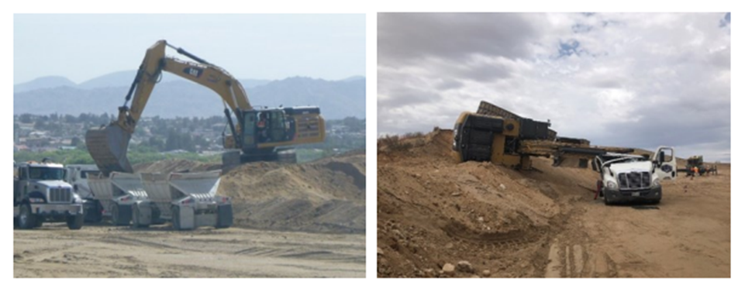
The excavator was operating at height on earthworks. The excavator operator placed a bucket of material into the front trailer of the truck when he felt the excavator move. The excavator was positioned too close to the edge, it slipped and the excavator bucket came into contact with the far side of the trailer. It is believed the operator raised the boom and curled the bucket back, subsequently grabbing the inside edge of the trailer with the teeth of the bucket,. This lifted the truck, weighing 15 US ton and moved it approximately one meter towards the excavator. The excavator overturned and the boom crushed the area of the cab directly over the driver.

Slide 4
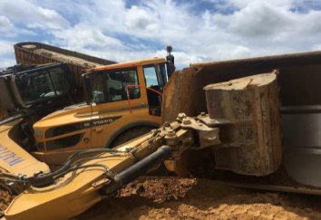
Could this happen here?
A14 – 16th June 2018 working at Borrow Pit 1
Excavator with loaded bucket rotated to load truck when the operator felt the rear of the excavator start to rise – the machine then slid approximately 2ms down the edge and overturned, the boom struck the ADT causing the skip to overturn. The boom caused damage to the front of the ADT and smashed the window – the ADT operator suffered minor leg lacerations.

Slide 5
RtB 15 – Task Lighting
Current document is not required – it just reinforces current HSE guidance on lighting levels.
Proposal to write some new guidance relating specifically to lighting and the public highways interface which is not covered by the guidance e.g. light spillage which can cause distraction to drivers
This guidance will also cover LED head torches and human factors relating to moving from a well lit area into a dark area.

Slide 6
RtB 16 Working at Height and RtB
RtB 16 Working at Height – to be put into the new template
RtB 22 Fatigue – following previous discussions a draft RtB will be presented at the next meeting
RtB 25 Loading Vehicles RtB 35 Loading Plant RtB 36 Lost Loads – being combined into one and to be presented at the next meeting
RtB 39 Traffic Safety & Control at Roadworks - there is some resistance around raising the training requirements for TSCOs; a gap analysis is being undertaken currently between the version presented by Keith Smith and the one sent back in by the TMCA
RtB XX – Working on Hard Shoulders & Verges – out for consultation, comments to Keith Smith

Slide 7
Campaigns
Autumn / Winter working – clocks change 30th October
WINTER 2021 (highwayssafetyhub.com)
Road Safety Week – 14th to 20th November
Road Safety Week | Brake

