Slide 1
de5ign Framework for HSE in Design
Ray Coleman
Senior Associate Director – HSE in Design

Slide 2
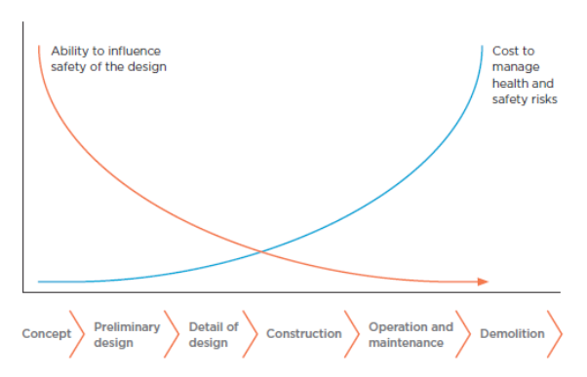
Global Infrastructure Challenge
The greatest opportunity to reduce or eliminate risk to the health and safety of the work and the end user lies with the designer.
Research of the Impact of Safe Design:
60% of fatal accidents on building sites arise from decisions made before construction commences (European Foundation, 1991).
Half of all construction accidents could have been eliminated or reduced with more thought during the design process (Alistair Gibb, 2004).
On review of the National Institute of Occupational Safety and Health (NIOSH) Fatality Assessment Control and Evaluation (FACE) programme in the United States, 42% of 224 construction industry fatalities were linked to design issues (Behm, 2005).
Poor design was the cause of 42% of work-related fatalities in Australia from 1997 through 2002 (Mroszczyk, 2014).
Source: Szymberski, TAPPI Journal 1997

Slide 3
Safety in Design Definitions
Name | Definition
US Dept of Labor: OSHA | “Organizations that eliminate or reduce hazards by making design or engineering changes generally improve their workplace safety and health and save money in the long run”
NIOSH Prevention through Design (PtD) | “The mission of the Prevention through Design National initiative is to prevent or reduce occupational injuries, illnesses, and fatalities through the inclusion of prevention considerations in all designs that impact workers”
Safe Work Australia | “Safe design means the integration of control measures early in the design process to eliminate or, if this is not reasonable practicable, minimise risks to health and safety throughout the lifecycle of the product being designed. ”
Design for Safety Singapore | “Design for Safety is the process of identifying and reducing safety and health risks through good design at the conceptual and planning phases of a project.”

Slide 4
Safety in Design Definition – National Highways

Slide 5
de5ign Definition
BeyondZero is our behavioural safety culture which promotes a culture of caring for personal safety and wellbeing with the emphasis that we all can and should take personal accountability for each other’s safety; i.e. we can all make a positive difference.
de5ign is our global framework which provides a consistent approach and common language to the management of Health, Safety and Environment (HSE) in design, by applying five behaviours which create HSE in design excellence.

Slide 6
Five Behaviors of de5ign

Slide 7
Why de5ign?
Common approach and language to HSE in Design, across our global operations, for countries with and without HSE in Design Management Legislation and/or codes of practice.
Silent on legislation references which can be applied on any project, of any scale in any country.
Takes us beyond basic compliance with legislation and standards consideration the following over the whole lifecycle of the asset
Safety in design,
Occupational disease in design,
Mental health and wellbeing in design,
Benefits the environment, climate change and sustainable design and procurement.
Solutions which challenge standard practice but reduces impact on the asset’s whole lifecycle to benefit people and the environment.

Slide 8
Safety in Design
Thought | Purpose
Hazard elimination or reduction | Basic application of the principles of prevention. Greatest opportunity to eliminate or reduce risk to the health and safety of the construction worker and the end user and the environment lies with the designer.
Confined spaces | Design out confined spaces or removal of vital equipment/controls from the confined space.
Construction sequencing | Communicating defined construction methodology which forms the basis of the design, space to facilitate the temporary works, how materials will be imported or exported, specialised installation equipment, defined safe construction timeframe.
Modern methods of construction | Off site construction, reduction of on-site fabrication, non-structural assemblies on-site, modular panelling, digital delivery, improved quality.
Operation & Maintenance | Communicating design assumptions to the end user which may impact O&M, safe access/egress, fall protection, accommodation of shift working, adverse weather, lighting, physical security, design safety for working over/near liquids.
Emergencies | Elimination of fire risk activities/materials, design for incapacitated workers, emergency clearway, muster points, explosive atmospheres
Demolition | Data sharing of historical site use, determine inherent hazardous materials and/or contaminated ground, stored energy sources, unusual stability concepts, identify materials for repurposing, reuse and recycling at end of serviceable life

Slide 9
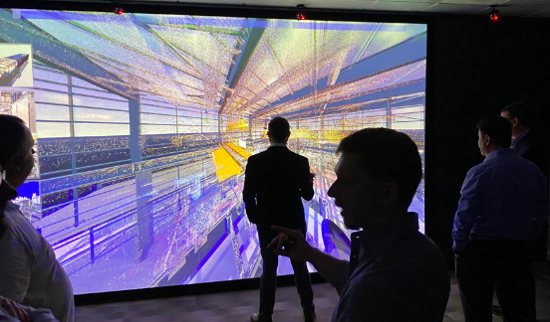
de5ign
Project Name – Flask Maintenance Facility, Sellafield nuclear site, U.K
Business Unit – ES&T, CMS
Risk removed – Immersive visuals using gaming software to benefit design, construction sequencing and programme
Original Design Requirements
Upgrade capability and reduce risk by repurposing the existing plant.
To be used for decontamination and effluent management, flask handling, flask machining, paint removal and application, redundant equipment strip-out and service provision.
Opportunities for improvement:
Jacobs’ Visual Media team, used the Unreal Engine (an advanced real-time 3D creation tool used in the gaming industry), to create immersive visuals and experiences to assist with the design of the project and improve project delivery.
de5ign outcome
Laser scan of the facility for use throughout design, construction, commissioning and operation.
The scans were overlaid onto a model to validate positioning and show the relationship between existing and new plant.
Enabled designers to move easily and quickly between 3D and virtual reality and also formed the basis of a digital twin.
Visualisations used for planning of preparatory works and initial construction sequencing against the project timeline.
Relatively small investment, produced large benefits :
Communicating designs which, in-turn, facilitated rapid feedback and rapid turnaround.
The flexibility of the platform also proved beneficial for the resultant design output, including the ease of transformation into Virtual Reality (VR).

Slide 10
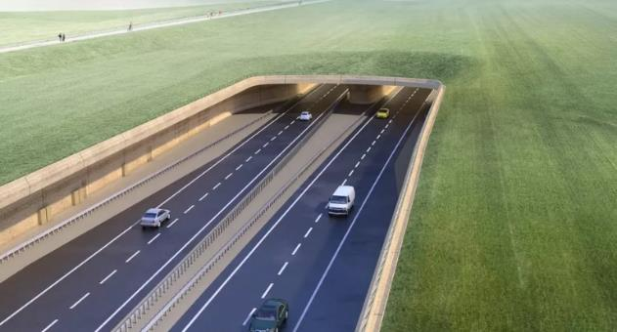
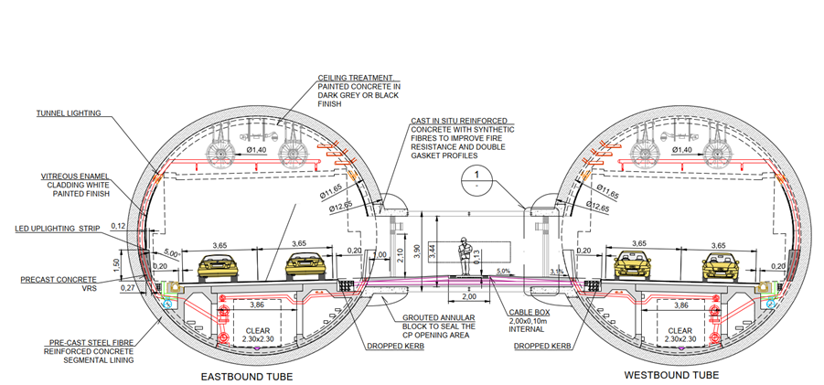
de5ign
Project Name – A303 tender design, U.K.
Business Unit – Highways, P&PS
Risk removed – Enabling safe access for maintenance without closing the tunnel
Original Design Requirements
Design and Build contract 3km long twin bore road tunnel to be constructed close to Stonehenge to relieve the congestion on the A303.
Opportunities for improvement:
Client driver: maximization of lane availability for maintenance of essential equipment for the safe operation of the tunnel to meet minimum operational requirements.
Most equipment monitored remotely – manage planned or unplanned maintenance.
Traditionally equipment is located at cross passages at 150m centres between tunnel bores.
de5ign outcome
In consideration of future access for operations, provided an underdeck services gallery beneath the carriageway, accessed from the basement of the Tunnel Service Buildings at either end of the tunnel.
To will contain a majority of the “wet” and “dry” services enabling access for maintenance to be undertaken at any time without needing to close a tunnel bore and importantly without any interface with the traffic using the tunnel.
Ample access and egress points for maintenance, including fire and rescue teams to ensure safety protocols are in place for the confined space elements.

Slide 11
Occupational Disease in Design
Thought | Purpose
Diseases caused by agents arising from chemical, physical, biological or infectious or parasitic diseases | Avoid processes that create hazardous fumes/vapours/irritant dust, reduce exposure to VOCs, determine in-situ hazardous materials (ground, air and water). Isolate the process to limit exposure, adequate hazard control equipment for the hazard during construction, O&M and demolition.
Diseases of target organ systems respiratory, skin, musculoskeletal and disorders | Design: mechanical aids/interventions to prevent musculoskeletal disorder. Specify: Materials that are easier to handle, less hazardous, resolving poorly ventilated areas and/or confined spaces, avoid wet work involving substances or products that may be a skin irritant, installation of monitoring systems.
Occupational cancers direct exposure to a carcinogen or exposure to a carcinogen produced as part of a work process | Ground/gas/water samples to determine the presence of carcinogens, likely level of exposure and possible emissions or spread of carcinogenic substances. Expose workers to Radiation Hazards (Ionizing / Non-ionizing) Replacement of carcinogenic agents with non-carcinogenic agents.
Notes:
For health, we consider both occupational disease and mental health of the construction worker and end user.
Above themes from the ILO.

Slide 12
Mental Health and Wellbeing in Design
Thought | Purpose
Biophilic design | Design improvements to create strong connections between nature and manmade environments which can have benefits for physical health and psychological wellbeing.
Crime | Improve the perception of safety and prevent crime by deterring the opportunist criminal who is influenced by both the physical opportunity and the probability of being caught.
Provision of support spaces | Focusing on mental and physical health, cultural and religious practices, and lactation needs. A supportive environment makes people feel that they are respected and that their thoughts ,beliefs and opinions matter.
Wellbeing design | Design considerations for thermal comfort, natural and artificial lighting, indoor air quality, acoustic considerations, nourishment, movement and exercise.
Design for dementia | Bioethics of space design for persons suffering with symptoms of memory, thinking and social ability loss.
Human factors | Design for individuals considering age, gender, fitness and fatigue so that all people, regardless of age, ability, or disability, can easily access, understand and freely use all buildings and spaces to the greatest extent possible.
Psychosocial factors | Considering stress and time to do the task/work of the asset. Supportive environments are more likely to encourage trust and camaraderie, and will encourage people to look out for each other, while reducing mental stress and anxiety.

Slide 13
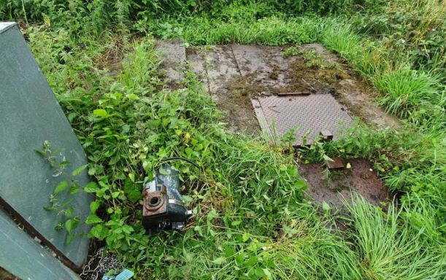
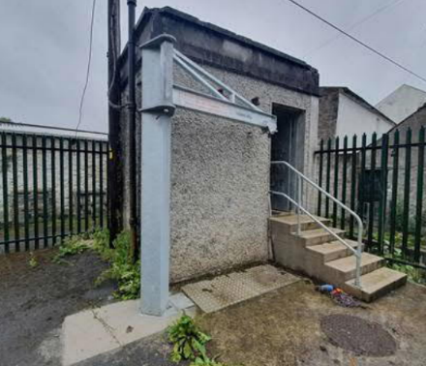
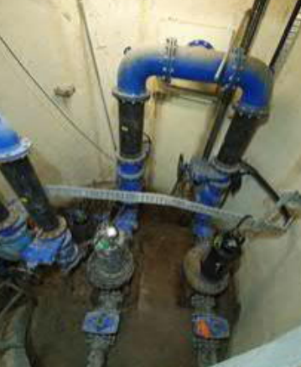
de5ign
Project Name -Wastewater Pumping Stations & Rising Mains Capital Maintenance Project, Ireland
Business Unit – Water & Environment, P&PS
Risk removed – Structural failure, confined space & ventilation risk
Original Design Requirements
Assessment of over 2,500 existing wastewater pumping stations (WwPS).
Produce design reports to address operational and capital maintenance issues.
Opportunities for improvement:
Structural stability of plant at Talbotsinch WwPS, deterioration and fragile surfaces, access and likelihood of further deterioration.
Cloheen Lane WwPS confined space for maintenance due to increase in pump sizes. Manual handling difficulties in removing pumps, access risks to pipework and valves in the building housed beneath floor slabs with a small access hatch.
No ventilation system in place at The Bridge WwPS. Existing plant was a circular dry well within a circular cavity wet well sump surrounding it. The floor level was 5m below the level of the entry to the pump house, presenting risk to operatives accessing for maintenance.
de5ign outcome
Talbotsinch WwPS: Demolition and full rebuild.
Cloheen Lane WwPS: Demolition of existing control building, a new control kiosk for control systems, providing safe access for operatives, removing confined space entry risks and reduction of manual handling risks.
The Bridge WwPS: Forced mechanical ventilation to the dry well which will operate with a low and high rate of ventilation.
Notes:
Very poor workplaces
Solutions may be deemed easy/obvious. Someone has to consciously make the design decision to make changes. Behaviour.

Slide 14
Environment, Climate and Sustainability in Design
Thought | Purpose
Policy and Engagement | Driving the adoption of sustainability policies, establishing sustainability objectives/goals for each project, selection of consultants or suppliers that can demonstrate a proven track record in sustainable design.
Procurement | Green procurement policies/principles, assessment criteria for whole lifecycle material/equipment costs, contractual requirements to drive sustainability improvements, selection of sustainable materials/equipment, defining pollution control practices to benefit construction and demolition, promote the use of recycled materials during construction.
Resource Management (Energy, Materials, Water) | Adopt UN SDG’s for each design, consider need for a new asset vs do nothing/refurbishment or changes in working practices, target net zero energy, specify energy uses with low operational carbon, specify materials or equipment with low embodied carbon, divert waste from landfill, position of asset to maximise solar gain and/or prevailing wind, collecting and treating greywater, measurement of ’in-use’ scenario post construction.
Biodiversity | Local biodiversity improvement, minimising construction activity impact on existing habitats, identify and minimising spread of invasive species.
Operation & Maintenance | Sourcing of renewable energy for long term O&M, water conservation management waste management and pollution control practices.
Demolition | Design to facilitate the dismantling, re-use, re-sale, recycling, disposal of hazardous materials and pollution and the end of the asset’s lifecycle

Slide 15
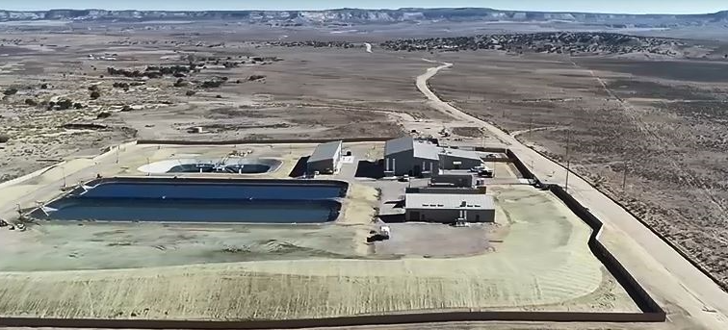
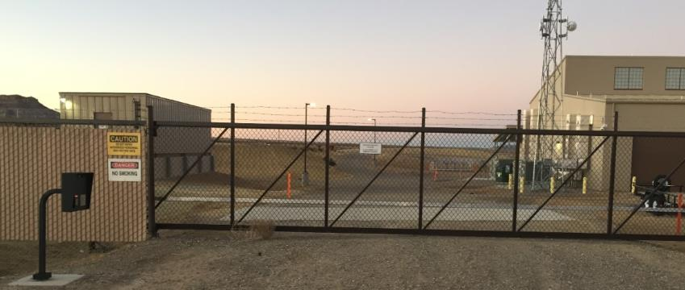
de5ign
Project Name – Water Treatment Plant (Confidential Project), New Mexico, USA
Business Unit – Design Build, P&PS
Value Impact – Sustainability in Design Build
Original Design Requirements
Client’s scope included a number of Sustainable Design Performance requirements in order to achieve its corporate sustainability goals.
Opportunities for improvement
Devised a regular monitoring regime to track compliance with the Sustainable Design Performance requirements of the contract.
Reported through a monthly Sustainability Report issued throughout construction phase.
de5ign Outcome
Achieved a 50% reduction of construction waste diversion from landfill during construction, installation of materials and products.
Recycled content goal of 10% was achieved.
Water usage reduction by 11% during operational period.
Selection of energy efficient equipment.
Selection of low VOC emitting paints/adhesives/sealants and
Combated heat island effect on the building’s roofs through material selection.

Slide 16
Practical Application of de5ign
HSE in Design Training
Awareness training.
Global baseline for our designers.

Slide 17
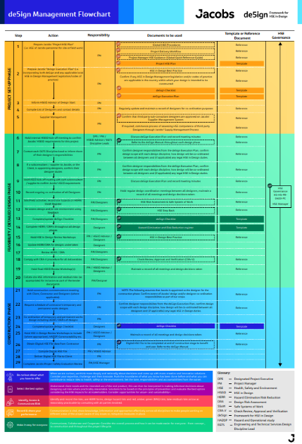
Practical Application of de5ign
2. de5ign Management Flowchart
Quick reference/desktop guidance.
HSEiD inputs during project planning, design and construction phases
Links to procedures, templates and guidance.

Slide 18
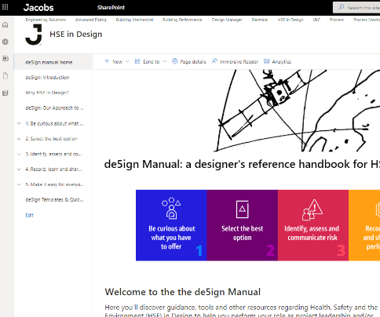
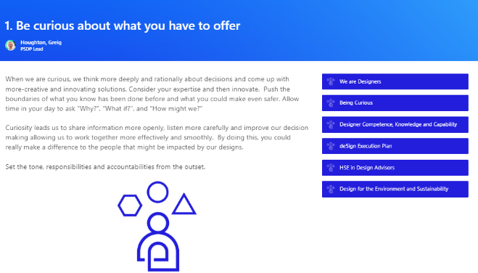
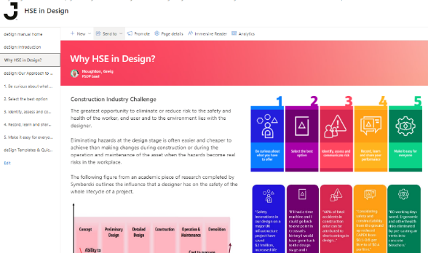
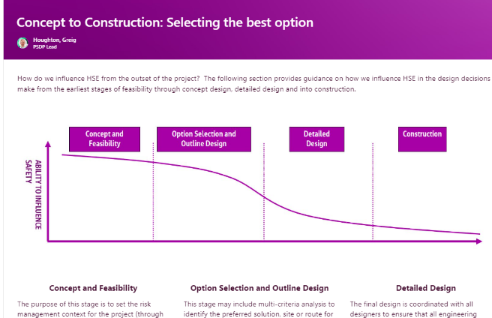
Practical Application of de5ign
3. de5ign Manual
Main depository for de5ign information and guidance.
SharePoint based.
Detailed information for each de5ign behaviour.
Templates, digital tools, quick reference guides, experts.

Slide 19
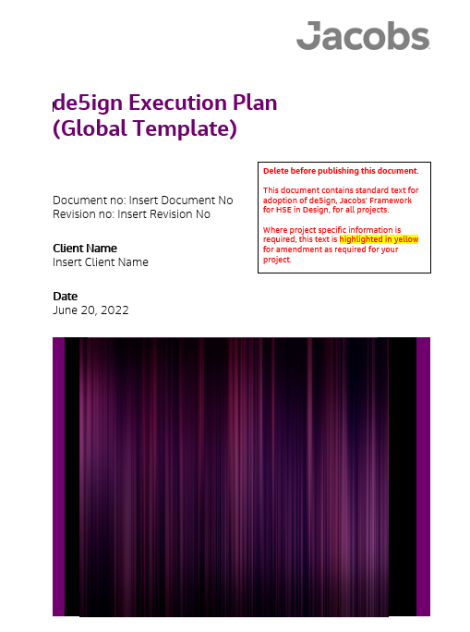
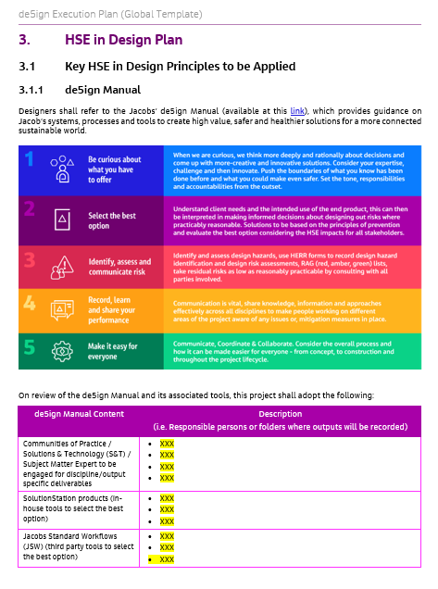
Practical Application of de5ign
4. de5ign Execution Plan
Project specific plan for the management of the design process.
Legislative requirements.
Key design interfaces.
HSEiD deliverables.
Designer coordination.
DRA’s, workshops and audits.
Engaging experts.

Slide 20
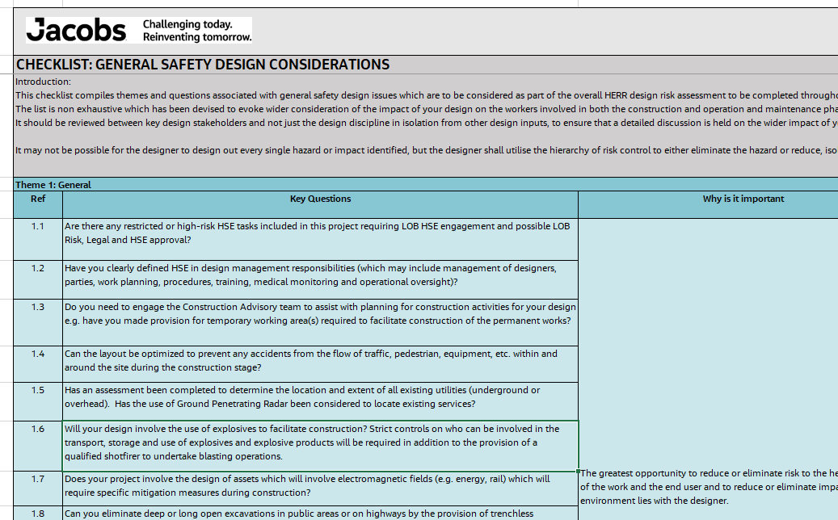
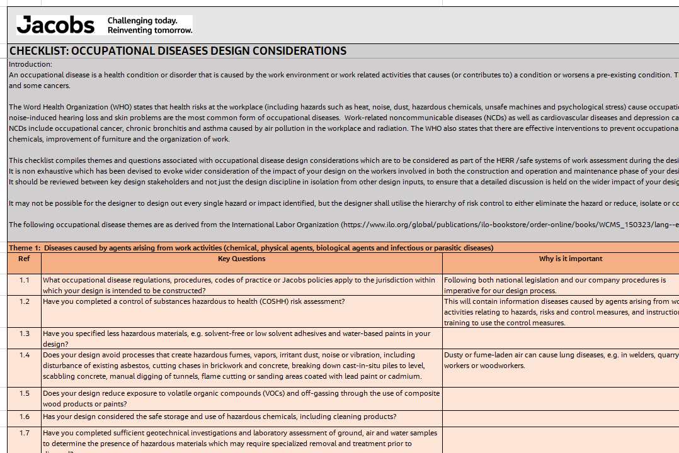
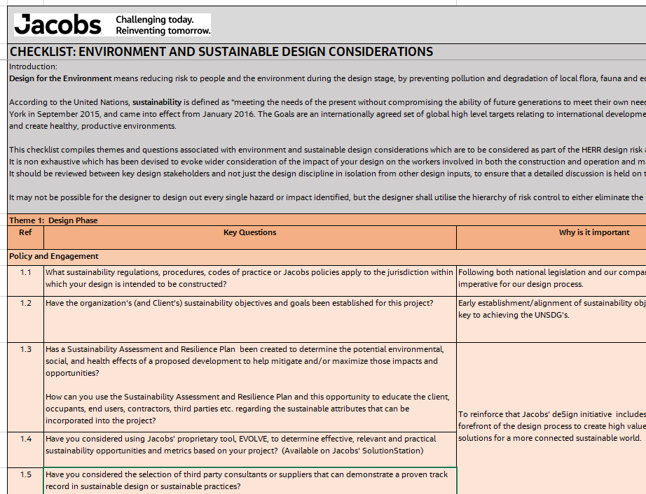
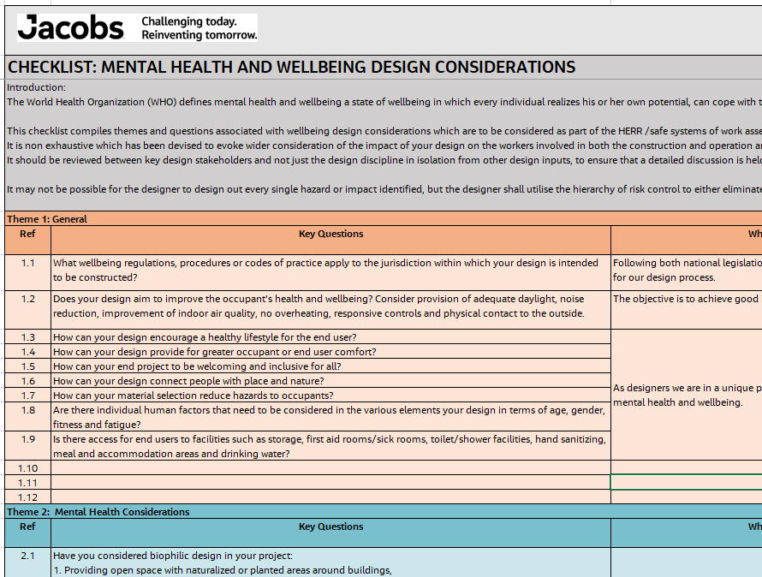
Practical Application of de5ign
5. de5ign Checklist
Excel based c250 questions.
Whole asset lifecycle impact of designs.
Source data from WHO, ILO, UN, emerging best practice.
Safety, occupational disease, mental health and wellbeing, environment, climate and sustainable design and procurement.

Slide 21
Innovation in HSE in Design
de5ign is a behavioural approach to HSE in design – moving beyond compliance with base technical and legal compliance.
Focuses on
People: Not only safety in design but also occupational diseases, mental health and wellbeing of the construction worker and end user and
Environment: Environmental and climate change and sustainable design and procurement.
Combines emerging best practice from legislation and codes of practice with academic research and guidance from the UN, WHO and ILO.
Utilising the digitisation of HSE data, considering the whole asset lifecycle, to drive an upward curve of positive designer behaviour, for every subsequent project.

Slide 22
Awards
Shortlisted for the Health and Safety Initiative of the Year of the 2022 UK Water Industry Awards.
Shortlisted for the Health, Safety & Wellbeing Initiative of the Year for the 2022 British Construction Industry Awards.

Slide 23
Questions and next steps?

