Slide 1
Whole Life Design Task Group
Membership
Andrew Finch, Chair (Jacobs)
Richard Wilson (Highways England)
Ian Scott (Highways England)
Martin Partington (Jacobs)
Doug Potter (Arcadis)
Tim Goddard (Arcadis)
Paul Brown (WSP)
Simon Bourne (Mott MacDonald)

Slide 2
July * Draft template * First draft samples
October / November * Final versions to PD WG * Finalise web / app
August / September * Web / app development * Add examples
December * Launch
Programme

Slide 3
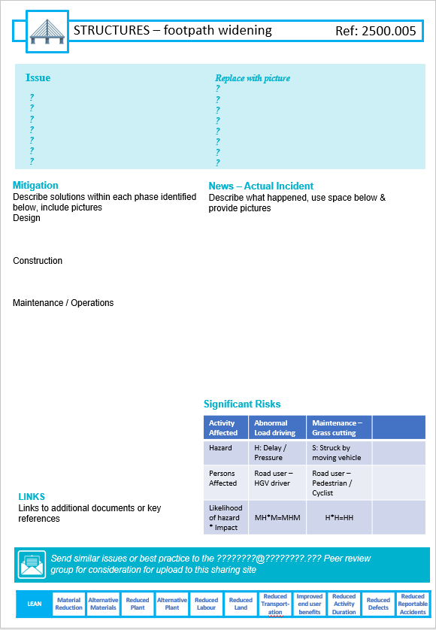
Template

Slide 4
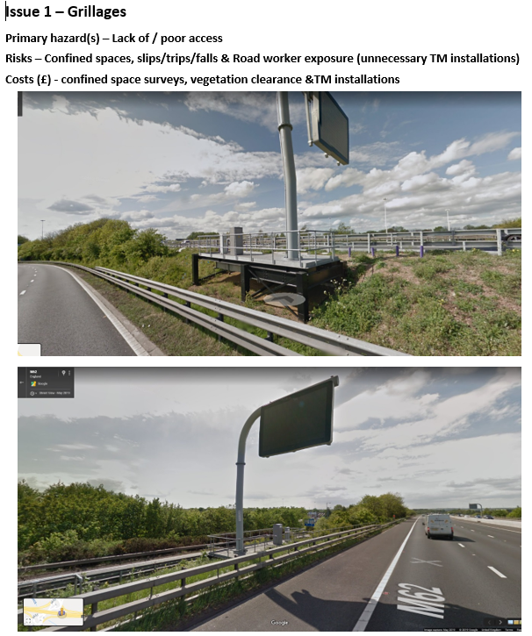
O&M Safety Shares

Slide 5
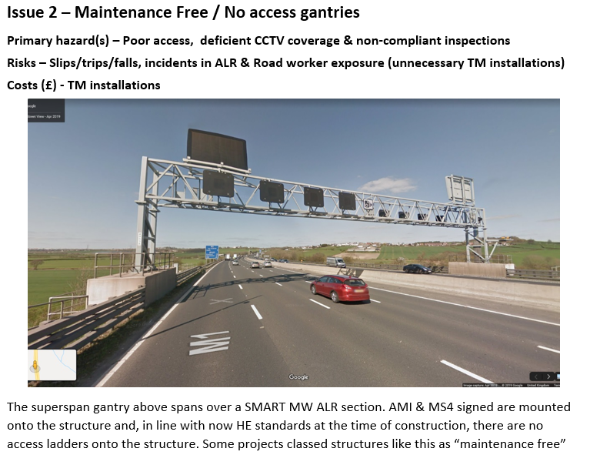
O&M Safety Shares

Slide 6
O&M Safety Shares

Slide 7
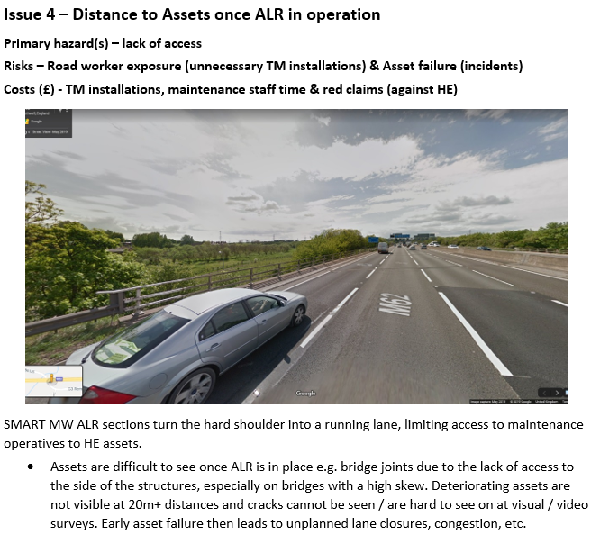
O&M Safety Shares

Slide 8
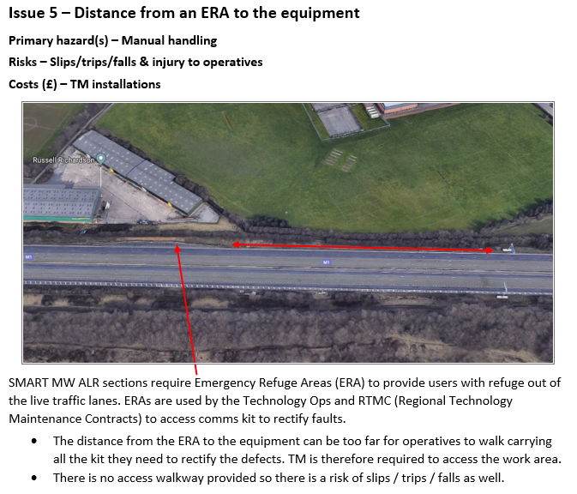
O&M Safety Shares

Slide 9
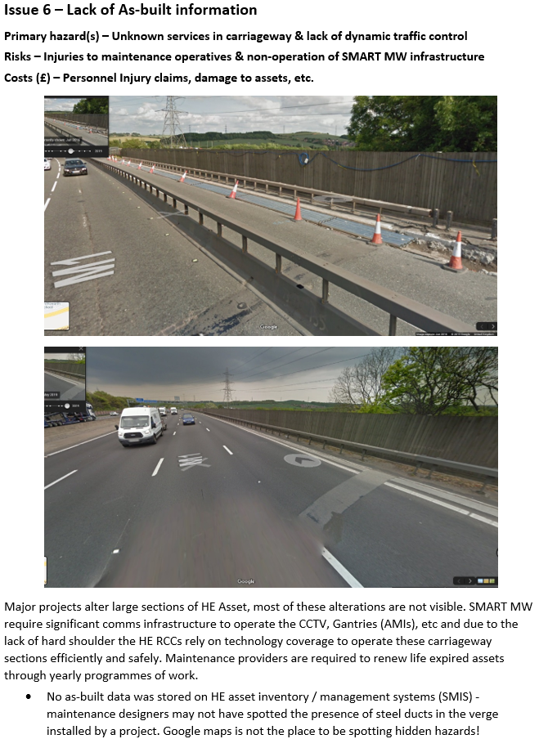
O&M Safety Shares

Slide 10
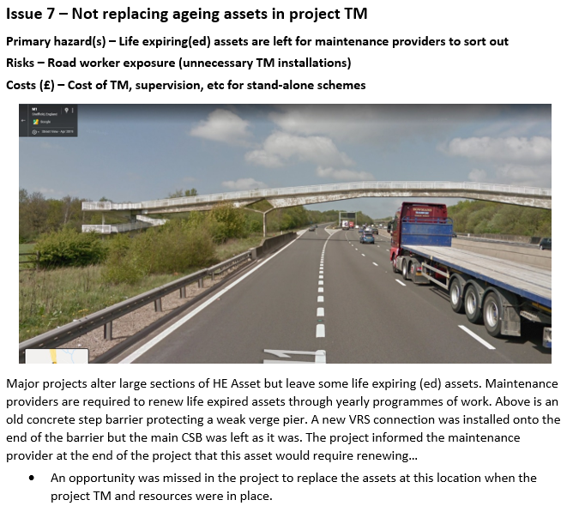
O&M Safety Shares

Slide 11
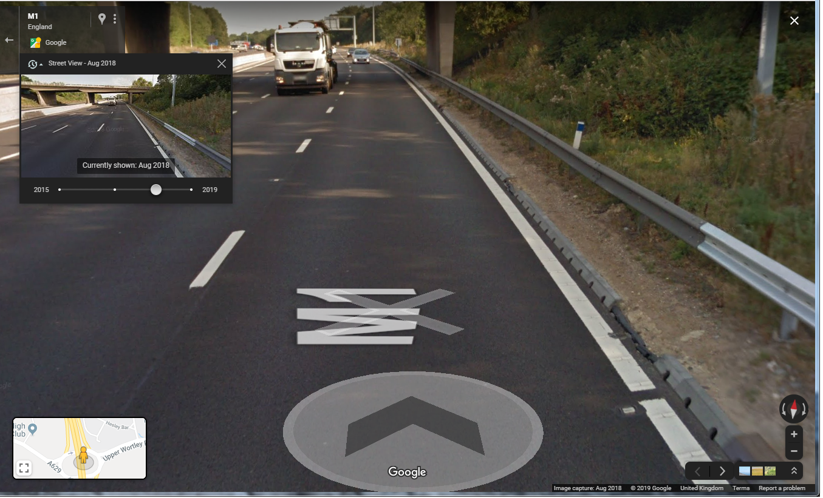
O&M Safety Shares

Slide 12
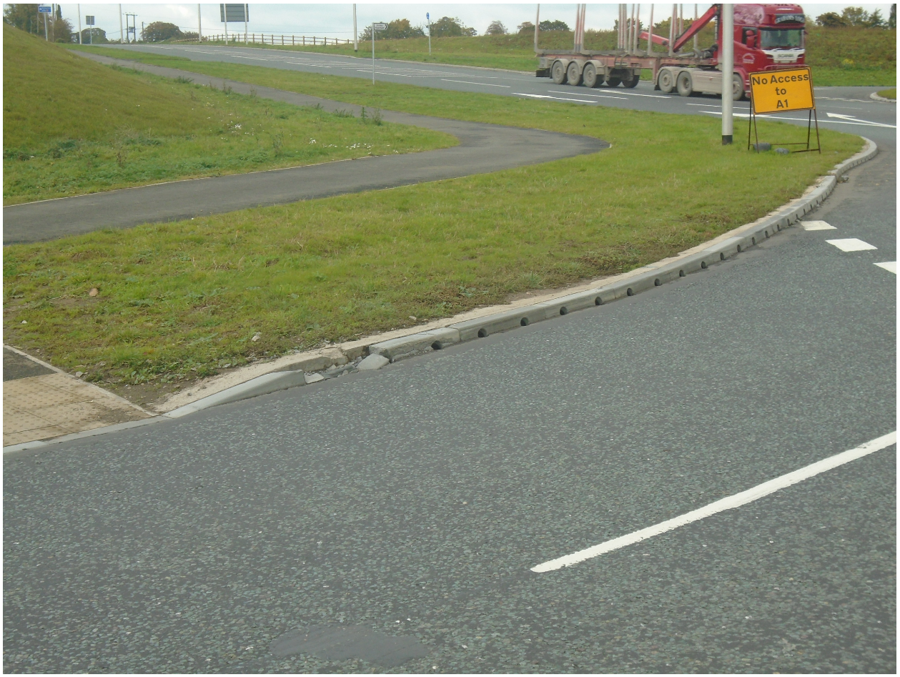
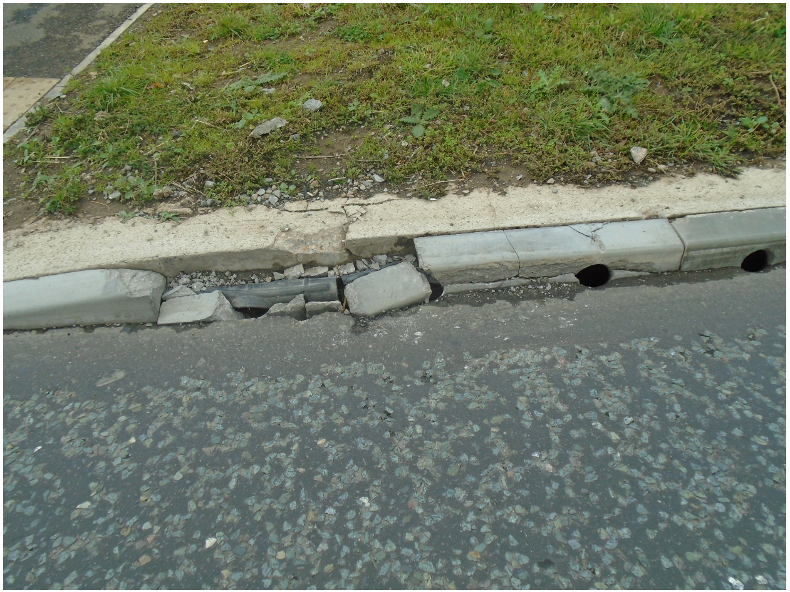
O&M Safety Shares

Slide 13
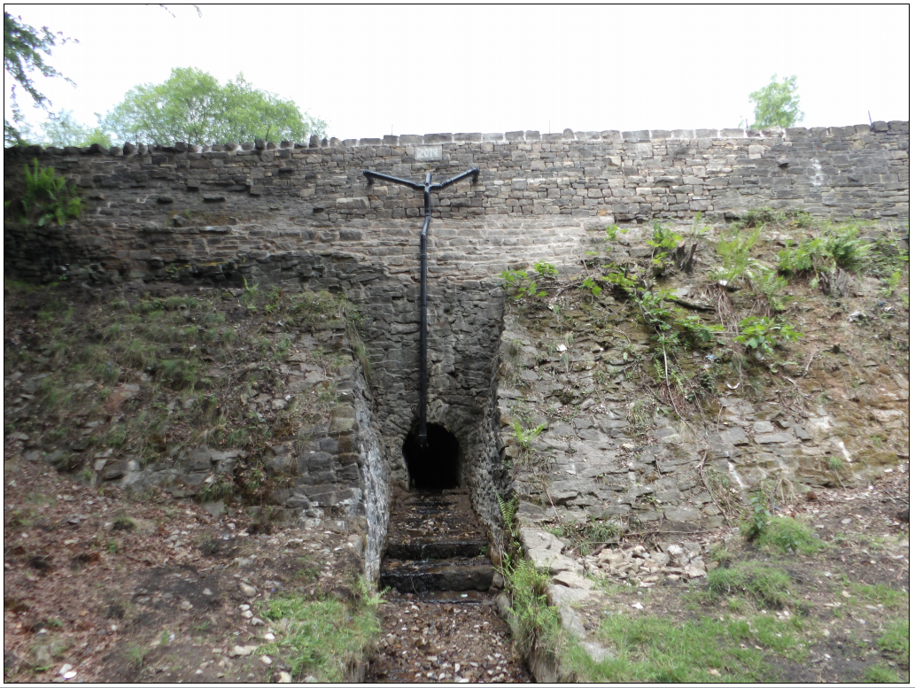
O&M Safety Shares

Slide 14
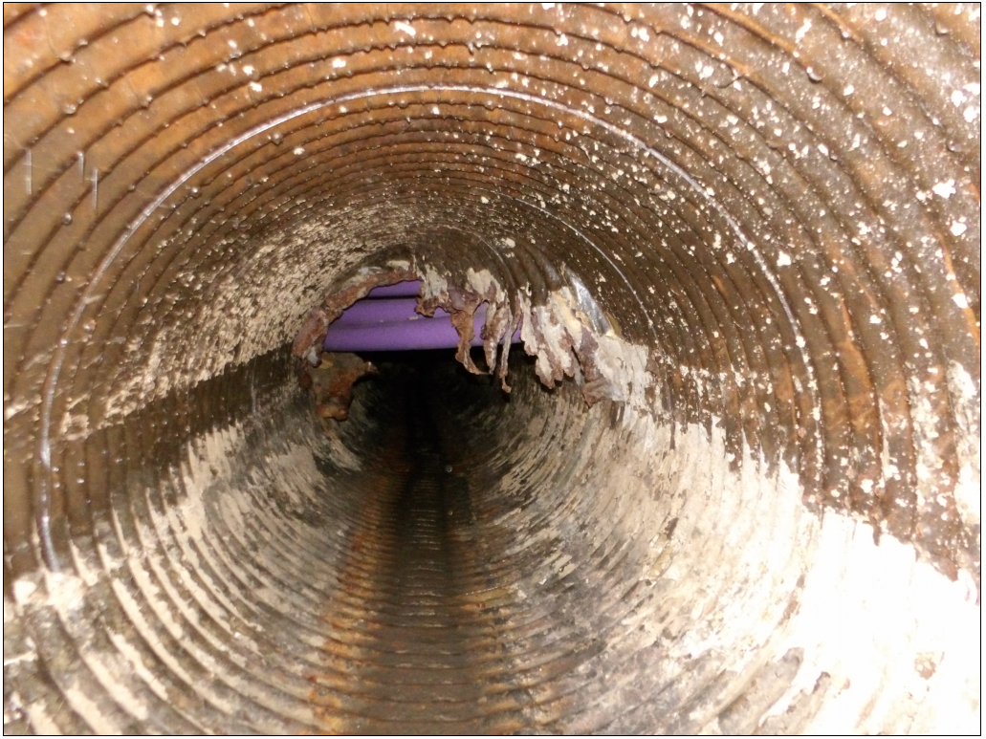
O&M Safety Shares

Slide 15
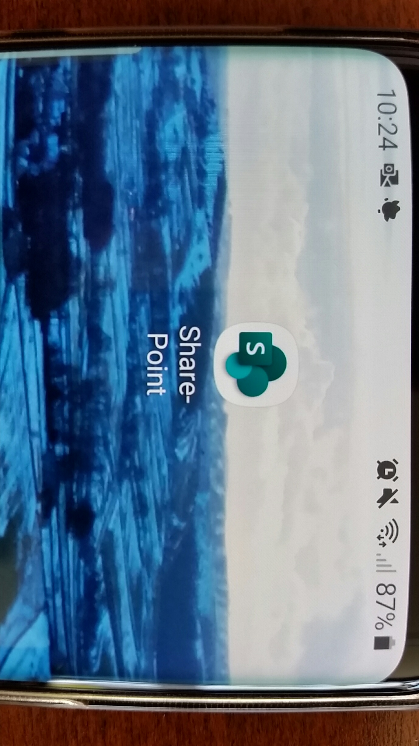
Mobile app

