Slide 1
Supply Chain Maturity Matrix
(SCMM)
Teresa Moss/ Richard Wilson

Slide 2
Supply Chain Maturity Matrix (SCMM)
Previous version 228 questions using an excel spreadsheet
Revised to 30 Questions
Aligned to Home Safe and Well focus areas / Hudson Parker Model
4 Beta tests carried out with supply chain members – feedback incorporated into new version
  Arcadis
  Carnells
  Amey
  Skanska
  Costain
  WJ North
  Jacobs
  Balfour Beatty
New version via Microsoft forms
Automatic Power BI Reporting (based on submission responses)
  Provides overall rating based on submission
  Areas for action plan
Action Plan template for submission alongside evidence

Slide 3
Contractual Obligation – forms part of Annexe 15 HSW Scope
1st Assessment 6 weeks after contract start
Annual Assessment
Assurance against action plan

Slide 4
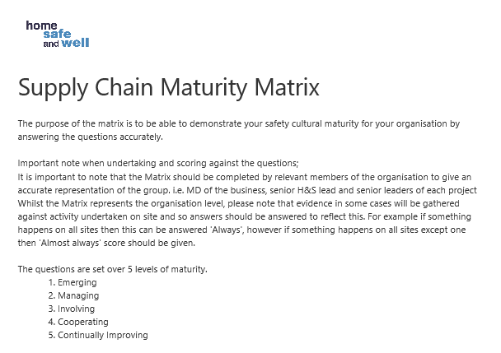

Slide 5
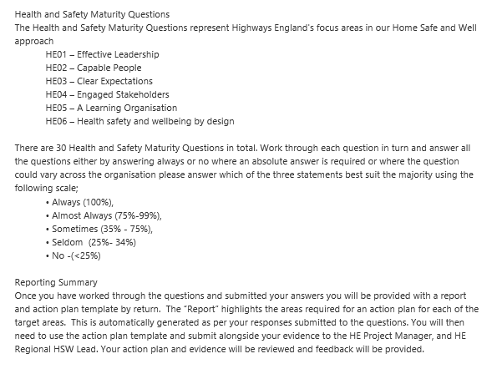

Slide 6
Theme | Question
Effective Leadership | Leaders across the organisation take account of informal conversations about health, safety and wellbeing, as well as what is reported in the system?
Effective Leadership | Leaders actively visit the workplace (digitally or in person) to ensure appropriate welfare facilities, and leaders are visible and engage with the workforce
Effective Leadership | Leaders recognise when organisational failings are a potential contributing factor to the root cause of incidents and this is reflected where appropriate in investigations recommendations.
Effective Leadership | Benchmarking against others in the same industries takes place and is driven by leaders who want to be the best within the sector.
Effective Leadership | Senior leaders have health, safety and wellbeing experience and capability.
Capable People | Resource is available for communicating key learning opportunities from health, safety and wellbeing, in various formats.
Capable People | The workforce are able to identify their own additional training needs and competency is determined by testing knowledge and skills on the task.
Capable People | Supply chain partners are only selected if they are working, in accordance with PAS91 health safety and wellbeing management systems.
Capable People | The organisation carries out incident investigation, which identifies root causes, makes and implements appropriate recommendations and shares significant learning.
Capable People | Health Safety and Wellbeing is intrinsic throughout the organisation and advice is sought and trusted.
Clear Expectations | Work planning methods (e.g. safe systems of work) are developed with the workforce (direct and indirect employees) using their skills and knowledge of the task.
Clear Expectations | Everybody understands and feels empowered to challenge and stop tasks where necessary.
Clear Expectations | There is a clear system in place for reporting incidents and near misses as well as positive interventions, with feedback provided for actions taken, allowing trends to be identified, mitigated and shared.
Clear Expectations | There is a fair and just culture for dealing with health, safety and wellbeing issues and incidents.
Engaged Stakeholders | Direct employees are confident discussing health and safety concerns.
Engaged Stakeholders | Supply chain employees are confident discussing health and safety concerns.
Engaged Stakeholders | The organisation is confident that significant risks are managed in line with the principles of prevention.
Engaged Stakeholders | Procedures are kept up-to-date and communicated to users if changes are made.
Engaged Stakeholders | Relevant stakeholders are engaged in order to help them make sense of specific incidents and improve working practices.
Engaged Stakeholders | Health, safety and wellbeing assurance activities are seen as positive, and focus not only on compliance, but also people's understanding and opportunities for improvement, to share best practice.
Engaged Stakeholders | All stakeholders (indirect employees) are respected in the same way as company employees.
A Learning Organisation | Positive recognition is given for good health, safety and wellbeing behaviour.
A Learning Organisation | Identified unsafe, unhealthy or unwell situations and interventions lead to constructive discussions on how to do things better.
A Learning Organisation | The organisation seeks and identifies best practice to share with others to eliminate/mitigate significant hazards before they occur becoming business as usual.
A Learning Organisation | The organisation attempts to learn from best practice and incidents from other organisations and industries, where relevant.
A Learning Organisation | The organisation looks beyond individual behaviours, and considers the whole health, safety and wellbeing system, including procedures, processes and workplace conditions that contributed to the incident.
Health, Safety and Wellbeing by Design | The resources and time committed to achieving health safety and wellbeing are ring-fenced and protected from other demands.
Health, Safety and Wellbeing by Design | Health, safety and wellbeing has been integrated into work planning, to ensure risks are eliminated. Where risks can not be eliminated the hierarchy of control is applied to construction, maintenance and operation activities.
Health, Safety and Wellbeing by Design | There is a risk-based maintenance plan, to ensure critical equipment is maintained and trending is used to improve maintenance and planning.
Health, Safety and Wellbeing by Design | Resource planning and delivery are designed to ensure appropriate levels of management and supervision are met for adequate health, safety and wellbeing provision.

Slide 7
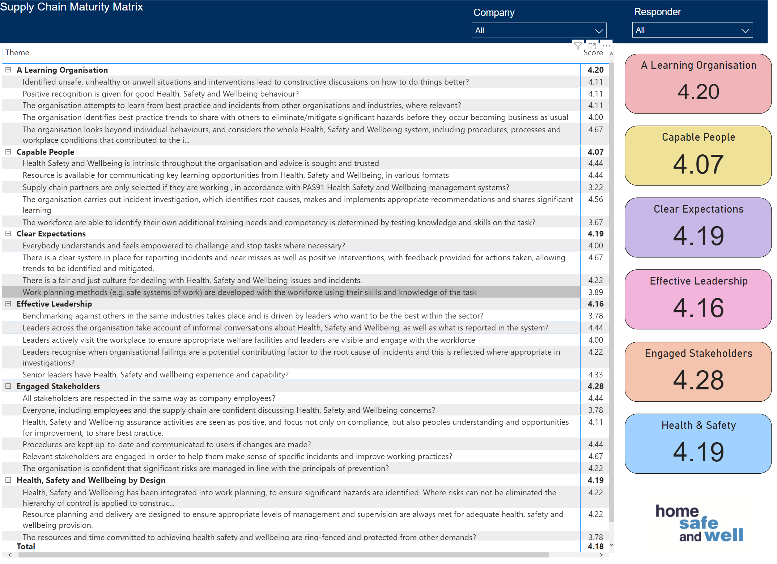

Slide 8
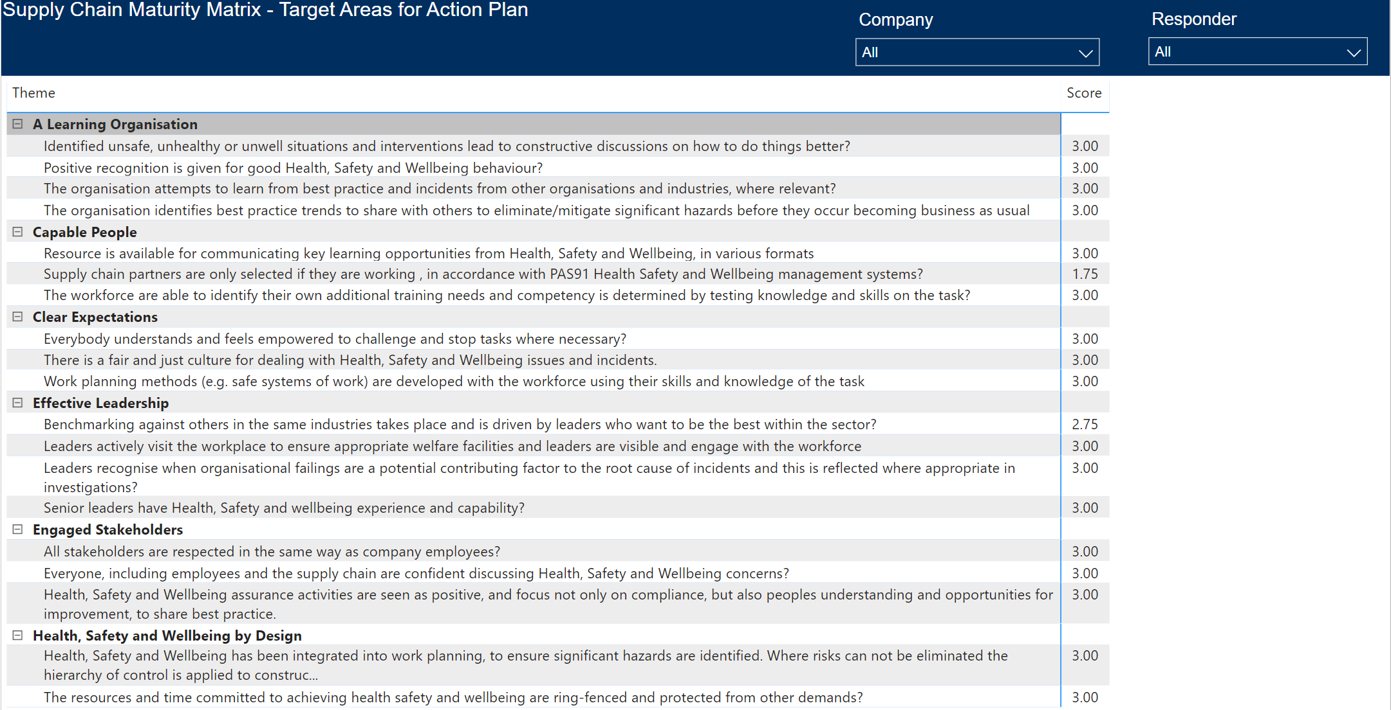

Slide 10
